Slide 1
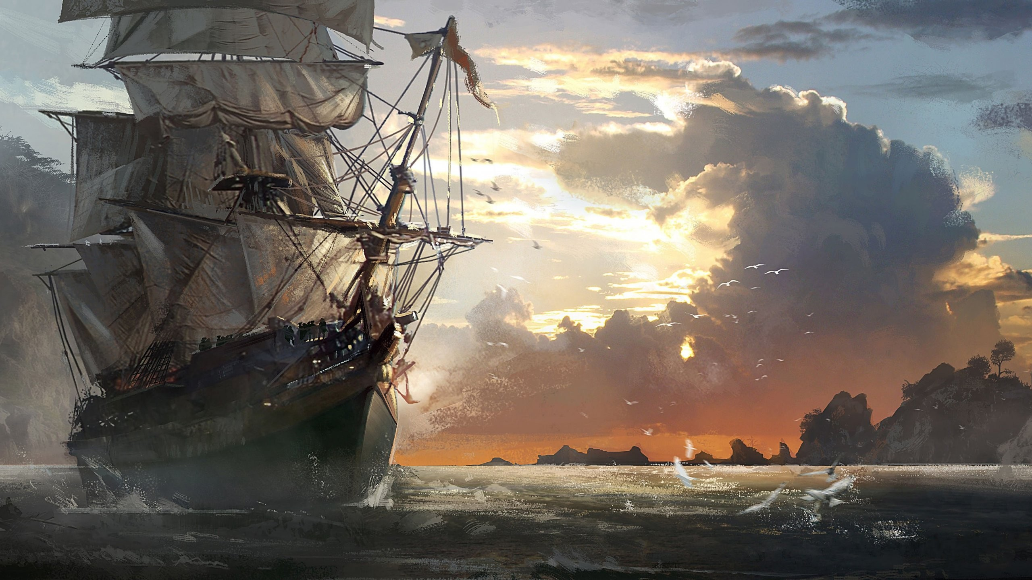
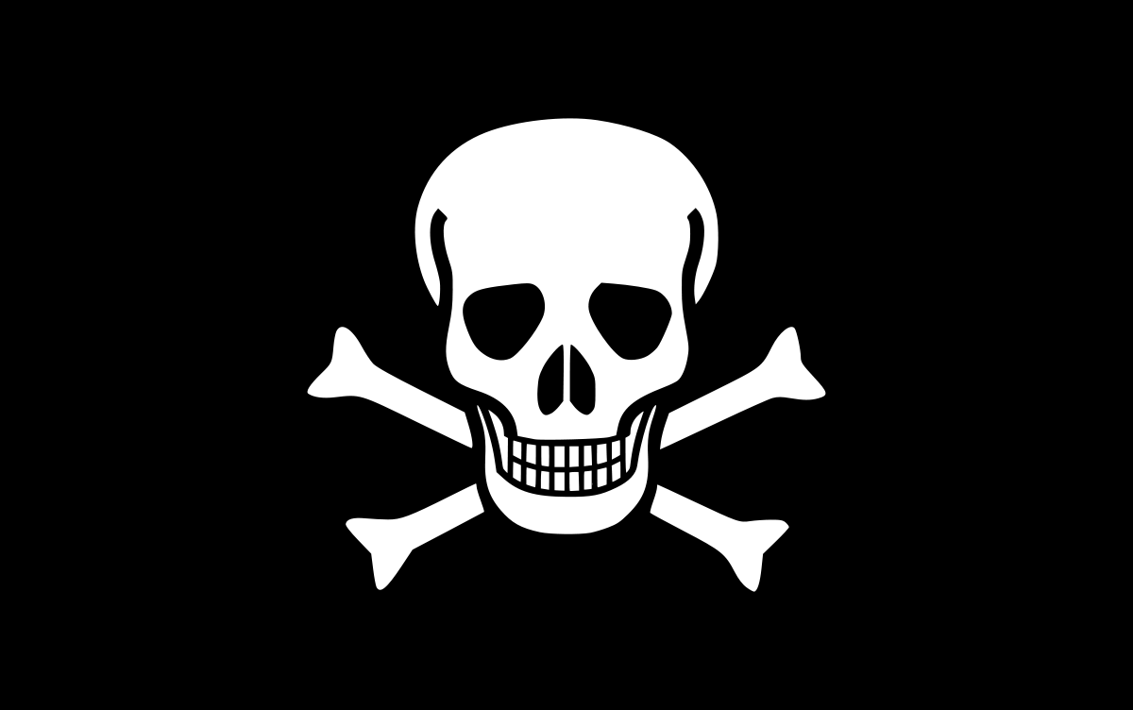
Pirates
Ahoy! Today we will be learning about Pirates!
Does anyone know anything about Pirates?

Slide 2
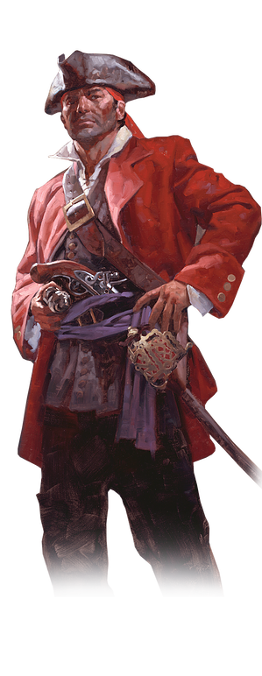
Who were Pirates?
A pirate is a robber who roams the seas and steals from others.
They have been around since ancient times.
Most famous pirates in the Middle Ages were the Vikings.
Most targeted other ships, but sometimes coastal towns.
Men became pirates for lots of reasons:
    Pirate’s life was full of adventure.
    Plenty of precious treasure.
    Easy life.
Pirates sometimes known as corsairs or buccaneers.

Slide 3
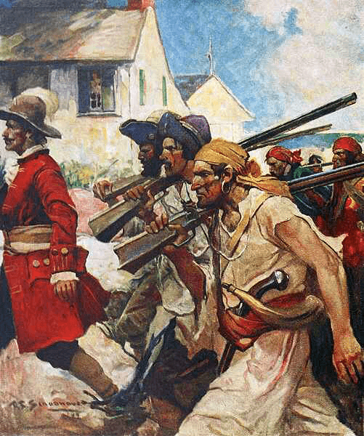
The Golden Age:
1650-1725 – The Golden Age of Piracy.
The time when pirates ruled the seas.
1000’s of pirates were around.
The increase in pirates happened for 2 reasons:
    Sailors out of work.
    Shipping traffic grew because of slave trade.
A lot of famous pirates originate from this era:
    Henry Morgan.
    Edward “Blackbeard” Teach.
    Charles Vane.
    William “Captain” Kidd.

Slide 4
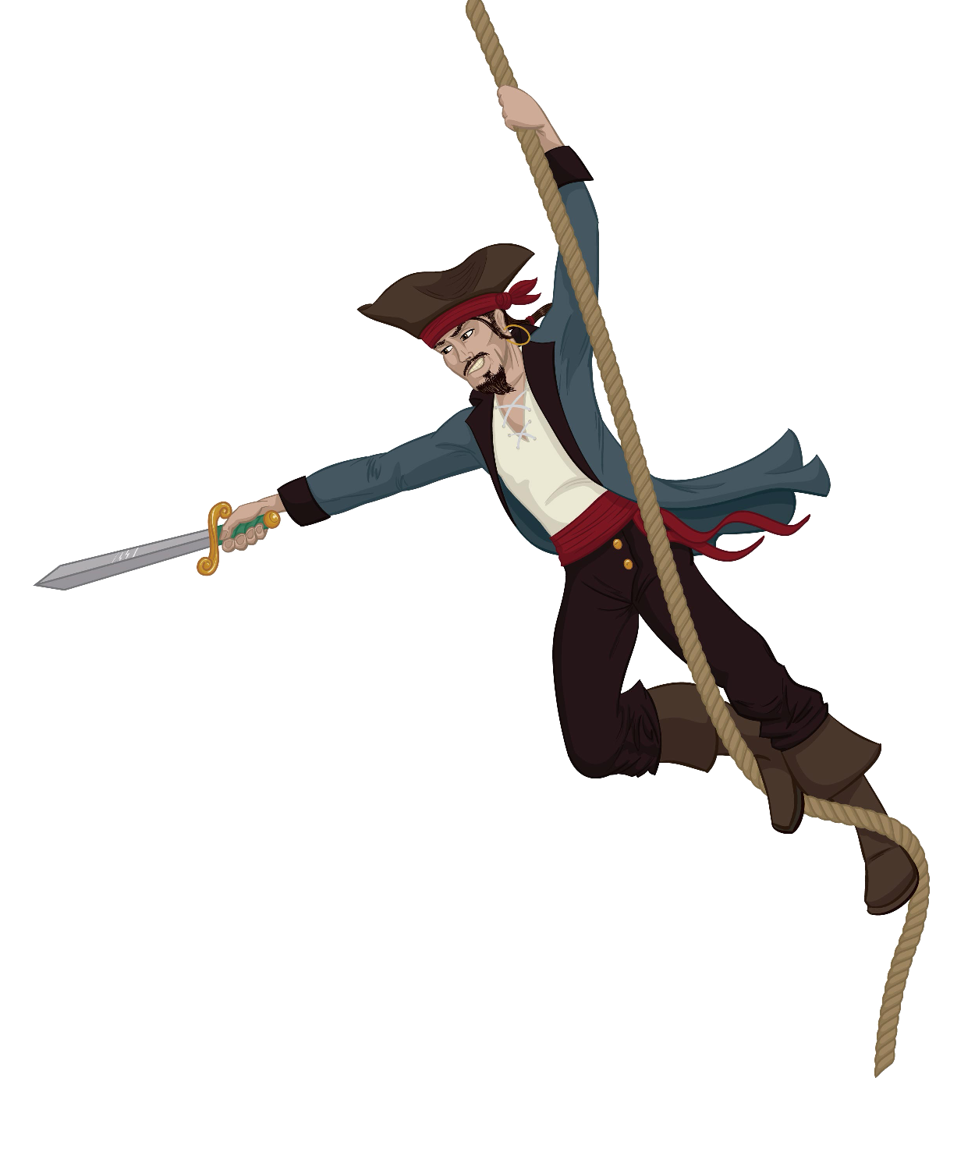
Pirate Clothing:
Pirates wore rough clothes or clothes they had stolen.
Wore best clothes when they went ashore.
Common sailors wore simpler clothes to captains:
    Long, loose trousers.
    No shoes on ship, not necessary.
    Loose, open neck shirt with a neck cloth.
Pirate hat’s or headscarf protected them from the sun.
Ribbons & sashes used to attach weapons.
Boots were strong & kept feet dry.
Pirates wore lots of jewellery.

Slide 5
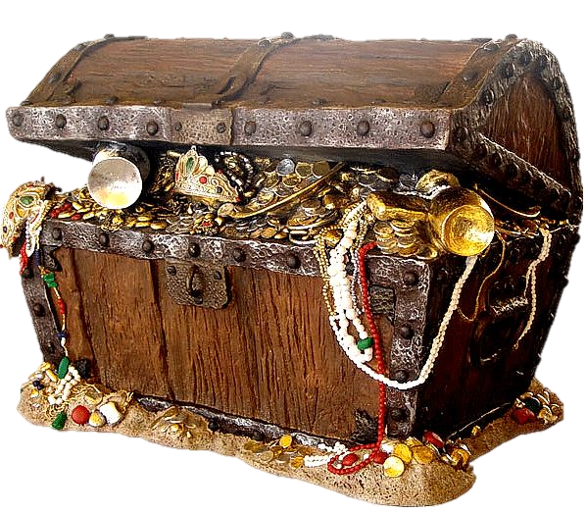
Pirate Treasure:
Pirate’s loved treasure – which wasn’t always gold.
Pirate treasure was often called “booty”.
Quartermaster was in charge of the treasure → he shared it among the crew.
A captured ship was called a “prize”.
Gold coins were the most popular as they were easy to share.
Gold, silver & jewels were the most precious.
Also took prizes they thought were useful.
Took sails, clothes, food & tools.
Often set the enemy crew adrift on a small boat.

Slide 6
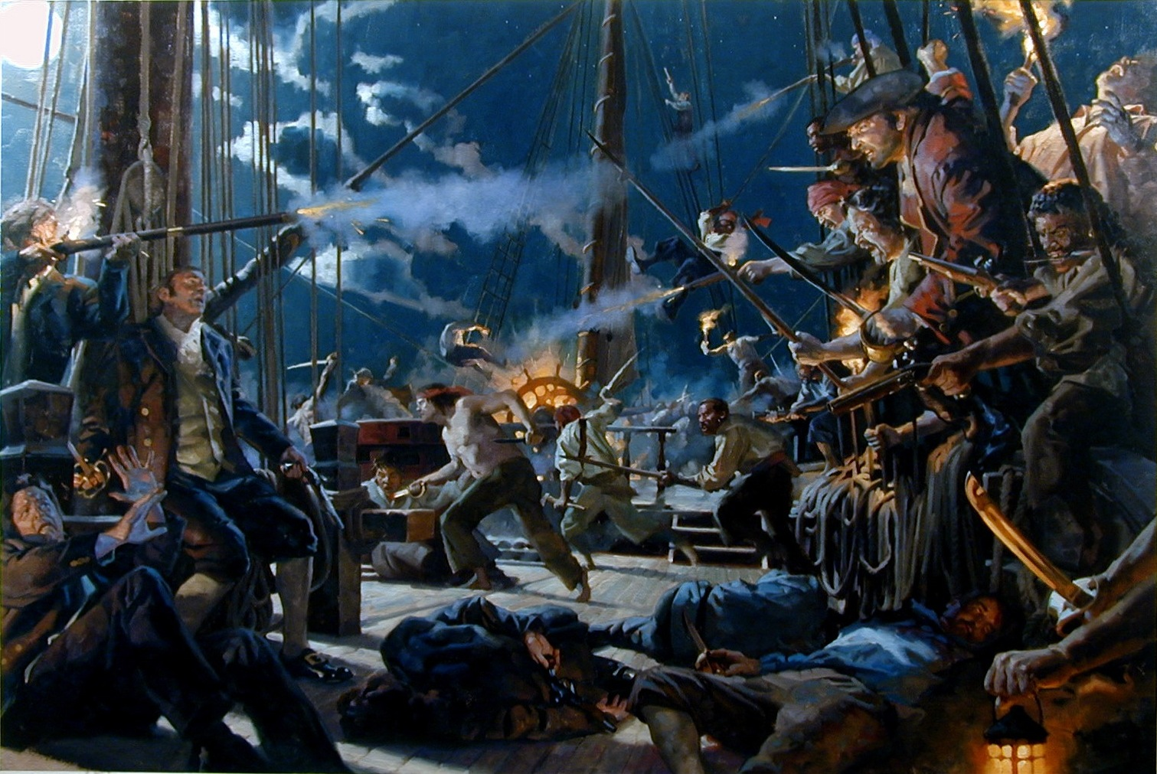
Pirates in Battle:
Pirates very rarely lost a battle on the sea.
Usually carried far more crew than a normal ship of the same size.
Outnumbered their enemies during battle.
Pirates changed their ships a lot.
Carried a lot more cannons than other ships.
Most had cannons on both sides of the ship.
Pirates also boarded enemy ships to take them over.
Swing on ropes & board the enemy ship with their weapons.
Notes:
Link attached to image. Link is a pirate ship battle from Pirates of the Caribbean movie.

Slide 7
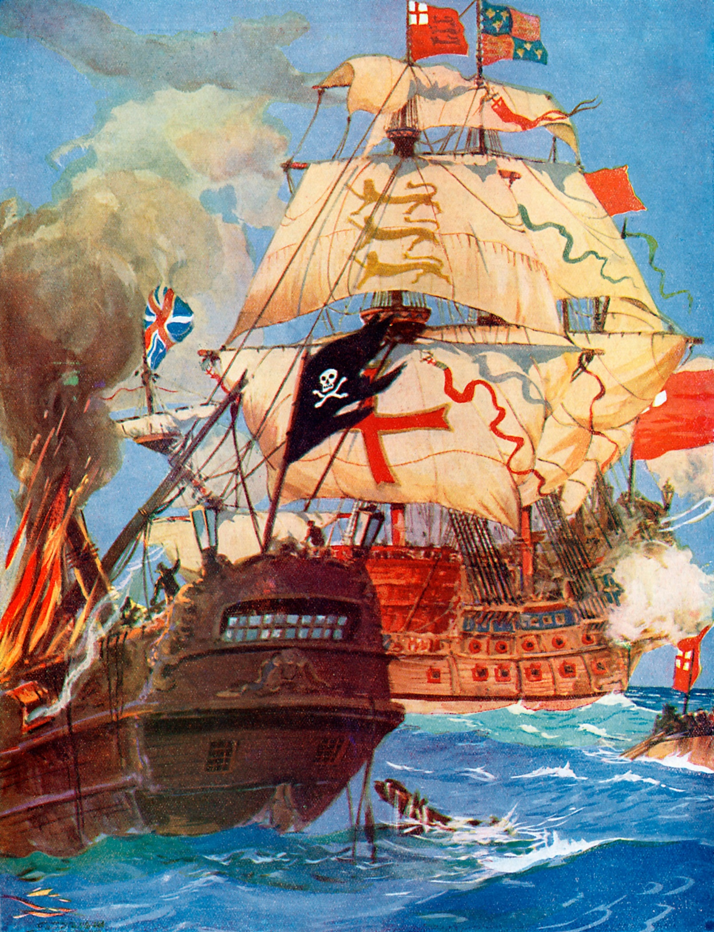
What happened to Pirates?
After a while, the British got sick of pirates.
Too many British ships were being attacked by pirates.
The British Navy decided to fight back.
Warships began hunting down & capturing pirates.
Many pirates were put on trial for their crimes.
Most of these pirates were found guilty & were killed.
The “Golden Age” of pirates ended with most of the famous pirates being captured & killed.

Slide 8
Task
Using the information from the previous slides as well as your own research create a fact file all about Pirates!

