Slide 1
We are learning to identify how to be a good friend.
Remember to:
Listen to the story.
Discuss why people behave differently.
Identify what a friend would or wouldn’t do.
Think about a time you needed friends.

Slide 2
http://www.mylife4schools.org.uk/resources/tommys-story
Play ‘Tommy’s story’

Slide 3
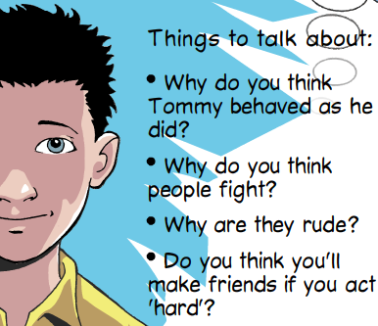

Slide 4
http://www.bbc.co.uk/education/clips/zvxqxnb

Slide 5
Things to talk about:
Why did Jess let Megan win?
What was she concerned about?
Was she being a true friend?
What did the teacher mean when she said 'Do you think you'd be doing Megan a favour?'

Slide 6
Worksheet activity.
Think about a time you needed a friend.
Why did you need a friend?
How did your friend help you?

