Slide 1

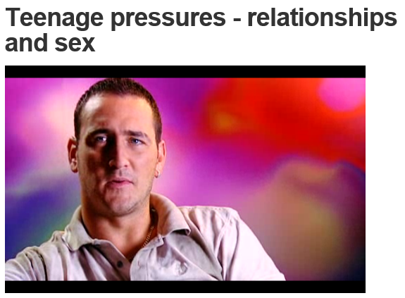
Sex and Relationships
Ground Rules

Slide 2
Sex and Relationships
Ground Rules
You should know all about the mechanics of sex from Biology lessons
In PSHCE we will focus on relationships and the risks of sex
If you want to know anything about the mechanics of sex then there are lots of decent websites you can use…

Slide 3
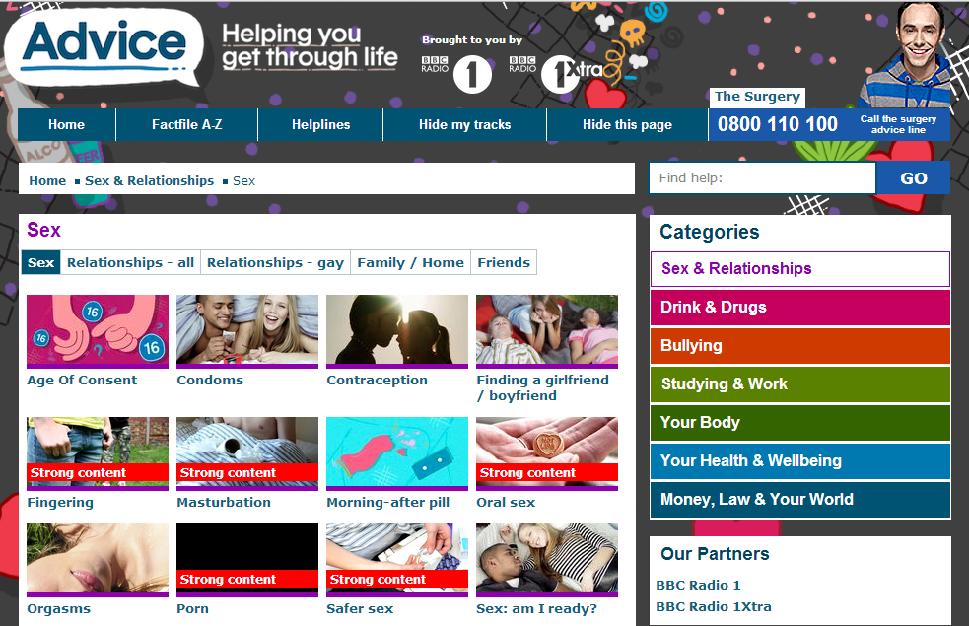
Sex and Relationships
http://www.bbc.co.uk/radio1/advice/sex_relationships/sex

Slide 4
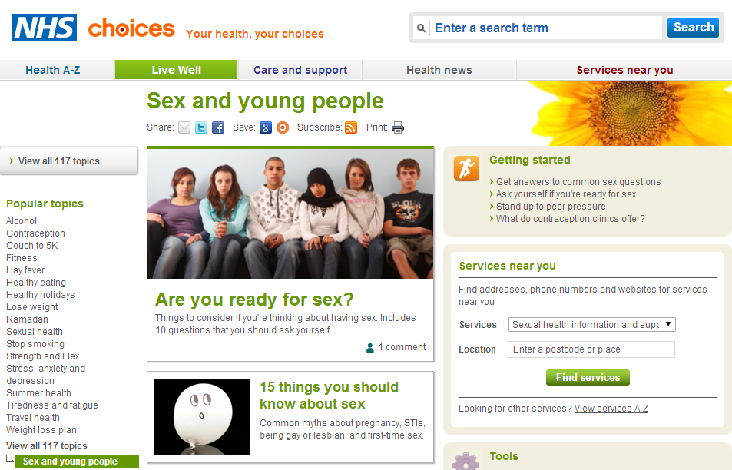
Sex and Relationships
http://www.nhs.uk/livewell/sexandyoungpeople/Pages/Sex-and-young-people-hub.aspx

Slide 5
Sex and Relationships
Ground Rules
Sex myths
1.) You can't catch STIs from oral sex.
2.) Wearing two condoms is better than one.
3.) Men think about sex more than women.
4.) No women like porn.
5.) If you don't have a condom you can use clingfilm or a crisp packet.
6.) Masturbation makes you blind.
7.) Men think about sex every seven seconds.
8.) You can judge the size of a man's package by the size of his feet.
9.) "Pulling out" is an effective form of birth control.
10.) Men enjoy sex more than women.
11.) Taking 'The Pill' leads to weight gain.
12.) Size is all that matters.
13.) Some penises are just too big for condoms.
14.) Jumping up and down immediately after sex prevents pregnancy.
15.) Guys who watch porn will treat girls like porn stars.
16.) You can make your penis bigger by taking certain pills.
17.) If she isn't making any noises then she isn't enjoying the sex.
18.) It's 100% guaranteed that you won't get pregnant during your period.
19.) "Blue balls" can cause long term damage.

Slide 6
Sex and Relationships
20.) The G-spot is a myth.
21.) Stimulating a woman's 'G-spot' is guaranteed to give her an orgasm.
22.) Green M&Ms make you horny.
23.) The average penis is 8 inches long when erect.
24.) First time sex doesn't lead to pregnancy.
25.) Women are incapable of having just casual sex because they're so emotional.
26.) You can get pregnant from kissing.
27.) You can contract an STD from a toilet seat.
28.) If you masturbate too much you'll get hairy palms.
29.) Steroids make your penis smaller.
30.) Having sexual partners before marriage will ruin sex after marriage.
31.) Peeing after sex helps prevent pregnancy.
32.) Oysters will make you horny.
33.) Longer sex is always better sex.
34.) Fantasizing about someone else means that you don't fancy who you are with any more.
35.) Old people don't have sex

Slide 7
Sex and Relationships
Ground Rules
Aims
To develop appropriate relationships with a widening range of adults in a variety of contexts
To explain the importance of different relationships and associated responsibilities, including the significance of marriage, stable relationships, civil partnerships, and long term commitments
To describe some of the possible effects of family and other significant events on feelings, emotions and personal wellbeing, and the impact these may have on relationships

Slide 8
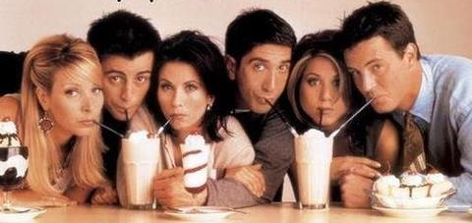

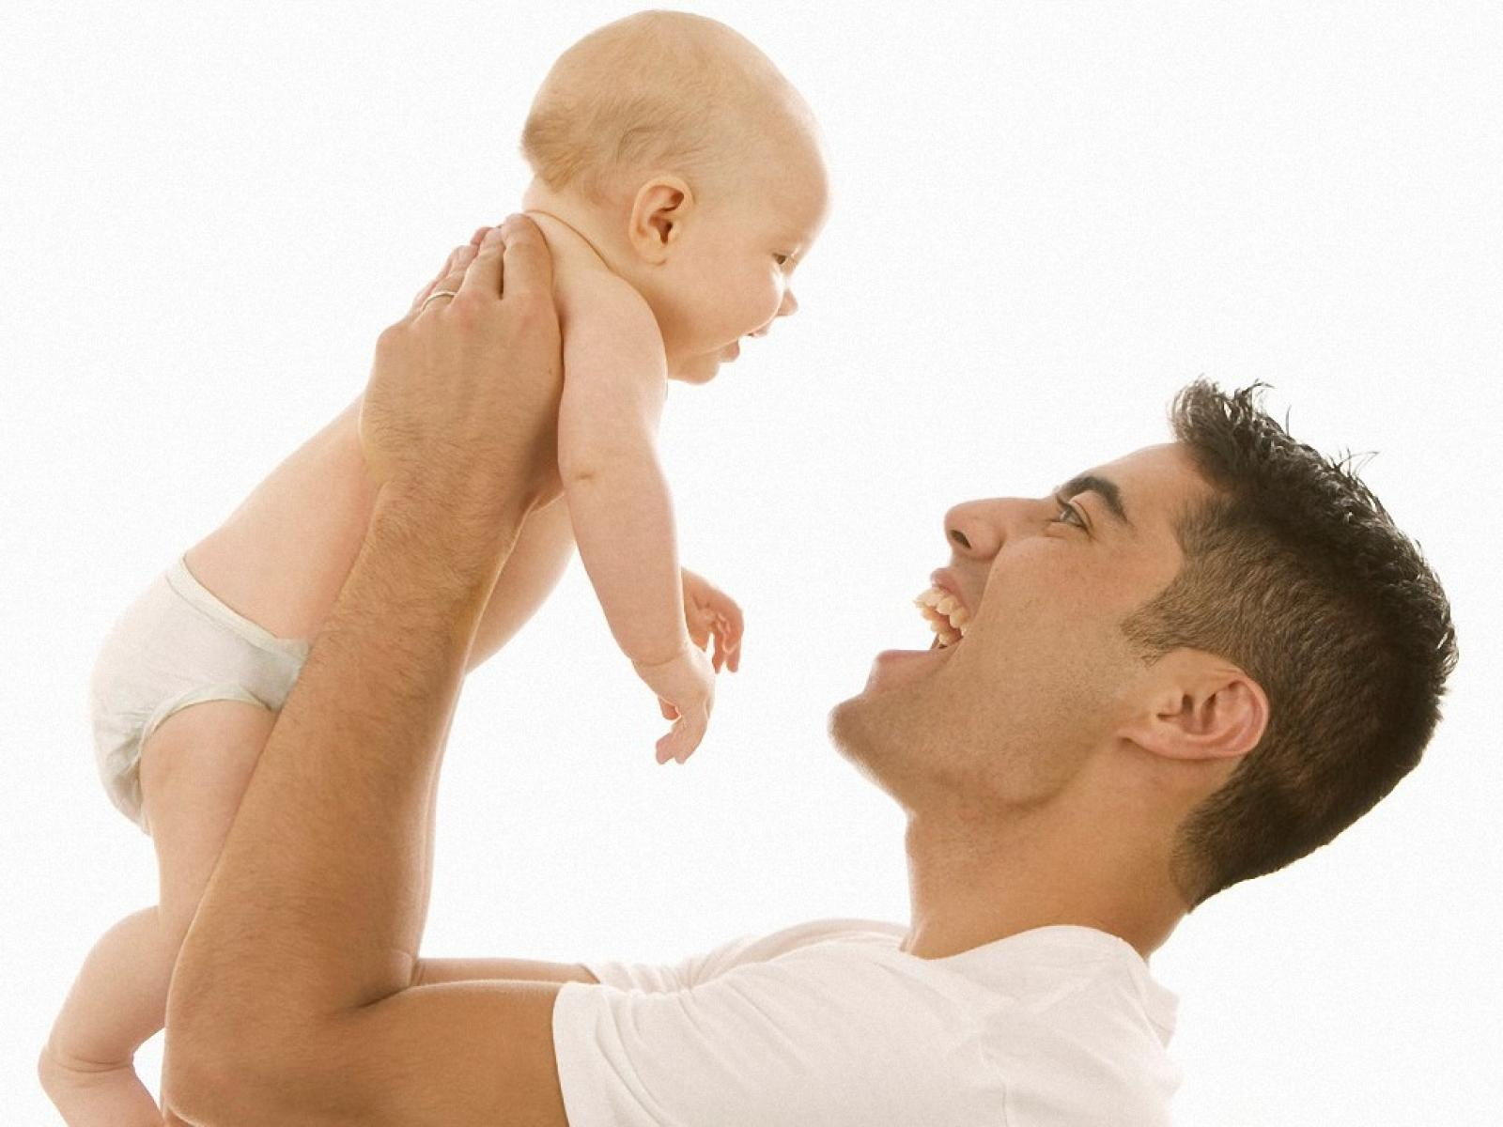

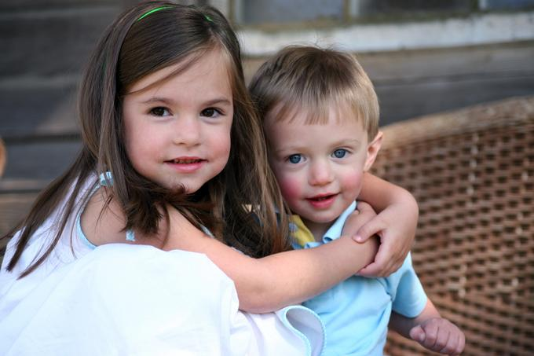
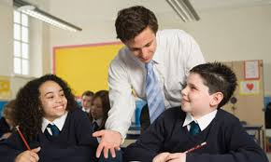
Sex and Relationships
Ground Rules
Relationships
Task
Write the types of relationship below into the first column of your table. Try to include one of your own
1. Parent and child
2. Friends
3. Boyfriend and girlfriend
4. Employer and employee
5. Brother and sister
6. Teacher and pupil

Slide 9
Sex and Relationships
Ground Rules
Relationships
Add a similarity and a difference for each subsequent type of relationship
Relationship
1. Parent and child
2. Friend and (best) friends
3. Boyfriend and girlfriend
4. Employer and employee
5. Siblings
6. Teacher and pupil
7. Coach? Stranger? Religion leader? Friends with benefits?
Similarity | Difference
Share common interests and a sense of humour
 | Wouldn’t want a sexual relationship with the boss!

Slide 10
Sex and Relationships
Ground Rules
Relationships
Task
For the relationship you have been allocated, create a spider diagram of all the qualities and aspects that would make the relationship healthy
Make each other laugh
Are attracted to each other
Listen to each other
Treat each other as equals
Trust each other
Love each other
3. Boyfriend and girlfriend

Slide 11
Sex and Relationships
Ground Rules
Relationships
Task
With those who have examined a different relationship, discuss the common aspects of healthy relationships
1. Parent and child
2. Friends
3. Boyfriend and girlfriend
4. Employer and employee
5. Brother and sister
6. Teacher and pupil

Slide 12
Sex and Relationships
Ground Rules
Relationships
Task
Provide at least one reason why each relationship is important and how it might change over time
1. Parent and child
2. Friends
3. Boyfriend and girlfriend
4. Employer and employee
5. Brother and sister
6. Teacher and pupil

Slide 13

Sex and Relationships
Ground Rules
Relationships
What should you look for in a partner?
Choose the two most and least important factors

Slide 14
Sex and Relationships
Ground Rules
Relationships
What are the advantages of marriage?
Try to think of an advantage for your health, wealth and happiness
Marriage and Health
• On average, husbands and wives are healthier, happier and enjoy longer lives than those who are not married.
• Men appear to reap the most physical health benefits from marriage and suffer the greatest health consequences if they divorce.
• Married mothers have lower rates of depression than single or cohabiting mothers, probably because they are more likely to receive practical and emotional support from their child’s father and his family.

Slide 15
Sex and Relationships
Ground Rules
Relationships
What are the advantages of marriage?
Try to think of an advantage for your health, wealth and happiness
Marriage and Wealth
• Married couples build more wealth on average than singles or cohabiting couples.
• Married men earn more money than do single men with similar education and job histories.
• Married women are economically better off than divorced, cohabiting or never-married women.

Slide 16
Sex and Relationships
Ground Rules
Relationships
What are the advantages of marriage?
Try to think of an advantage for your health, wealth and happiness
Marriage and Children
Children raised by their own married mother and father are:
• Less likely to be poor or to experience persistent economic insecurity
• More likely to stay in school, have fewer behavioral and attendance problems, and earn four-year college degrees
• Less vulnerable to serious emotional illness, depression and suicide
• More likely to have positive attitudes towards marriage and greater success in forming lasting marriages

Slide 17
Sex and Relationships
Ground Rules
Relationships
What are the advantages of marriage?
Try to think of an advantage for your health, wealth and happiness
Marriage and Crime/Domestic Violence
• Married women are at lower risk for domestic violence than women in cohabiting or dating relationships.
• Boys raised in single-parent homes are more likely to engage in criminal and delinquent behavior than those raised by two married biological parents.
• Married women are significantly less likely to be the victims of violent crime than single or divorced women. Married men are less likely to perpetrate violent crimes than unmarried men.

Slide 18
Sex and Relationships
Ground Rules
Relationships
What are the advantages of marriage?
Try to think of an advantage for your health, wealth and happiness
Marriage and Society
• The institution of marriage reliably creates the social, economic and affective conditions for effective parenting.
• Being married changes people’s lifestyles and habits in ways that are personally and socially beneficial. Marriage is a “seedbed” of prosocial behavior.
• Marriage generates social capital. The social bonds created through marriage yield benefits not only for the family but for others as well, including the larger society.

Slide 19
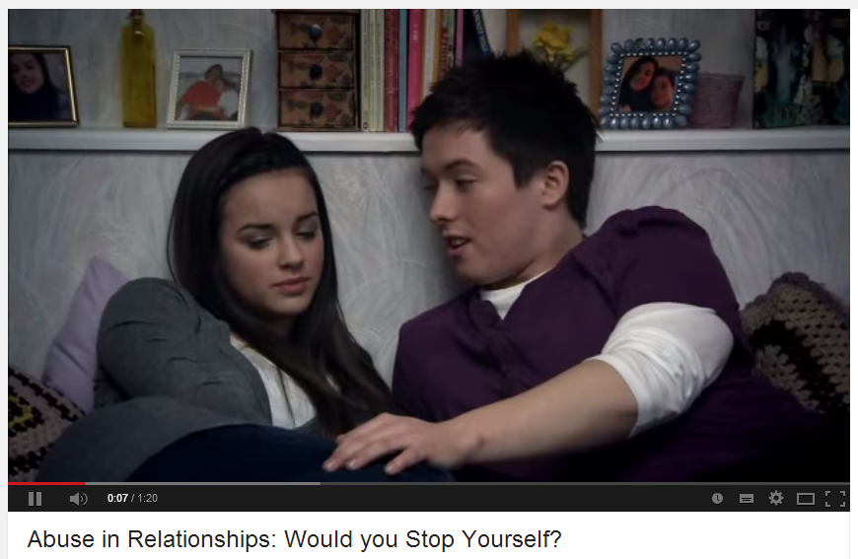
Sex and Relationships
Ground Rules
Relationships
Watch the clip and read the worksheet provided

Slide 20
Sex and Relationships
Ground Rules
Relationships
Healthy relationship | Unhealthy relationship

Slide 21

Sex and Contraception
Sex and Relationships
Tweet of the Day:
……………………………………………………………………………………………………………………………………………………………………………………………………………………………………………………………………………………………………………………

Slide 22
Relationship
1. Parent and child
2.
3.
4.
5.
6.
7.
Relationship
1. Parent and child
2.
3.
4.
5.
6.
7.

Slide 23
1. X tells you that they love being with you because you always have such a laugh when you are together.
2. X tells you that you are so close and so meant for each other that you don’t need anyone else. X doesn’t like it when you spend time with your friends.
3. X is really attractive and popular and people tell you that you are lucky to be with them. X expects to have sex whenever you meet even if you don’t want to.
4. You and X have had an argument and broke up. X has come round to see you and say that they want to get back together as they need you and that they can’t cope without you.
5. You and X had an argument and broke up. X comes round to see you as they want to get back together. X apologises, says they have thought about what they said in the argument and that they were wrong.
6. X is very stressed at the moment and so they often say things to you that really hurt and upset you. X always apologise afterwards and says that it is just a combination of too much alcohol, stress and that some of things that you say really make them angry.
7. You went out with your friends last night and had a great time. X doesn’t like it when you talk about what a good time you had and goes very moody and quiet.
8. X is angry because they want to kiss and you are not in the mood.
9. You are feeling low. X listens to you and reassures you of how great you are.
10. You and X are off out separately tonight with your friends. You ask if X is jealous of you going out without them and they say that there is no need to be jealous because they trust you.
11. You and X go out to the cinema, X suggests that they pay for both tickets and you pay the next time you go to see a film together.
12. You and X go out to the cinema, X says that you have to pay for both tickets because you chose the film.
13. X comes to meet your family and gets on really well with them and is pleased to see them again in future.
14. You and X are going out. X tells you that you look really good.
15. You and X are going out. X tells you that you look really good and that you are nearly as attractive as your best friend.
16. You are at school / college when you see one of X’s mates. He laughs and tells you things that you thought were private between you and X.
17. X wants to go out but you have a lot of studying to do. X gets angry and says that if you cared about them then you would leave your ‘stupid studies’ and come out. They threaten to end the relationship unless you show how much you care about them by coming out for the night.
18. X wants to go out but you have a lot of studying. X understands and says it is really important to get the grades if you want to go on to your chosen career. X asks if it is okay if they still go out as they would like to meet up with some friends.
19. X has a lot of studying to do but you want to go out. You are supportive of their studies but would like to go and meet with some of your friends. X doesn’t want you to go out without them and gets into a bad mood.
20. You and X are going out. X tells you that you look really good and then immediately asks for sex.
1. X tells you that they love being with you because you always have such a laugh when you are together.
2. X tells you that you are so close and so meant for each other that you don’t need anyone else. X doesn’t like it when you spend time with your friends.
3. X is really attractive and popular and people tell you that you are lucky to be with them. X expects to have sex whenever you meet even if you don’t want to.
4. You and X have had an argument and broke up. X has come round to see you and say that they want to get back together as they need you and that they can’t cope without you.
5. You and X had an argument and broke up. X comes round to see you as they want to get back together. X apologises, says they have thought about what they said in the argument and that they were wrong.
6. X is very stressed at the moment and so they often say things to you that really hurt and upset you. X always apologise afterwards and says that it is just a combination of too much alcohol, stress and that some of things that you say really make them angry.
7. You went out with your friends last night and had a great time. X doesn’t like it when you talk about what a good time you had and goes very moody and quiet.
8. X is angry because they want to kiss and you are not in the mood.
9. You are feeling low. X listens to you and reassures you of how great you are.
10. You and X are off out separately tonight with your friends. You ask if X is jealous of you going out without them and they say that there is no need to be jealous because they trust you.
11. You and X go out to the cinema, X suggests that they pay for both tickets and you pay the next time you go to see a film together.
12. You and X go out to the cinema, X says that you have to pay for both tickets because you chose the film.
13. X comes to meet your family and gets on really well with them and is pleased to see them again in future.
14. You and X are going out. X tells you that you look really good.
15. You and X are going out. X tells you that you look really good and that you are nearly as attractive as your best friend.
16. You are at school / college when you see one of X’s mates. He laughs and tells you things that you thought were private between you and X.
17. X wants to go out but you have a lot of studying to do. X gets angry and says that if you cared about them then you would leave your ‘stupid studies’ and come out. They threaten to end the relationship unless you show how much you care about them by coming out for the night.
18. X wants to go out but you have a lot of studying. X understands and says it is really important to get the grades if you want to go on to your chosen career. X asks if it is okay if they still go out as they would like to meet up with some friends.
19. X has a lot of studying to do but you want to go out. You are supportive of their studies but would like to go and meet with some of your friends. X doesn’t want you to go out without them and gets into a bad mood.
20. You and X are going out. X tells you that you look really good and then immediately asks for sex.

Slide 25
Aims
-To develop appropriate relationships with a widening range of adults in a variety of contexts
-To explain the importance of different relationships and associated responsibilities, including the significance of marriage, stable relationships, civil partnerships, and long term commitments
-To describe some of the possible effects of family and other significant events on feelings, emotions and personal wellbeing, and the impact these may have on relationships
Time | Task
10 mins | Show video about sex and relationships. Highlight that we will focus on relationships and show students websites where they can get more information on sex if needed. Quickly provide 35 myths about sex.
5 mins | Introduce aims. Get students to write the different relationships from the pictures onto their worksheet. Reveal answers and encourage students to think of one more relationship
10 mins | Students write a similarity and difference for each adjacent relationship on their work sheet. Discuss as a class.
10 mins | With the exception of the example provided (boyfriend and girlfriend), allocate a relationship to each student. Students create a spider diagram showing the aspects of a healthy relationship. Students then get in groups of 5 to discuss the similarities between the positive aspects of the relationships to provide a top 5.
5 mins | Label the outline of a person with what students want in a partner. Students then choose their top three attributes
5 mins | Discuss the benefits of marriage with the class
5 mins | Give students the hand-outs with different relationship scenarios. Ask students to create a list of attributes for a healthy and an unhealthy relationship
5 mins | Tweet of the day: Students write a tweet (no more than 140 characters, in their books) to summarise the lesson. This could be a key fact or question from the lesson

