Slide 1

How did the universe begin?
Any Volunteers???
Notes:
Answer = cherry

Slide 2
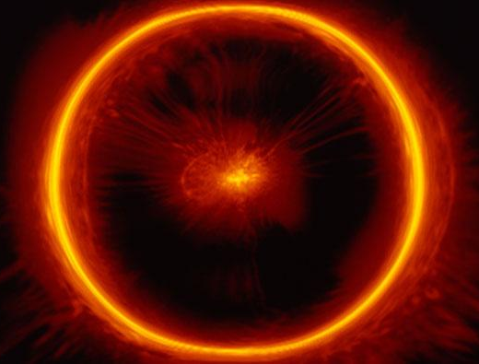
The Big Bang Theory of the Universe
Starter
presentations!
To understand how the universe began
ALL – state what is meant by the big bang theory
MOST – describe the big bang theory and the possible fates of the universe
SOME – explain how red-shift provides evidence for the big bang theory of the universe
KEYWORDS: big bang, big crunch, big yawn,
open, closed, flat, density, gravity

Slide 3
What is the Big Bang Theory?
LO: Understand how the universe began
The Big Bang theory is a theory of how the universe began. It says that the ENTIRE universe and everything in it was at one point compressed into one tiny, infinitely small point.
.
This is what the universe would have looked like 15bn years ago!

Slide 4
The Big Bang Theory
LO: Understand how the universe began
Scientists have calculated that the universe is (approximately) 15bn years old. That means, the big bang happened about 15bn years ago!
.
This is what the universe would have looked like 15bn years ago!

Slide 5
Time zero
LO: Understand how the universe began
Before the big bang, there is no concept of time. The universe is infinitely small and infinitely hot. The forces that we know (gravity, electromagnetism etc.) do not exist.
.
This is what the universe would have looked like 15bn years ago!

Slide 6
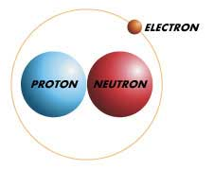
1 second after Big Bang
LO: Understand how the universe began
1 second after the big bang, the first particles form. It is still incredibly hot, so the only particles that can exist are protons and neutrons.

Slide 7
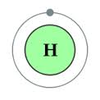
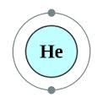
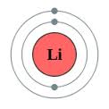
3 seconds after Big Bang
LO: Understand how the universe began
Protons and neutrons come together to form the nuclei of simple elements (hydrogen, helium, lithium)

Slide 8
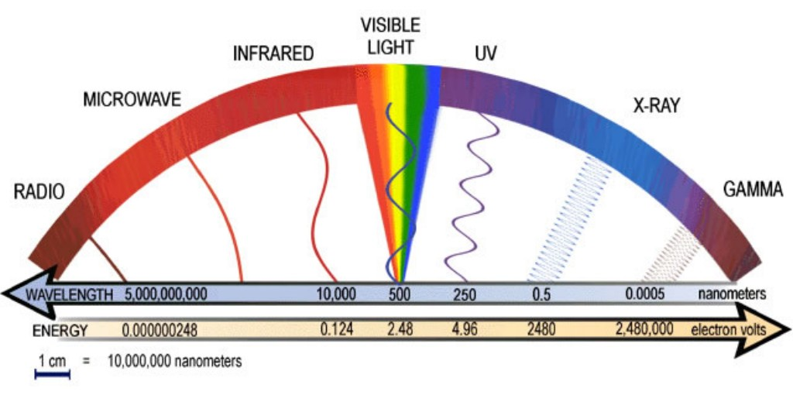
3-10,000 years after big bang
LO: Understand how the universe began
This is known as the radiation era of the universe. There is very little matter (stuff!) and the universe is mostly full of high frequency electromagnetic radiation

Slide 9
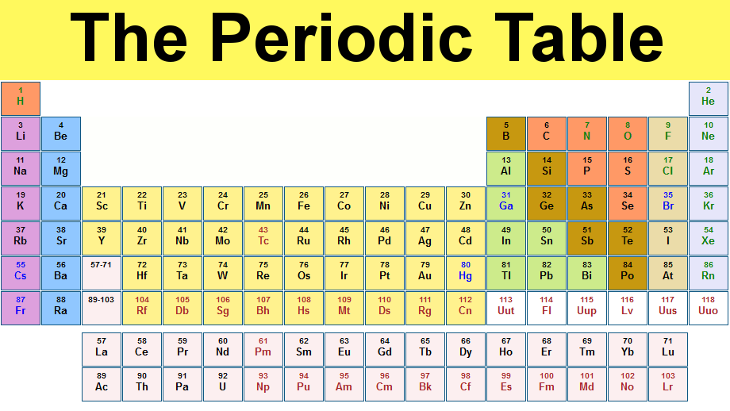
300,000 years after big bang
LO: Understand how the universe began
This is the beginning of the era of matter domination. The temperature is now low enough for electrons to bind with nuclei and form neutral atoms.

Slide 10
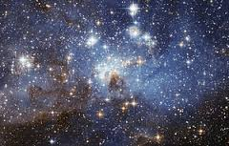
300m years after big bang
LO: Understand how the universe began
The first stars are born. Groups of these stars will go on to become the earliest galaxies

Slide 11
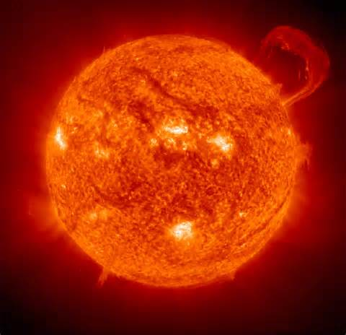
(approximately) 10bn years after big bang
LO: Understand how the universe began
Our sun and the solar system that the Earth is in is born!

Slide 12
Task
LO: Understand how the universe began
Write a story pretending that you are god and you are witnessing the big bang. Make the story as creative as possible.
A/A* - Include details of the key events of the big bang in your story!
.
This is what the universe would have looked like 15bn years ago!

Slide 13
Mini-plenary
LO: Understand how the universe began
The Big Bang theory is a theory of how the __________ began. It states that, at one point, the entire universe was _____________ into an infinitely small point. The universe is approximately _______ years old. During the big bang, the universe rapidly ____________. It also __________ __________ in the process, which allowed it to form matter, stars, galaxies and everything else we now see.
15bn, universe, cooled down, condensed, expanded

Slide 14

Evidence for the Big Bang
LO: Understand how the universe began
When it was first suggested, the big bang theory was difficult for a lot of scientists to accept because of the lack of evidence for it. However, it’s now widely accepted to be true!
What evidence is there for the big bang?

Slide 15
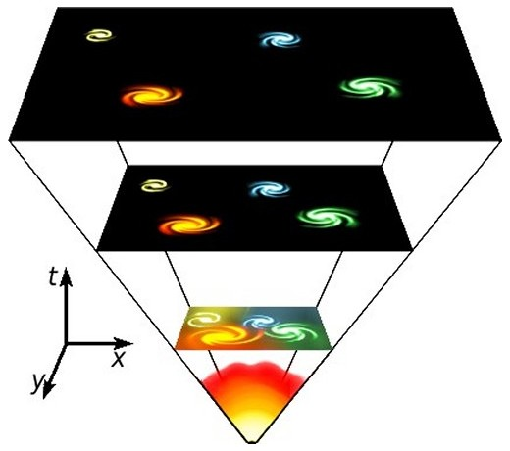
Red Shift
LO: Understand how the universe began
One of the main pieces of evidence for the big bang is red-shift.
Distance stars and galaxies are moving away from us, which must mean they were much closer together

Slide 16
Red Shift
LO: Understand how the universe began
If we go back in time far enough, at some point, all of the stars and galaxies must have been condensed together!

Slide 17

KNOWLEDGE CHECK
C
What is the big bang theory of the universe?
Start Timer
10 Minutes
10
Explain how red-shift provides evidence for the big bang theory of the universe
B
8
6
4
Explain why the big bang theory may not have been believed when it was first suggested
A
2
0

Slide 18
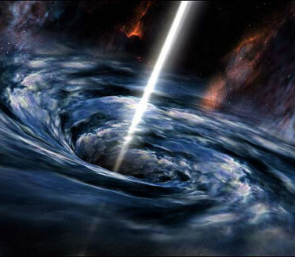
End of the universe
LO: Understand how the universe began
The big bang theory tells us how the universe may have started…however, it doesn’t tell us how it may end!

Slide 19
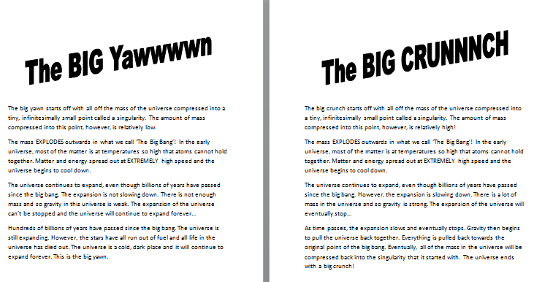
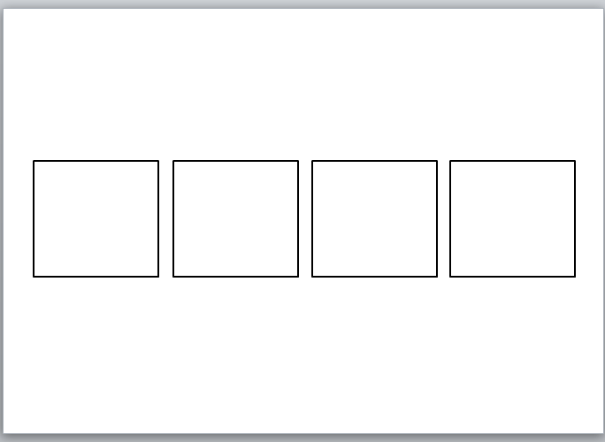
Home and Away task
LO: Understand how the universe began
You have been given an information sheet with four paragraphs and a worksheet with four boxes.
Read through each paragraph and write ONE word that summarises that paragraph in a box.

Slide 20
Home and Away task
LO: Understand how the universe began
Now visualise each paragraph as being made up of pictures, symbols and abbreviations.
Put as many of these pictures, symbols and abbreviations around the relevant box so that you’re able to remember the info.

Slide 21
Home and Away task
LO: Understand how the universe began
One person in your pair will now be going to find out the information from someone in the ‘Away’ group.
Take your book with you to write down any notes that you think are important.

Slide 22
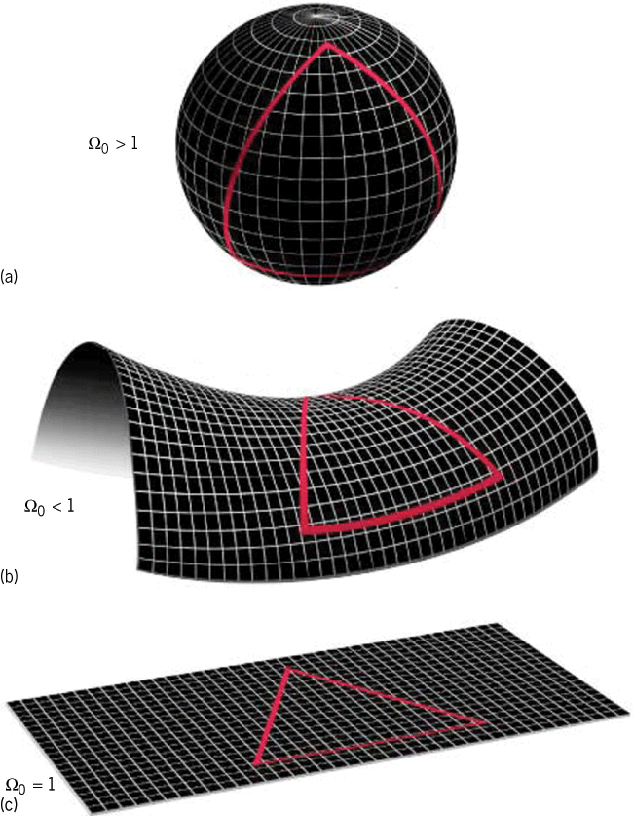
A third possibility…
LO: Understand how the universe began
The big crunch (closed universe) and big yawn (open universe) are two possible fates of the universe. However, there’s also a third.
If the mass in the universe is just right, the universe will expand to a certain size and then stay that size for ever. This is called a flat universe!

Slide 23
Task
LO: Understand how the universe began
Use your information sheet and the information that you gathered in the home and away task to complete the worksheet about the three possible fates of the universe.

Slide 24
Bingo – Pick 5 keywords from below!
LO: Understand how the universe began
Big crunch
Big yawn
Big bang
gravity
frequency
wavelength
Red shift
Doppler effect
diffraction
refraction

