Slide 1
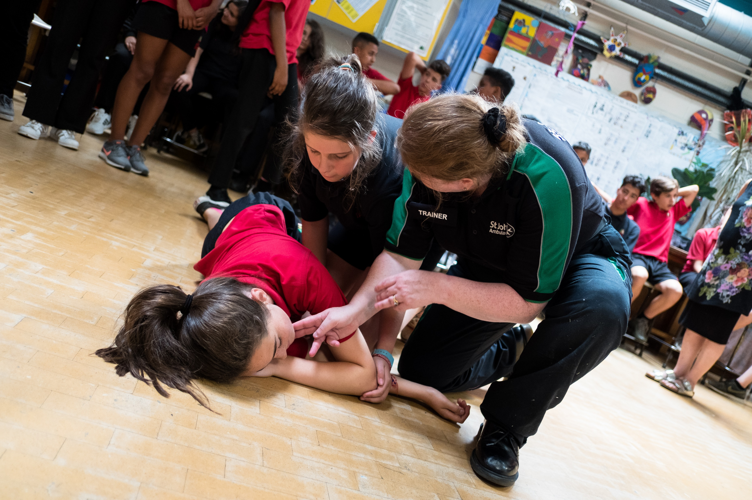

Basic life support
KS4 – Basic life support

Slide 2

Basic life support
A short course for young people to learn how to deal with first aid emergencies.
KS4- Basic life support

Slide 3
Learning outcomes
I am able to carry out a primary survey
I can place an unresponsive casualty, who is breathing normally, in to the recovery position
I know when and how to deliver CPR to an unresponsive casualty who is not breathing normally
KS4- Basic life support

Slide 4
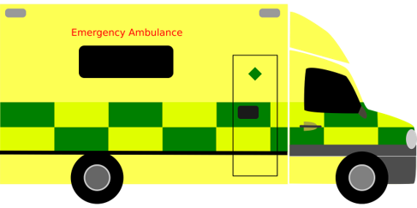
When things go wrong A12
Think of something that could happen to make someone unresponsive.
KS4 – Basic life support
Notes:
Explain the heart needs air (oxygen) and it’s a muscle that pumps blood around the body.
What can go wrong to cause a problem to the air and blood circulating? (circulation = "circling" the body)
Brief explanation and onto worksheet
General discussion - hit head, run over, choking etc. Emphasis on if it affects breathing, brain or heart (circulation) then this can cause unresponsiveness.

Slide 5
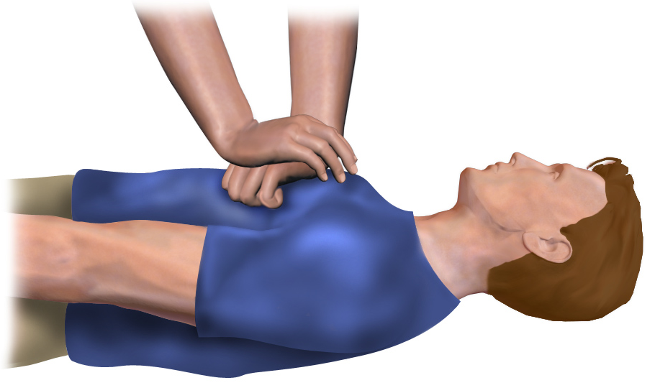
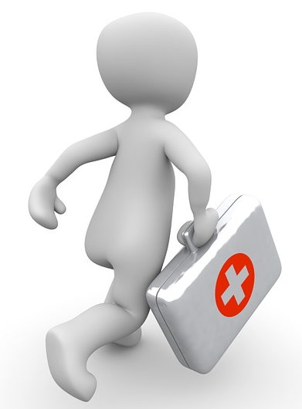
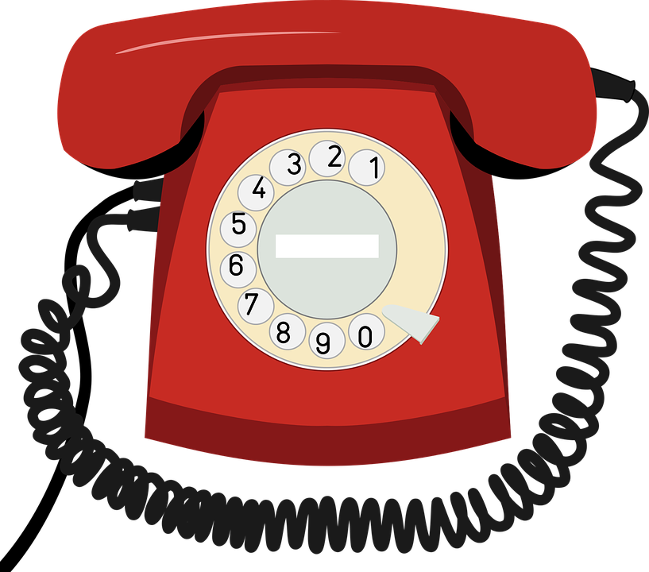

Chain of survival A13
Early CPR
Post resuscitation
Call for help
Early defibrillation
care
Discuss: Describe each link of the chain of survival
Challenge: Explain why it is important to follow these links to increase the casualty’s chances of survival
KS4 – Basic life support
Notes:
Chain of survival- if all steps in place MAY increase chance of survival
Note even best efforts at times do not ensure success when trying to resuscitate a casualty

Slide 6
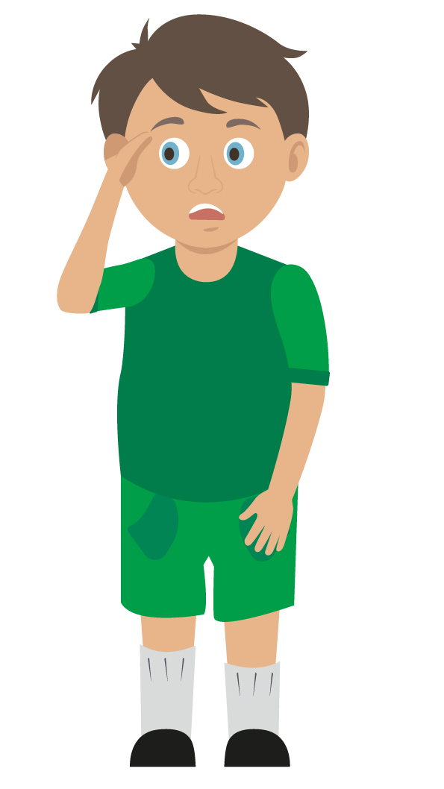
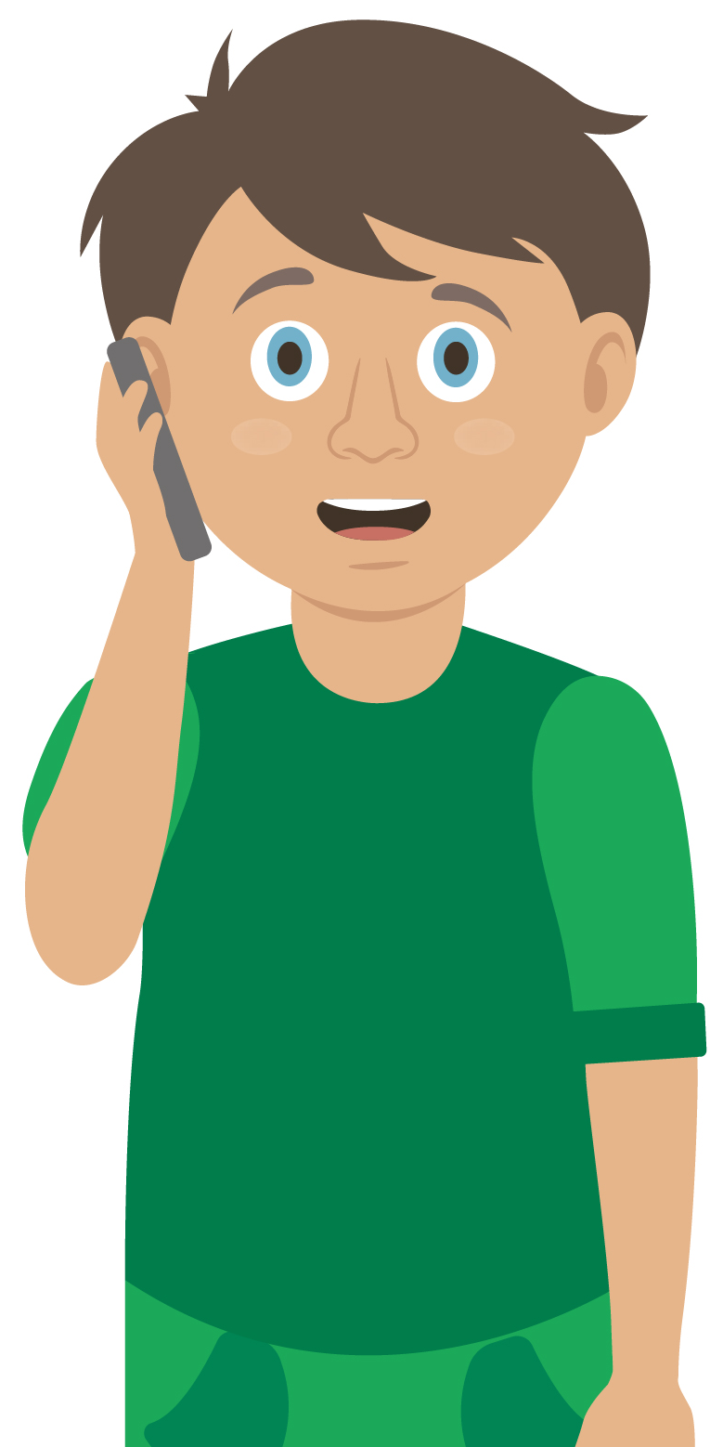
Primary survey
You do a primary survey to assess a casualty.
KS4 – Basic life support

Slide 7
Primary survey
D
Don’t / Danger / Dodge / Drive
Rescue / Run / Response / Repair
Silence / Summon / Slap / Shout
Automatic / Arm / Awful / Airway
Breathing / Back / Bruise / Belly
Catch / Cough / Circulation / Casualty
Choose the correct word for each part of the primary survey.
R
S
A
Why is it important that we use DRsABC?
B
C
KS4 – Basic life support
Notes:
ANSWERS: DANGER,RESPONSE,AIRWAY, BREATHING,CIRCULATION
Important as it structures approach

Slide 8
Watch this video
https://youtu.be/lCMhuRM0cIU
KS4 – Basic life support

Slide 9


Your turn: Primary survey
1. Check for danger
Always make sure the area is safe
2. Response
Check the casualty’s response. Ask questions and gently tap shoulders. Say “open your eyes!”
3. Shout for help
Anyone nearby can assist you
4. Airway
If not clear, then open by tilting the head back, use one hand on forehead and two fingers under the chin
5. Breathing
Check for normal breathing. Use look listen and feel to check. (Remember 10 seconds)
6. Circulation (only if breathing normally)
Check the casualty for bleeding
NB
If the casualty is not breathing normally call 999/112 then start CPR
If the casualty is breathing normally place them in the recovery position then call 999/112
KS4 – Basic life support

Slide 10

What’s next?
Is your casualty unresponsive but breathing normally?
If YES, then place your casualty in to the recovery position.
Primary survey completed?
KS4 – Basic life support

Slide 11
Watch this video
https://youtu.be/ubbZU15-ETM
KS4 – Basic life support

Slide 12
Your turn: Recovery position
1. Kneel
By the side of your casualty
2. Angle arm
Put the arm nearest to you to make a right angle. Palm facing upwards
3. Hand to cheek
Bring the arm furthest away across the chest and place the back of their hand against the cheek nearest to you
Hold it there
4. Knee bend
With other hand, bend their far knee up so that the foot is flat on the floor
5. Knee pull
Pull on the knee to roll the casualty towards you onto their side
Adjust them as necessary
6. Ensure airway is open
Recheck breathing
Call 999/112
Stay and monitor casualty until help arrives
KS4 – Basic life support
Notes:
Trainer demonstrates then gets the students to practice using either the PP slide as a prompt or the sheet in the workbook. Trainer circulate and correct as necessary

Slide 13
What’s next?
Call 999/112 for emergency help and start CPR. You can instruct an adult how to do this if you cannot do it yourself.
Primary survey completed?
Is your casualty unresponsive and not breathing normally?
KS4 – Basic life support

Slide 14
Watch this video
https://youtu.be/zZAIA7Iqhyo
KS4 – Basic life support

Slide 15
CPR remember…
You may not be strong/confident enough to do CPR on a casualty. That’s OK, you can tell someone else what they need to do
It is important to understand that sometimes even CPR cannot save somebody
Anything you can do to help, even just calling someone else to help, could be lifesaving
Never do CPR on someone if they are awake and breathing normally
KS4 – Basic life support

Slide 16
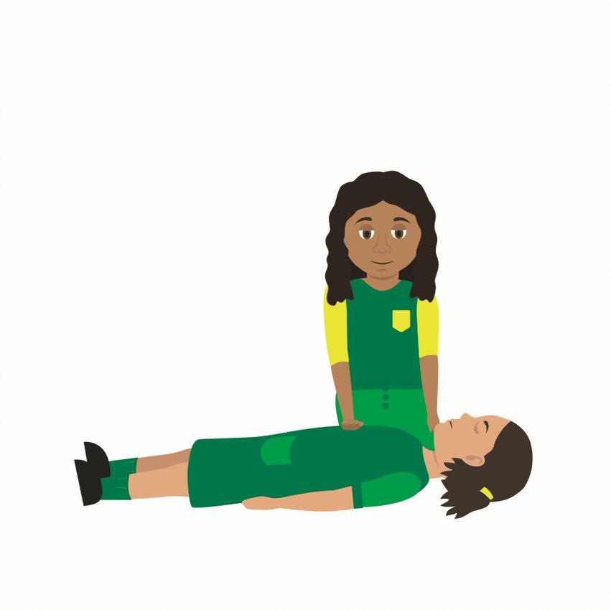
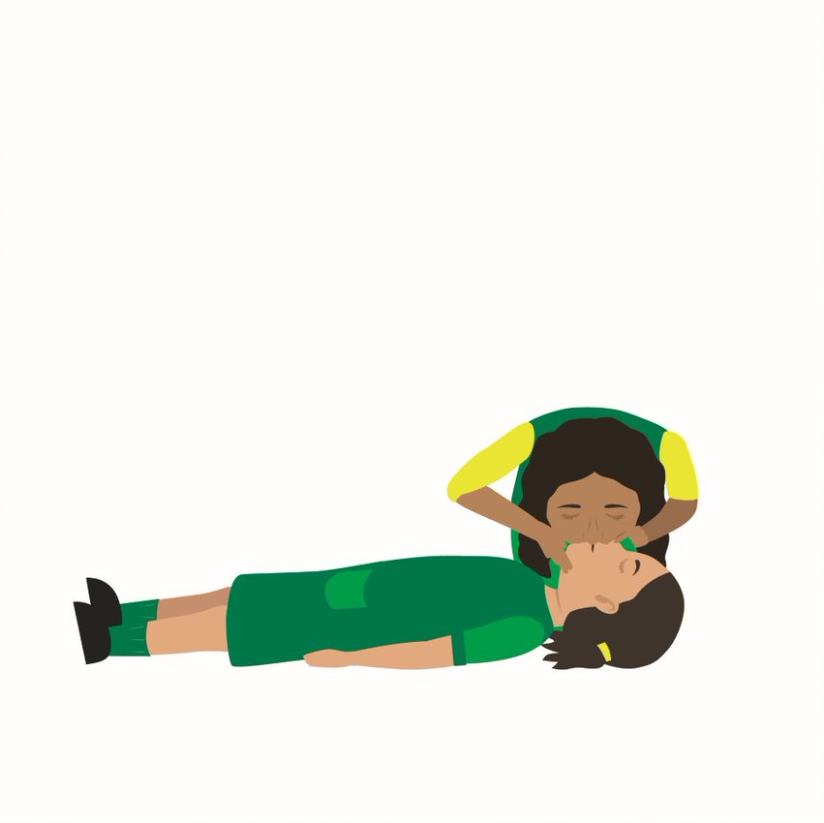
Your turn: CPR
1. Call 999/112
Kneel by the side of your casualty
Send a bystander for an AED if one is available
2. Place one hand
On the centre of the chest
Put the heel of the other hand on top
Interlock your fingers to lift them off the chest
3. Begin chest compressions
Lean over with your arms straight
Press downwards on breastbone 30 times
4. Press down
To a depth of about 5-6cm
Release the pressure but leave hands in place
Try to press at a rate of 100-120 times per minute
5. Breathe into casualty
open the airway and pinch the nostrils together
take a breath and blow into the mouth until the chest rises
repeat to give two breaths
6. Start compressions again
repeat 30 chest compressions with two breaths until help arrives
NEVER do this on someone if they are responsive!
KS4 – Basic life support
Notes:
.

Slide 17
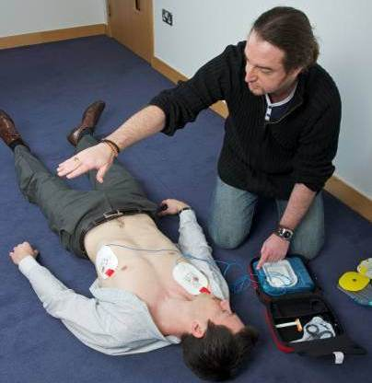
Using the AED
AED stands for automated external defibrillator. This is an emergency life-saving device used in the event of sudden cardiac arrest. The device analyses the heart rhythm and administers an electrical charge to the heart if needed to establish a regular heartbeat.
  Turn the AED on
  Follow all the AED voice prompts
  Ensure no one is touching the casualty when it is analysing
  Ensure no one is touching the casualty before pushing the shock button
KS4 – Basic life support

Slide 18
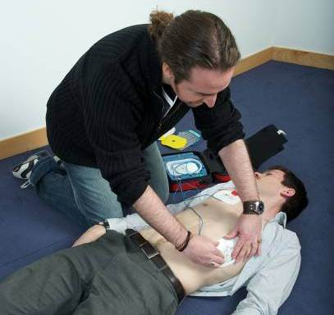
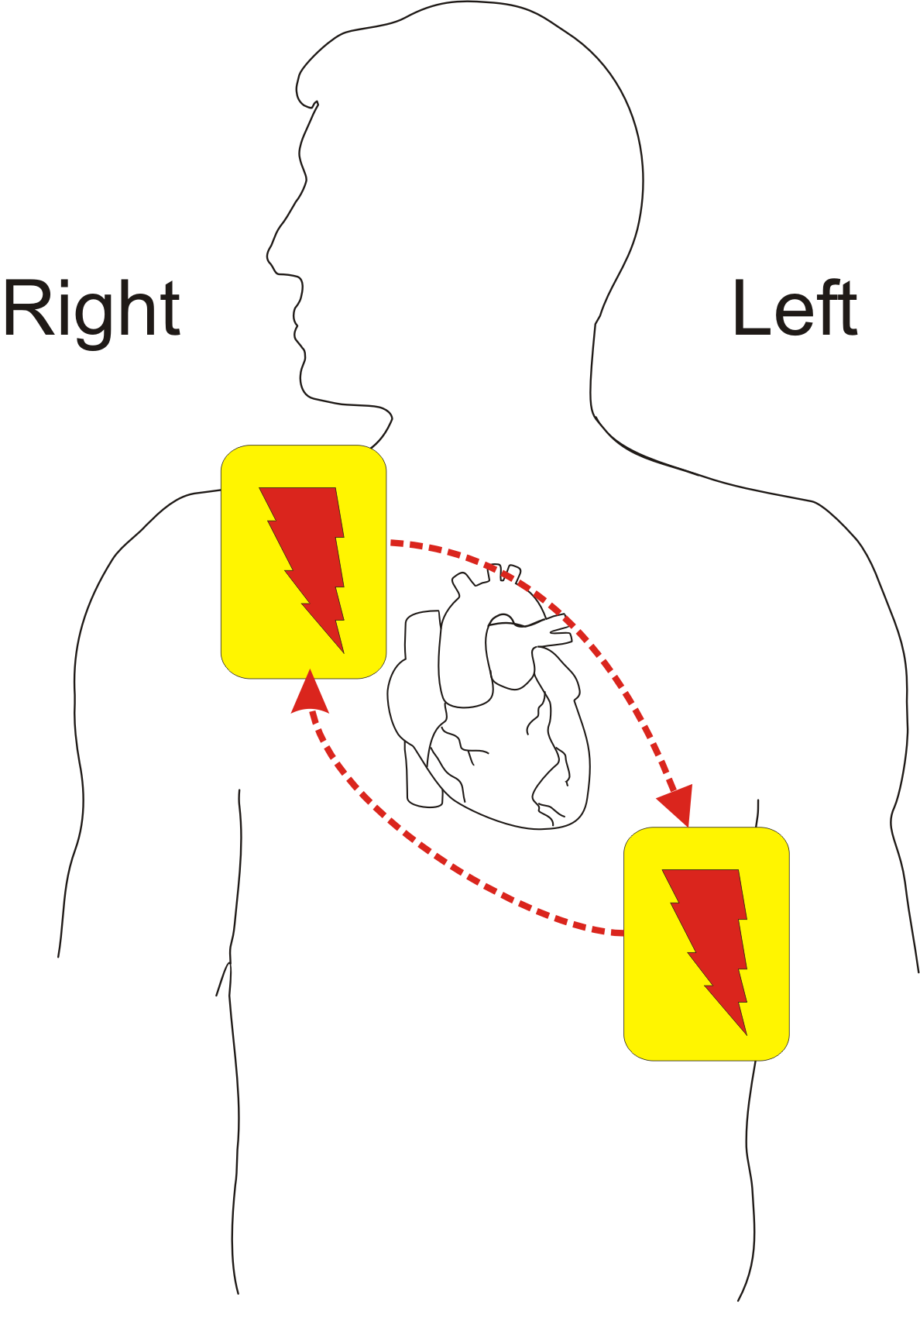
Connecting the AED pads
  Ensure that the chest is dry
  Consider shaving if the chest is hairy
  Use the pre-prepared pads that come with the AED, they are ready to use
  Stick pads to chest as directed by the diagram on the pads
  Ensure each pad is securely attached to the casualty
KS4 – Basic life support

Slide 19
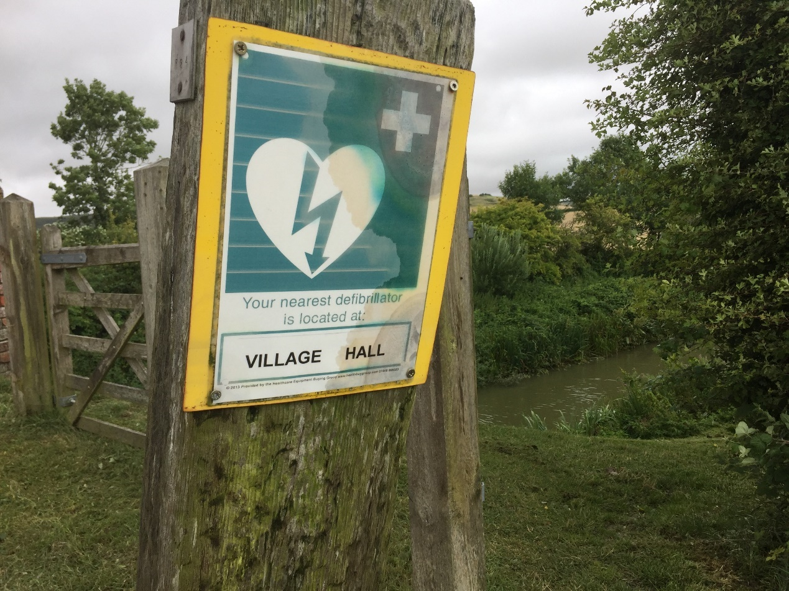
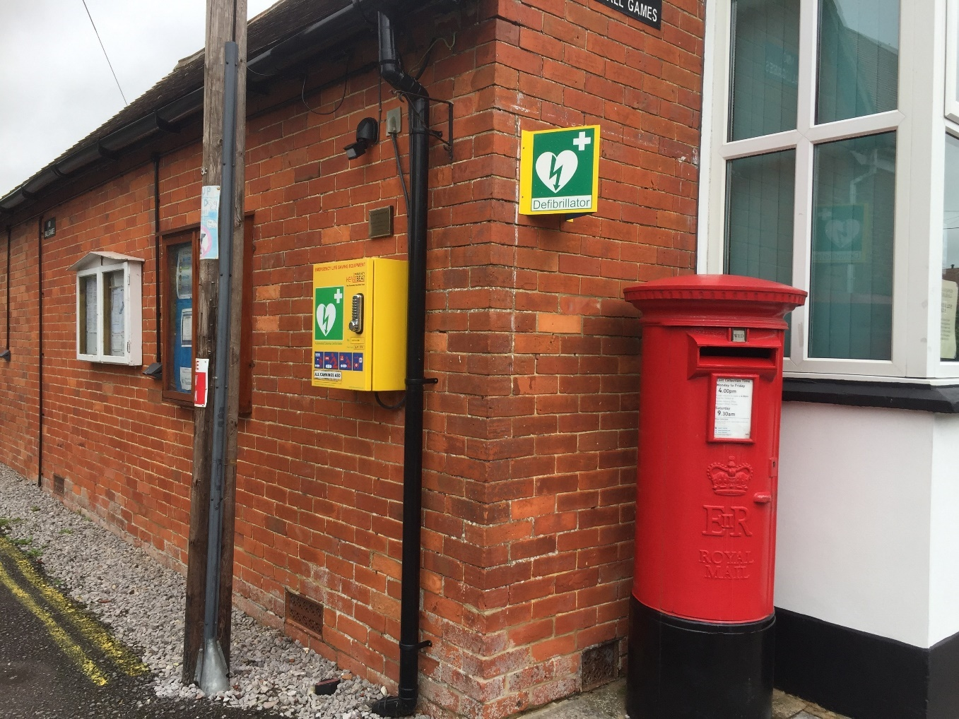
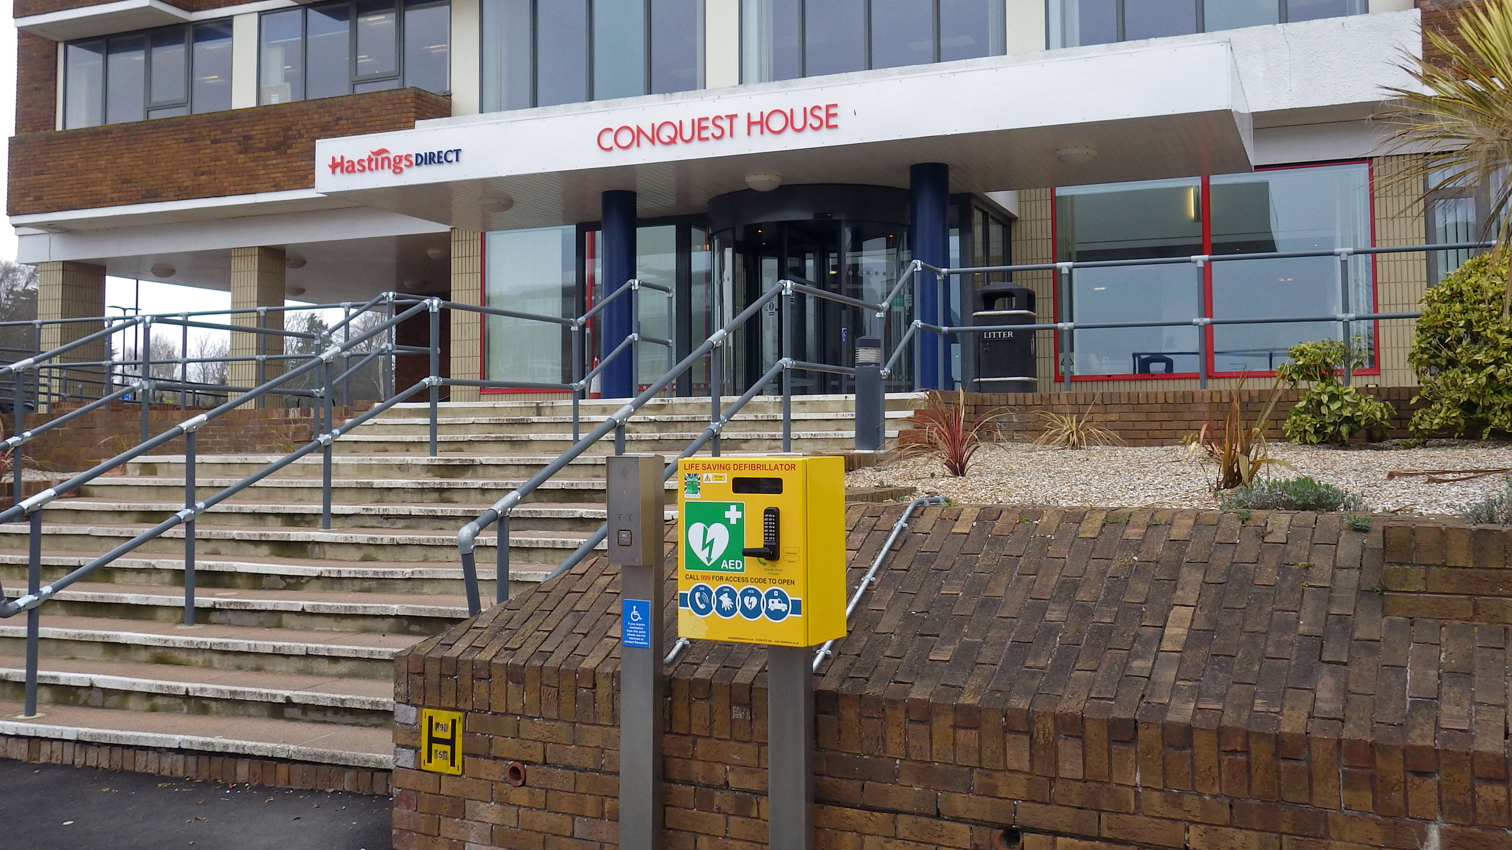
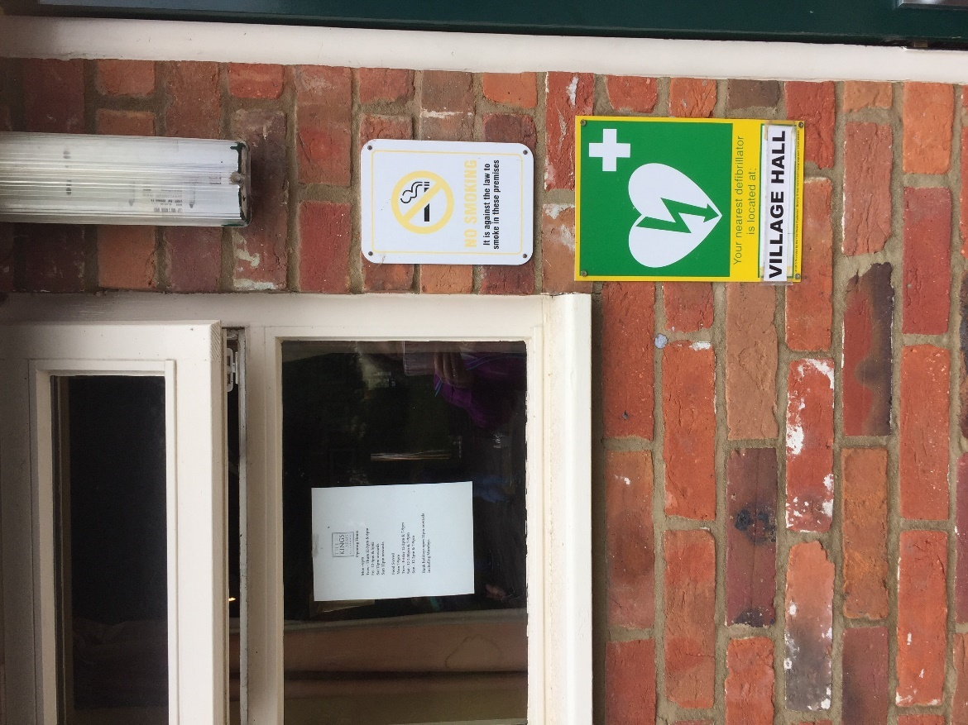
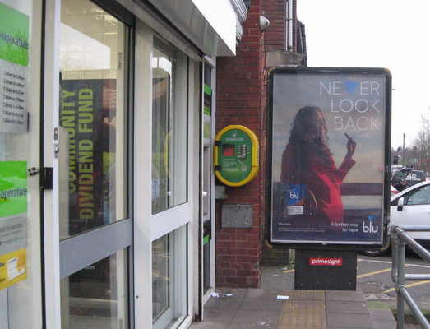
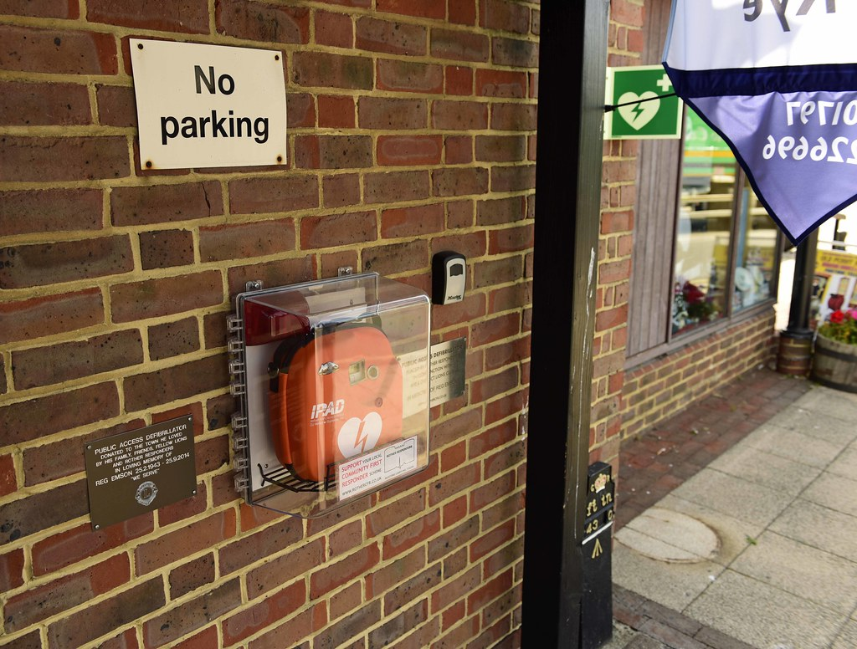
Public Access Defibrillators
You can find AEDs in many public places, including: offices, schools, shopping centres, supermarkets and airports. It is important that public places have AEDs because in the event of a cardiac arrest these would need to be accessed quickly; the sooner an AED is attached the sooner it can restart a heart.
KS4 – Basic life support

Slide 20
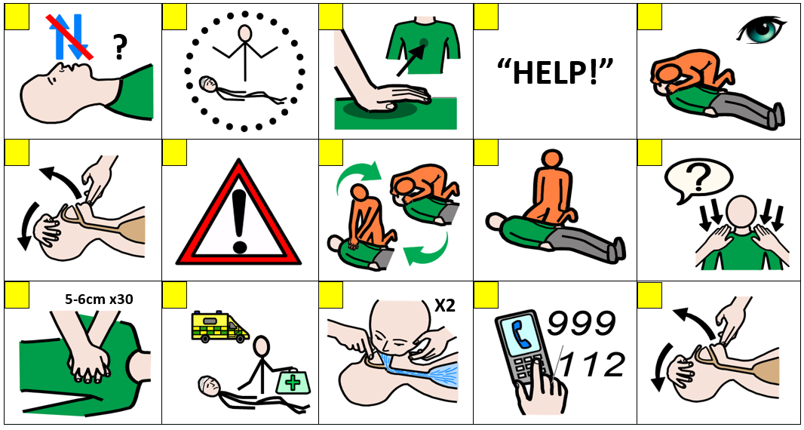
CPR sorting A15
KS4 – Basic life support

Slide 21
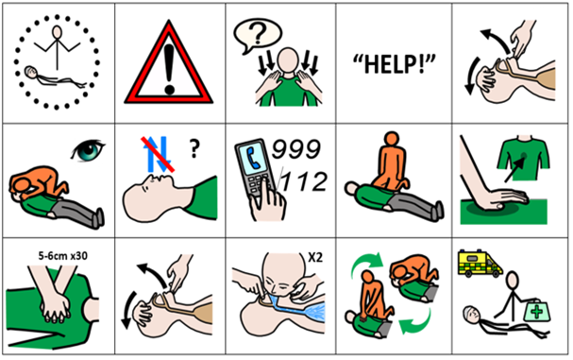
CPR sorting answers A15
KS4- Basic life support

Slide 22


Recap
Primary Survey
Breathing normally
Not breathing normally
Recovery position
Call for help and send a bystander for an AED if available
Make sure help is coming and give the casualty care
CPR
*and AED (if available)
KS4- Basic life support
Notes:
Just a recap, quick Q and A around room to check learning informally

Slide 23

Roll the dice
Identify something you have learnt from this session
State why the primary survey is important and describe each part of it
Explain the chain of survival
What is the first thing you would do if you found an unresponsive casualty and why?
What would you do with a casualty who was unresponsive and breathing normally?
How would you know if a casualty required CPR?
KS4- Basic life support
Notes:
Consider interactive dice

Slide 24



Check your learning
I am able to:
do a primary survey
place a casualty who is unresponsive but breathing normally in the recovery position
deliver CPR to an unresponsive casualty who is not breathing normally.
(or get help and tell someone else how to do it)
YES UNSURE NO
KS4- Basic life support

Slide 25

Thank you!

Slide 26
When things go wrong A12
Think of something that could happen to make someone unresponsive.
KS4- Basic life support
Notes:
Explain the heart needs air (oxygen) and it’s a muscle that pumps blood around the body.
What can go wrong to cause a problem to the air and blood circulating? (circulation = "circling" the body)
Brief explanation and onto worksheet
General discussion – blowing to head, being run over, choking etc. Emphasis on if it affects breathing, brain or heart (circulation) then this can cause unresponsiveness.

Slide 27
Chain of survival A13
Discuss: Describe each link of the chain of survival
Challenge: Explain why it is important to follow these links?
KS4 -Basic life support
Notes:
Can be used as a recap or HW exercise
They may not be able to complete this at this point so can revisit or HW.

Slide 28
Activity A16
The human body
Now you have the opportunity to learn some human anatomy. You could organise human structures and organs onto an outline of a human body. See if you can identify their positions and function. Use our downloadable worksheet which can be found on the St John Ambulance website.
KS4- Basic life support

Slide 29
Activity A40
Task choice
Can you achieve 50 points by completing a variety of set tasks? Each task is worth a different number of points. Use our downloadable worksheet which can be found on the St John Ambulance website.
KS4- Basic life support

