Slide 1
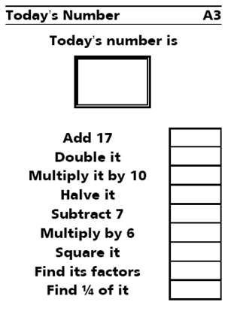



Keywords
Rainbow – Simplifying Fractions
$$Lv 4a$$
$$Lv 5c$$
$$Lv 5b$$
6
6
6
x 7.7
Find 50%
x 10²
Divide by 30
Find 6/7
Find 1/8
Find 8/11
x 7
Find 1/2
Divide by 3
x 12
Find 50%
Find 1/6
Find 6/7
Square it
Find 3/4
Find 1/3
x 25
+ 1986
Divide by 3
- 731
46.2
42
36
21
27
23.1
7
9
2310
84
225
77
42
2211
66
7
737
8.25
6
6
6
I can recognise fractions of shapes
I can shade a shape to represent a fraction
I can write fractions in the simplest form
5c
5b
5a

Slide 2
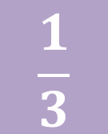
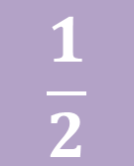
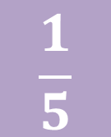
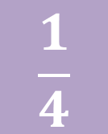
Keywords
Recap – what are fractions
$$\frac{1}{2}$$
$$\frac{1}{3}$$
$$\frac{1}{4}$$
$$\frac{1}{5}$$
One half
One third
One quarter
One fifth
I can recognise fractions of shapes
I can shade a shape to represent a fraction
I can write fractions in the simplest form
5c
5b
5a

Slide 3
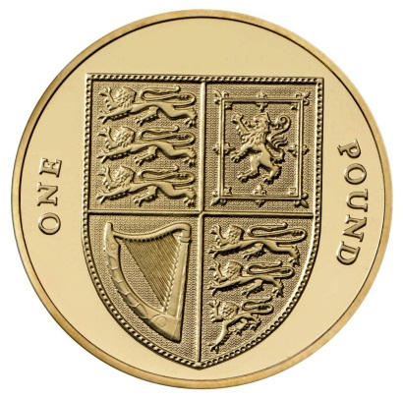
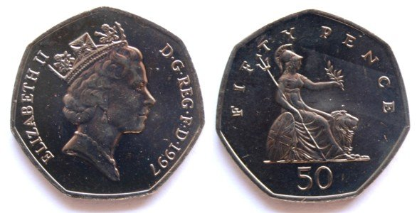
Keywords
Equivalence
The same
Equivalent
I can recognise fractions of shapes
I can shade a shape to represent a fraction
I can write fractions in the simplest form
5c
5b
5a

Slide 4
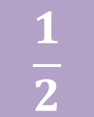
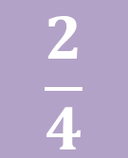
Keywords
Simplifying Fractions
=
$$\frac{2}{4}$$
=
$$\frac{1}{2}$$
Two quarters
One half
I can recognise fractions of shapes
I can shade a shape to represent a fraction
I can write fractions in the simplest form
5c
5b
5a

Slide 5
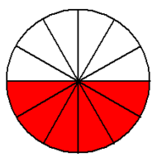
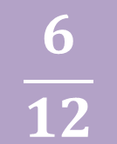
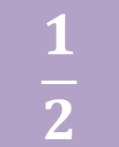
Keywords
Simplifying Fractions
=
$$\frac{6}{12}$$
=
$$\frac{1}{2}$$
Six twelfths
One half
I can recognise fractions of shapes
I can shade a shape to represent a fraction
I can write fractions in the simplest form
5c
5b
5a

Slide 6
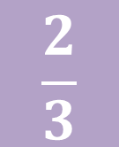
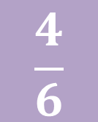
Keywords
Simplifying Fractions
=
$$\frac{4}{6}$$
$$\frac{2}{3}$$
=
Four sixths
Two thirds
I can recognise fractions of shapes
I can shade a shape to represent a fraction
I can write fractions in the simplest form
5c
5b
5a

Slide 7
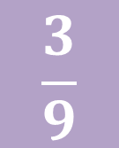
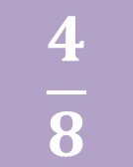
Keywords
Simplifying Fractions – I do
$$\frac{4}{8}$$
$$\frac{3}{9}$$
I can recognise fractions of shapes
I can shade a shape to represent a fraction
I can write fractions in the simplest form
5c
5b
5a

Slide 8
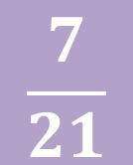
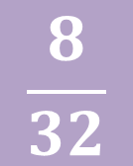
Keywords
Simplifying Fractions – we do
$$\frac{8}{32}$$
$$\frac{7}{21}$$
I can recognise fractions of shapes
I can shade a shape to represent a fraction
I can write fractions in the simplest form
5c
5b
5a

Slide 9
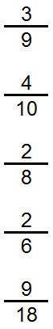

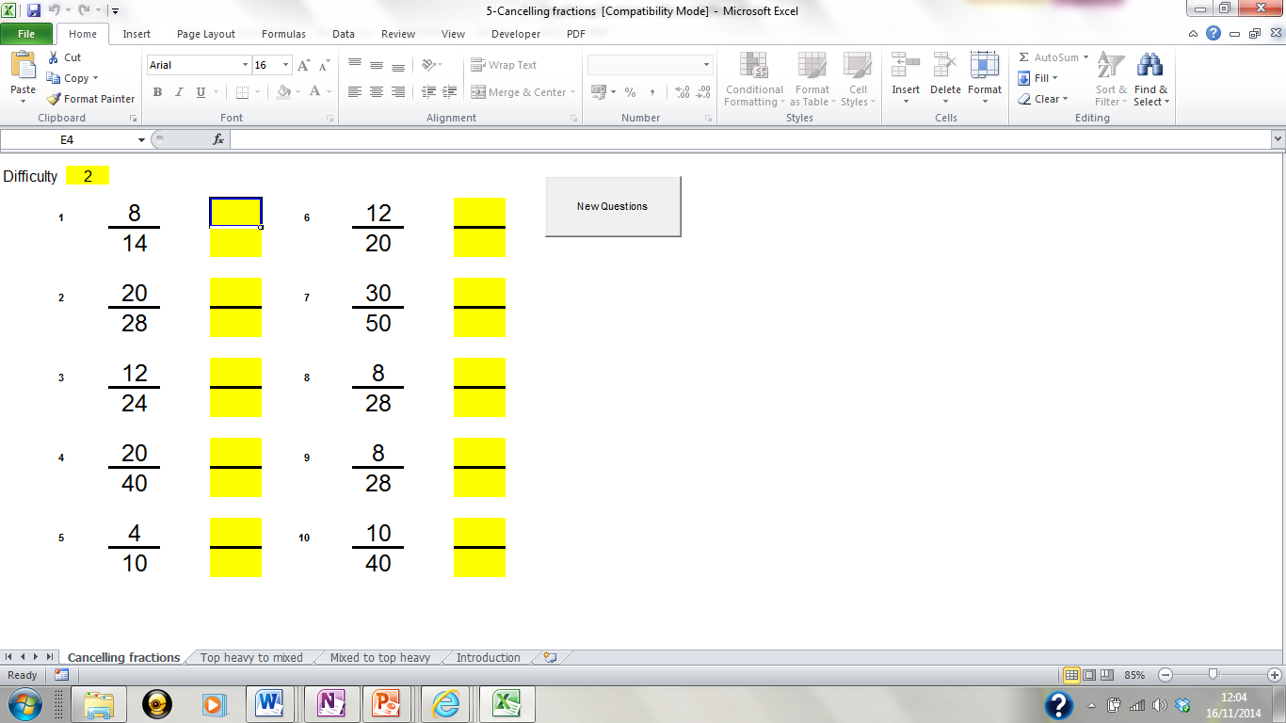


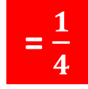
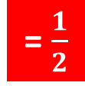
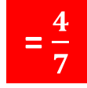
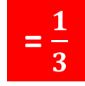




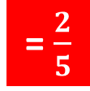

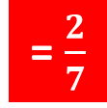



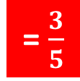
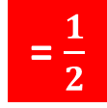
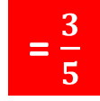
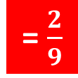

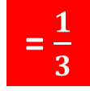
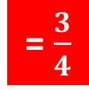


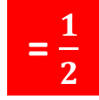
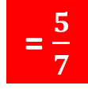
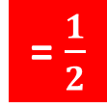

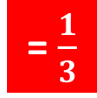

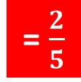
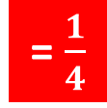
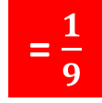

Keywords
Simplifying fractions – you do
$$Lv 5c$$
$$Lv 5b$$
$$Lv 5a$$
= $\frac{1}{3}$
= $\frac{1}{2}$
= $\frac{4}{7}$
= $\frac{3}{5}$
= $\frac{1}{9}$
= $\frac{9}{14}$
= $\frac{2}{5}$
= $\frac{1}{2}$
= $\frac{5}{7}$
= $\frac{3}{5}$
= $\frac{1}{2}$
= $\frac{9}{16}$
= $\frac{1}{4}$
= $\frac{1}{3}$
= $\frac{1}{2}$
= $\frac{2}{7}$
= $\frac{2}{9}$
= $\frac{9}{13}$
= $\frac{1}{3}$
= $\frac{3}{4}$
= $\frac{1}{2}$
= $\frac{1}{3}$
= $\frac{5}{11}$
= $\frac{1}{3}$
= $\frac{1}{2}$
= $\frac{3}{5}$
= $\frac{2}{5}$
= $\frac{1}{4}$
= $\frac{5}{13}$
= $\frac{2}{3}$
I can recognise fractions of shapes
I can shade a shape to represent a fraction
I can write fractions in the simplest form
5c
5b
5a

Slide 10
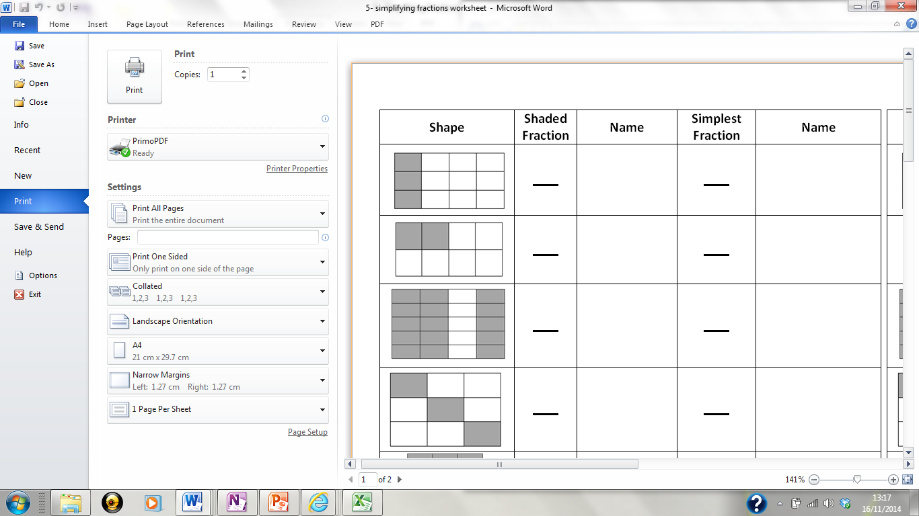
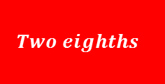

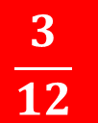
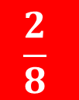
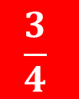

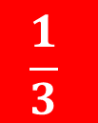

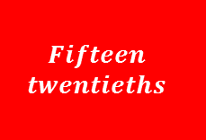
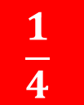
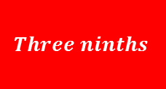
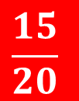

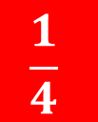

Keywords
$$\frac{3}{12}$$
$$Three twelfths$$
$$\frac{1}{4}$$
$$One quarter$$
$$\frac{2}{8}$$
$$Two eighths$$
$$\frac{1}{4}$$
$$One quarter$$
$$\frac{15}{20}$$
$$Fifteen$$
$$twentieths$$
$$\frac{3}{4}$$
$$Three quarters$$
$$\frac{3}{9}$$
$$Three ninths$$
$$\frac{1}{3}$$
$$One third$$
I can recognise fractions of shapes
I can shade a shape to represent a fraction
I can write fractions in the simplest form
5c
5b
5a

Slide 11

















Keywords
$$\frac{3}{15}$$
$$Three$$
$$fifteenths$$
$$\frac{1}{5}$$
$$One fifth$$
$$\frac{8}{16}$$
$$Eight$$
$$sixteenths$$
$$\frac{1}{2}$$
$$One half$$
$$\frac{10}{16}$$
$$Ten$$
$$sixteenths$$
$$\frac{5}{8}$$
$$Five eigths$$
$$\frac{20}{32}$$
$$Twenty out$$
$$of thirty two$$
$$\frac{5}{8}$$
$$Five eigths$$
I can recognise fractions of shapes
I can shade a shape to represent a fraction
I can write fractions in the simplest form
5c
5b
5a

Slide 12


Slide 13

3
?
?
?
2
?
?
?
1
?
?
?
A
B
C

Slide 14



















































$$\frac{27}{42}$$
$$\frac{6}{7}$$
$$\frac{4}{16}$$
$$\frac{9}{14}$$
$$\frac{1}{4}$$
$$\frac{2}{14}$$
5
$$\frac{15}{20}$$
$$\frac{1}{7}$$
$$\frac{3}{4}$$
$$\frac{18}{21}$$
$$\frac{7}{21}$$
$$\frac{9}{12}$$
$$\frac{1}{3}$$
$$\frac{9}{10}$$
$$\frac{3}{4}$$
$$\frac{63}{70}$$
$$\frac{12}{21}$$
$$\frac{4}{7}$$
$$\frac{36}{144}$$
4
$$\frac{1}{4}$$
$$\frac{12}{22}$$
$$\frac{14}{24}$$
$$\frac{7}{12}$$
$$\frac{15}{21}$$
$$\frac{8}{104}$$
$$\frac{9}{15}$$
$$\frac{5}{7}$$
3
$$\frac{6}{11}$$
$$\frac{1}{13}$$
$$\frac{3}{5}$$
$$\frac{10}{35}$$
$$\frac{6}{8}$$
$$\frac{2}{7}$$
$$\frac{3}{4}$$
$$\frac{35}{84}$$
$$\frac{5}{12}$$
$$\frac{6}{12}$$
2
$$\frac{140}{250}$$
$$\frac{1}{2}$$
$$\frac{14}{25}$$
$$\frac{63}{144}$$
$$\frac{30}{114}$$
$$\frac{7}{16}$$
$$\frac{5}{19}$$
$$\frac{15}{30}$$
$$\frac{6}{10}$$
$$\frac{1}{2}$$
$$\frac{30}{55}$$
1
$$\frac{6}{11}$$
$$\frac{3}{5}$$
A
B
C
D
E

Slide 15

























$$\frac{3}{4}$$
$$\frac{1}{4}$$
$$\frac{9}{14}$$
$$\frac{1}{7}$$
$$\frac{6}{7}$$
$$\frac{9}{10}$$
$$\frac{3}{4}$$
$$\frac{4}{7}$$
$$\frac{1}{4}$$
$$\frac{1}{3}$$
$$\frac{6}{11}$$
$$\frac{1}{13}$$
$$\frac{3}{5}$$
$$\frac{7}{12}$$
$$\frac{5}{7}$$
$$\frac{3}{4}$$
$$\frac{5}{12}$$
$$\frac{14}{25}$$
$$\frac{1}{2}$$
$$\frac{2}{7}$$
$$\frac{5}{19}$$
$$\frac{1}{2}$$
$$\frac{6}{11}$$
$$\frac{7}{16}$$
$$\frac{3}{5}$$

Slide 16
Keywords
Reflection - Use your green pens
Where did I get to today?
I can now.....
I still need to learn how to .....
I am scoring myself $\frac{}{10} for effort because……$
I can recognise fractions of shapes
I can shade a shape to represent a fraction
I can write fractions in the simplest form
5c
5b
5a

Slide 17














LO: Recognise equivalent fractions
$$\frac{9}{15}$$
$$\frac{9}{15}$$
$$\frac{15}{24}$$
$$\frac{12}{20}$$
$$\frac{25}{40}$$
$$\frac{2}{6}$$
$$\frac{4}{12}$$
$$\frac{10}{16}$$
$$\frac{15}{25}$$
$$\frac{20}{32}$$
$$\frac{3}{9}$$
$$\frac{5}{15}$$
$$\frac{6}{10}$$

