Slide 1
Adding and Subtracting Fractions

Slide 2
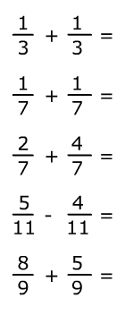
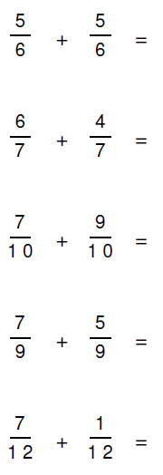




Starter – Add and subtract the fractions together. Simplify and convert to mixed numbers where possible. Some examples are completed for you.

Slide 3
Adding and Subtracting Fractions
What must we always have to be able to add or subtract fractions?
Hint: Something must be the same?
When we do not have the same denominators what do we do?

Slide 4




Adding Fractions
You need to make the denominators the same!

Slide 5



Subtracting Fractions
You need to make the denominators the same!

Slide 6
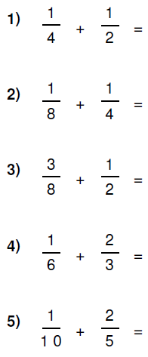
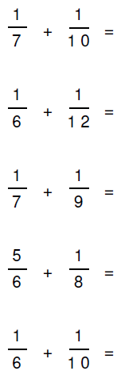
Your Turn
Green
Red
5
7

Slide 7




Mixed Numbers Adding

Slide 8
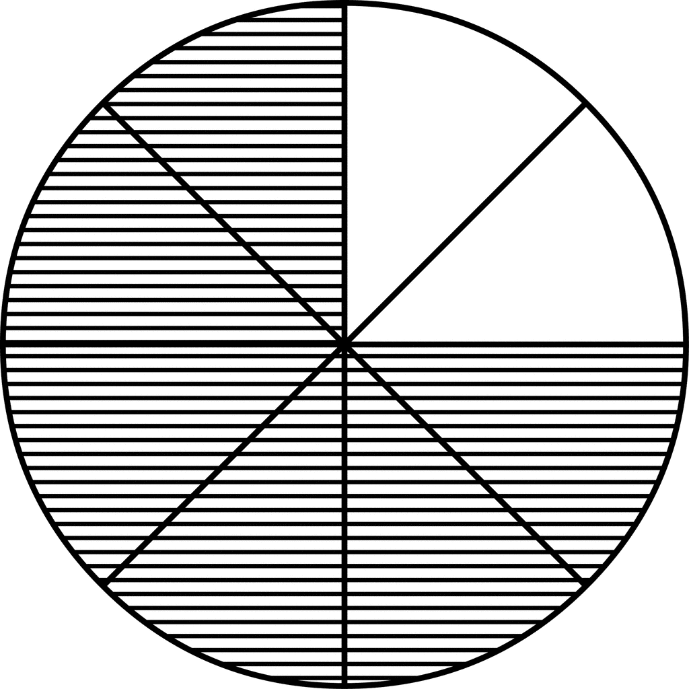
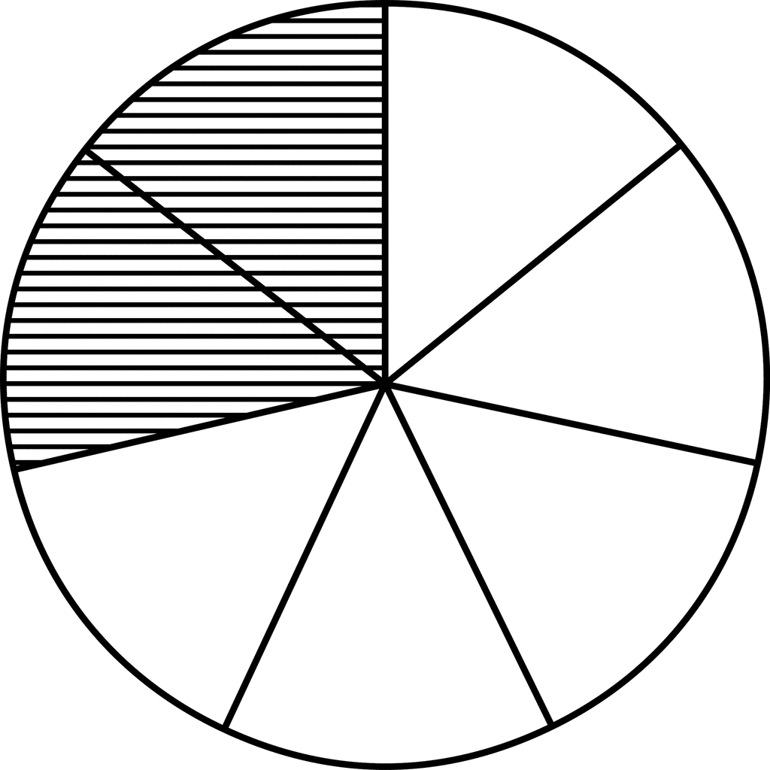
To finish
James and Brian order pizzas. James eats six eighths of his pizza and Brian only manages to eat two sevenths of his. If we put the left over pizza together, can we make one whole pizza?
James
Brian

