Slide 1
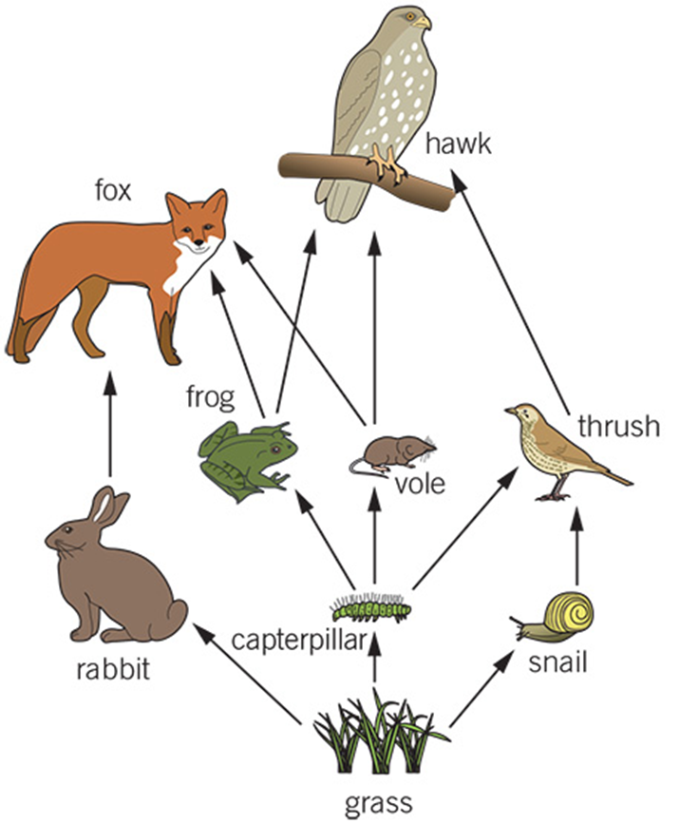
Title: Ecosystems
Starter: The caterpillar population has declined rapidly due to disease. How will this effect the food chain shown on the right?
Name another organism which may decrease in population
What organism may increase in number?
Sam predicts the snail population will also reduce as a consequence. Is she right? Explain why.
Design your own food chain considering animals you have seen out in the wild yourself.

Slide 2
Ecosystems
LO: To describe how different organisms co-exist within an ecosystem, and to explain the role of niches within ecosystems
Note that different organisms are needed in an ecosystem
Explain why different organisms within the same ecosystem have different niches
Use quadrats to take unbiased measurements in an ecosystem, describing trends observed in data
Analyse the effectiveness of the technique used

Slide 3
Ecosystems – definition
An ecosystem is the name given to plants and animals that are found in a particular location, and the area in which they live.
These plants and animals depend on one another in order to live

Slide 4
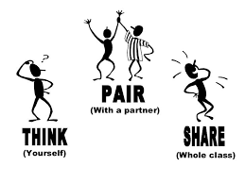
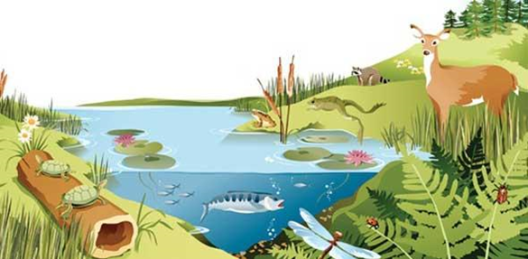
Ecosystems continued
The organisms in an ecosystem are known as the community
The area they live is called the habitat
How many animal types in this community?
What's the fishes habitat?

Slide 5
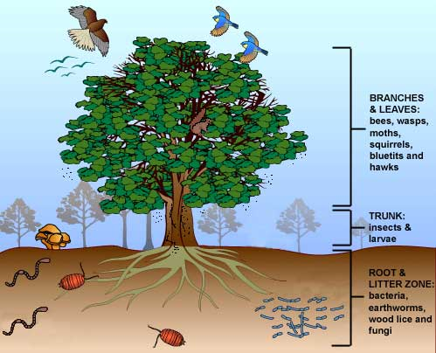
Coexistence in the ecosystem
The plants and animals within a community and a habitat co-exist – they live in the same place at the same time.
Oak tree example:
  Bees, wasps birds and other animals are found in the branches
  Insects and larvae are found in the trunk
  Root and litter zone contains bacteria, earthworms woodlice and fungi.

Slide 6
The niche
Each organism living on the oak tree has its own niche
A niche is a particular part or role an organism has within an ecosystem.
For example they might live in a particular part of the tree or have a particular food source
For example what is the habitat of the woodlouse within the oak tree? Are their any other organisms there?

Slide 7
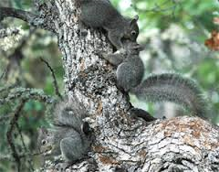
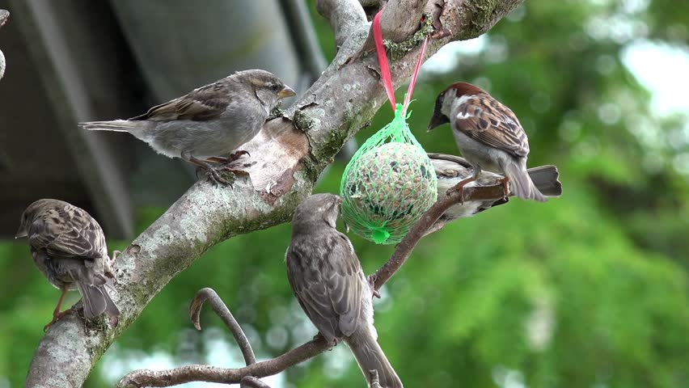
An example niche
Sparrows and squirrels both live in the tree canopy, but they do not compete for food
Squirrels feed on acorns, while sparrows feed on mostly larvae and caterpillars
The sparrows and squirrels have similar but slightly different niches.

Slide 8
Learning checkpoint – Questions 1 & 2
1.
Plants and animals found in a particular habitat
Ecosystem
Particular place or role that an organism has in an ecosystem
Community
Living organisms in a particular area, and the habitat they live in
Habitat
Niche
Place where a plant or animal lives
2.
Explain how bees and birds both live in the canopy of a tree?
3.
Describe how different niches occupied by three organisms in a habitat mean that organisms can co-exist

Slide 9
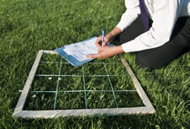
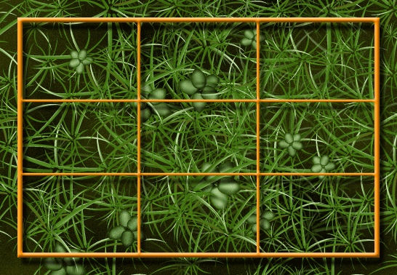
Investigating an ecosystem
It would be impossible to count all the plants in a habitat, so a sample is taken.
A tool called a quadrat is often used in sampling plants.
It marks off an exact area so that the plants in that area can be identified and counted.

Slide 10
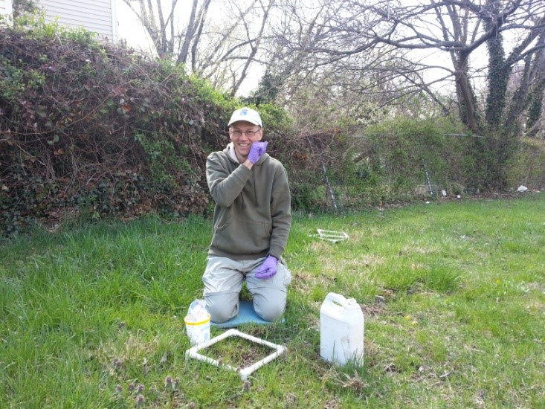
Investigating an ecosystem
A typical quadrat is 1 m × 1 m, or 1 m². Its area might be small compared to the area of a field
For example, there are 4 dandelion plants inside a 1 m² quadrat. The whole field is 50 m² in area , the estimated population size of dandelions in the field would be:
  4 × 50 = 200

Slide 11

Investigating an ecosystem
When using a quadrat:
  It should be placed randomly so that a representative sample is taken
  The validity and reproducibility of the results increases as the results from more quadrats are analysed

