Slide 1
Reflection, Translation and Rotation

Slide 2
Definitions
Flip (Reflection)
Slide (Translation)
Turn (Rotation)

Slide 3
Reflection
Is all about looking at it in a mirror.
If a shape can reflect itself perfectly then we call this a line of symmetry. In other words it’s the same shape folded in half and fitting perfectly.
You can be given a line to reflect a shape over.
Take a look at the following questions:

Slide 6
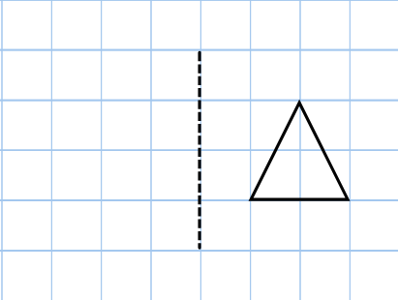
Reflection top tips!
The best thing to do for reflection is to count the number of squares from the line each corner (vertices) are and draw a dot.
All you have to do then is connect the dots on the other side of the line!
Try this one:

Slide 7
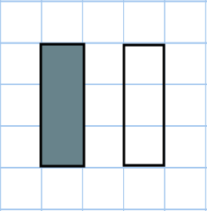
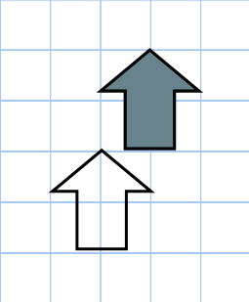
Translation
Translation is about sliding the shape.
How many squares has the shaded shape translated?

Slide 8
Translation
ALWAYS Say the across squares first and the up or down squares second!
Try the next question:
What could we do to make it easier?

Slide 9
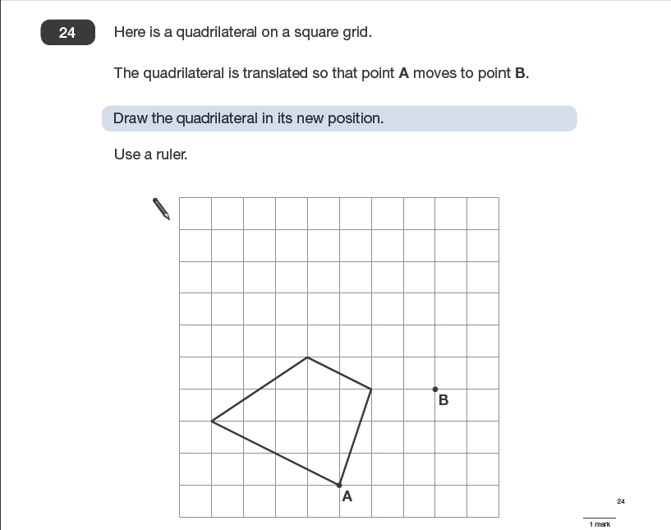

Slide 10
Rotational symmetry
What is this?
What is the rotational symmetry of each of these shapes?

Slide 11
Rotation
A shape can be rotated about a point either clockwise or anti-clockwise.

Slide 12
Question
Here is a shape:
Which shows it after it has been turned?

Slide 13
The diagram is turned. Draw the three missing shapes

