Slide 1
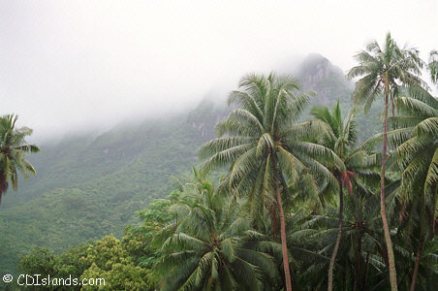
What is an ecosystem and where are they found?
To explain the location of different world biomes.
Starter
How do animals survive in this location? Think about where they sleep what they eat etc.
To explain what an ecosystem is and the different parts of it.
To be able to suggest reasons why ecosystems might change

Slide 2
So…what is an ecosystem?
What is an ecosystem?
An ecosystem is a community of living organisms (plants and animals) sharing an environment. The largest ecosystems are called biomes.
What is a biome?
A biome is a very large ecosystem e.g. Tropical Rainforest.
Copy the definitions down, and draw a picture to represent each one.

Slide 3
Match the term and definition
Key Term | Definition
Environment | A community of plants and animals unaffected by human activity.
The non-living environment | The natural or physical surroundings where plants and animals live.
The living environment | Rocks, soil, the air and climate.
A natural ecosystem | Animals, birds, fish, insects and people.

Slide 4
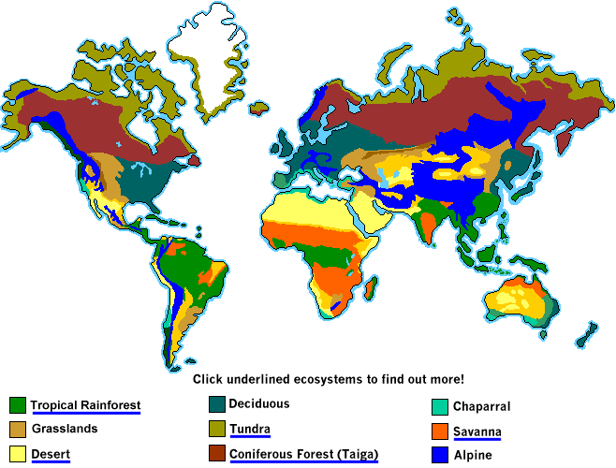
Biome – A world scale ecosystem. The rainforests are one biome, deserts are another.
Biosphere – The part of the Earth’s surface inhabited by living things.
Ecosystem – A unit made up of living things and their non living environment.

Slide 5
TASK
Using 5 colours shade the following biomes to the world map (next page): Tundra, Tropical Rainforest, Savanna Grasslands, Desert and Deciduous Forest.

Slide 6
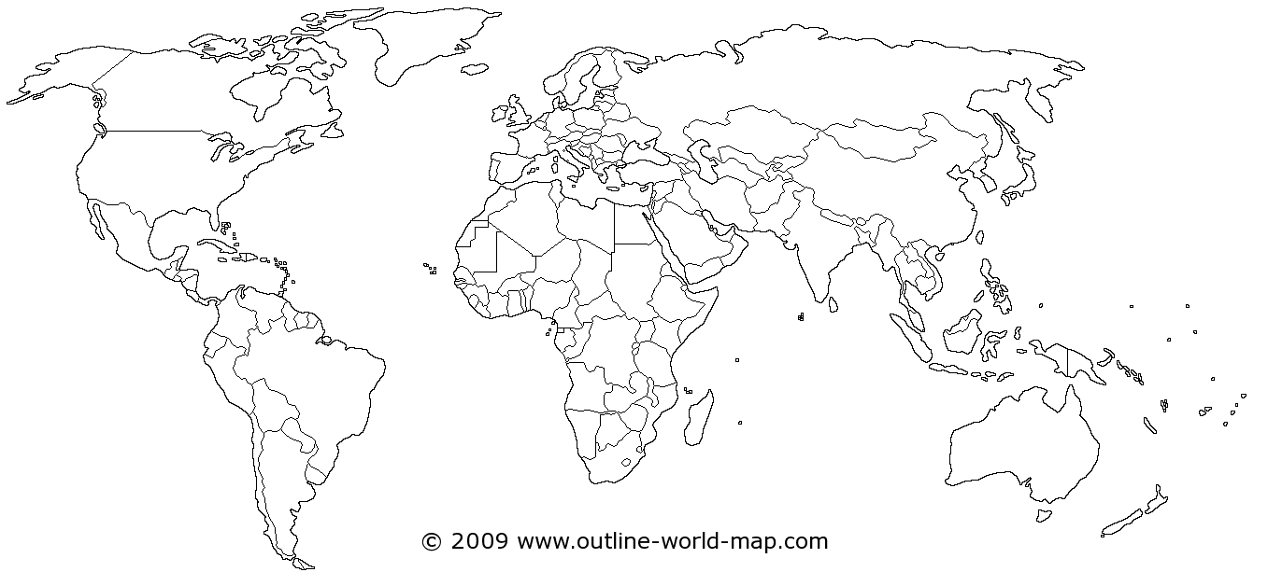
Mapping Biomes
Add the following: Equator, Tropic of Cancer, Tropic of Capricorn

