Slide 1


Statistics
Step 1: Read and Interpret Line Graphs
© Classroom Secrets Limited 2018

Slide 2
Introduction
What’s missing from this line graph?
© Classroom Secrets Limited 2018

Slide 3
Introduction
What’s missing from this line graph?
Label for the y axis – a dependent variable (what was measured)
Title: A Graph to Show...
5
4
3
2
1
0
Distance (km)
Scale – determine an appropriate scale that has equal gaps between numbers.
Label for the x axis – an independent variable (the thing that changes)
0 | 1 | 2 | 3 | 4 | 5
Time (minutes)
© Classroom Secrets Limited 2018

Slide 4
Varied Fluency 1
Which of the following could you show on a line graph?
A. Rainfall in two cities over a period of time.
B. Your classmates’ favourite sports.
C. How long it takes 2 children to run the same distance.
© Classroom Secrets Limited 2018

Slide 5
Varied Fluency 1
Which of the following could you show on a line graph?
A. Rainfall in two cities over a period of time.
B. Your classmates’ favourite sports.
C. How long it takes 2 children to run the same distance.
© Classroom Secrets Limited 2018

Slide 6
Varied Fluency 2
True or false?
On the weekend, more ice creams are sold at the park than the shopping centre.
© Classroom Secrets Limited 2018

Slide 7
Varied Fluency 2
True or false?
On the weekend, more ice creams are sold at the park than the shopping centre.
True
© Classroom Secrets Limited 2018

Slide 8
Varied Fluency 3
According to the graph, which statements are correct?
A. Both travelled the same distance because the lines both end at 3pm.
B. The cyclist travelled about 4 times further than the person walking by 3pm.
© Classroom Secrets Limited 2018

Slide 9
Varied Fluency 3
According to the graph, which statements are correct?
A. Both travelled the same distance because the lines both end at 3pm.
B. The cyclist travelled about 4 times further than the person walking by 3pm.
B is correct.
A has mixed up
what information is shown by each axis
on the graph.
© Classroom Secrets Limited 2018

Slide 10
Reasoning 1
Michaela is recording the amount of juice in 2 cartons throughout the week.
Which graph most likely shows her data?
Explain how you know.
A
B
© Classroom Secrets Limited 2018

Slide 11
Reasoning 1
Michaela is recording the amount of juice in 2 cartons throughout the week.
Which graph most likely shows her data?
Explain how you know.
B most likely shows her data because...
A
B
© Classroom Secrets Limited 2018

Slide 12
Reasoning 1
Michaela is recording the amount of juice in 2 cartons throughout the week.
Which graph most likely shows her data?
Explain how you know.
B most likely shows her data because it shows the amount in each carton decreasing over time as the contents are drunk.
A
B
© Classroom Secrets Limited 2018

Slide 13
Reasoning 2
Noel and Mei are interpreting this graph.
Noel says, “The flowers are exactly the same height in September.”
Mei says, “The flowers were the same height in June, but then Flower 2 grew slightly taller than Flower 1.”
Who is correct? Explain.
© Classroom Secrets Limited 2018

Slide 14
Reasoning 2
Noel and Mei are interpreting this graph.
Noel says, “The flowers are exactly the same height in September.”
Mei says, “The flowers were the same height in June, but then Flower 2 grew slightly taller than Flower 1.”
Who is correct? Explain.
Mei is correct because...
© Classroom Secrets Limited 2018

Slide 15
Reasoning 2
Noel and Mei are interpreting this graph.
Noel says, “The flowers are exactly the same height in September.”
Mei says, “The flowers were the same height in June, but then Flower 2 grew slightly taller than Flower 1.”
Who is correct? Explain.
Mei is correct because in June, both flowers are 4ft in height and in July, Flower 2 is about 1ft taller than Flower 1.
© Classroom Secrets Limited 2018

Slide 16
Problem Solving 1
Henri and Georgia are choosing a site to go camping.
Which site is the warmest throughout the night?
They each need extra warm socks for any temperatures under 6˚C, and a hot water bottle each for any temperatures under 4˚C. What extra supplies will they need for each site?
© Classroom Secrets Limited 2018

Slide 17
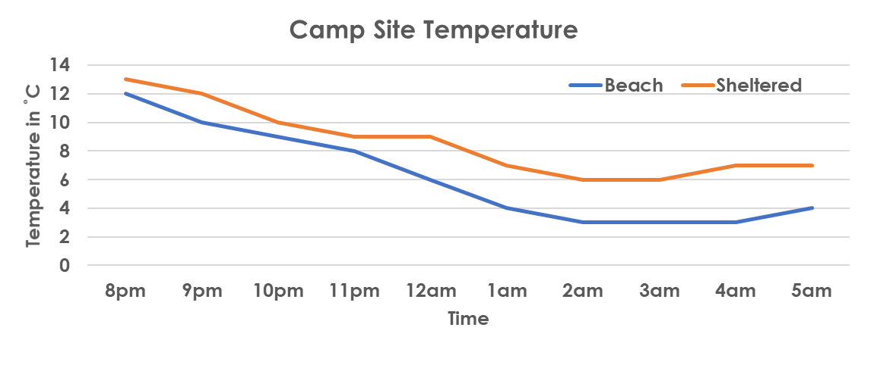
Problem Solving 1
Henri and Georgia are choosing a site to go camping.
Which site is the warmest throughout the night?
The sheltered site is warmer throughout the night.
They each need extra warm socks for any temperatures under 6˚C, and a hot water bottle each for any temperatures under 4˚C. What extra supplies will they need for each site?
On the beach, they will each need one pair of socks and one hot water bottle. On the sheltered campsite, they won’t need any extra supplies
© Classroom Secrets Limited 2018

