Slide 1


History
Ancient Egypt
Year One
History | UKS2 | Ancient Egypt | Who Were the Ancient Egyptians? | Lesson 1

Slide 2
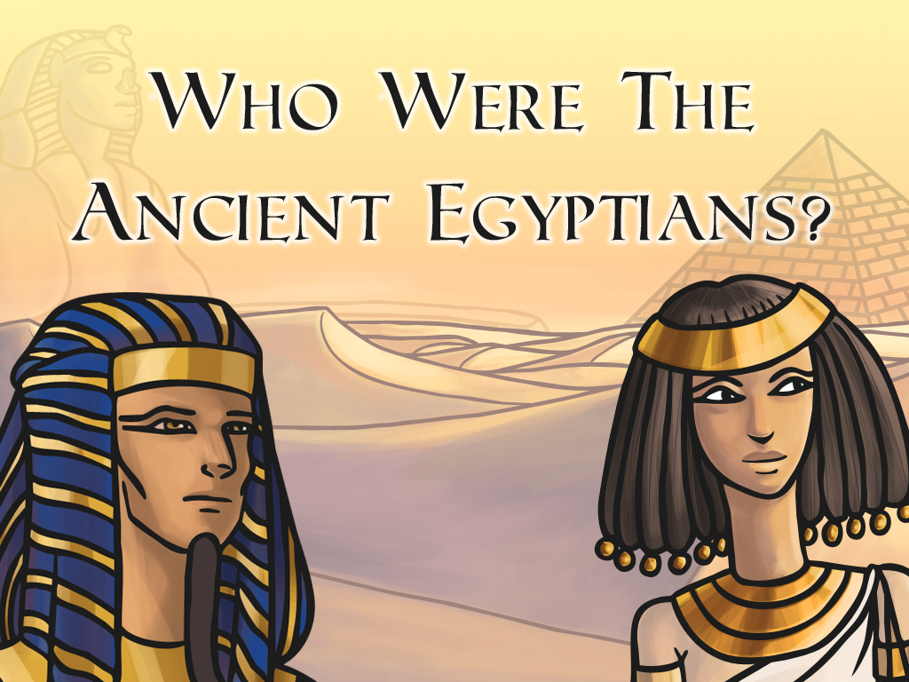


Slide 3
Aim
I can find out about Egyptian life by looking at artefacts.
Success Criteria
I can point out where Egypt is on a map.
I can describe when the ancient Egyptians lived.
I can raise at least two questions about an artefact.
I can decide what an artefact might have been used as.

Slide 4
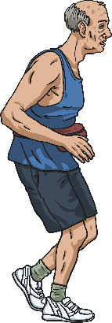

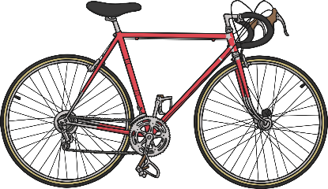


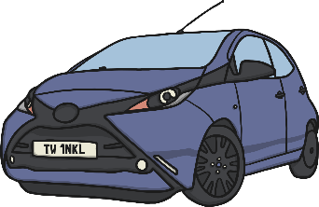
The Ancient Egyptians
Ancient means that something existed a long time ago in the past, or that it is really old.
Sort these items into ‘ancient’ and ‘modern.

Slide 5



The Ancient Egyptians
1560: The Bernacottis invent a wooden encased pencil.
1672: Verbiest’s steam powered trolley, known as the first ‘car’.
The Bible was written from 1400 BC to AD 90.
1926: John Logie Baird’s television.
1839: Kirkpatrick Macmillan’s pedal bicycle.
Modern: an 80 year old man.

Slide 6

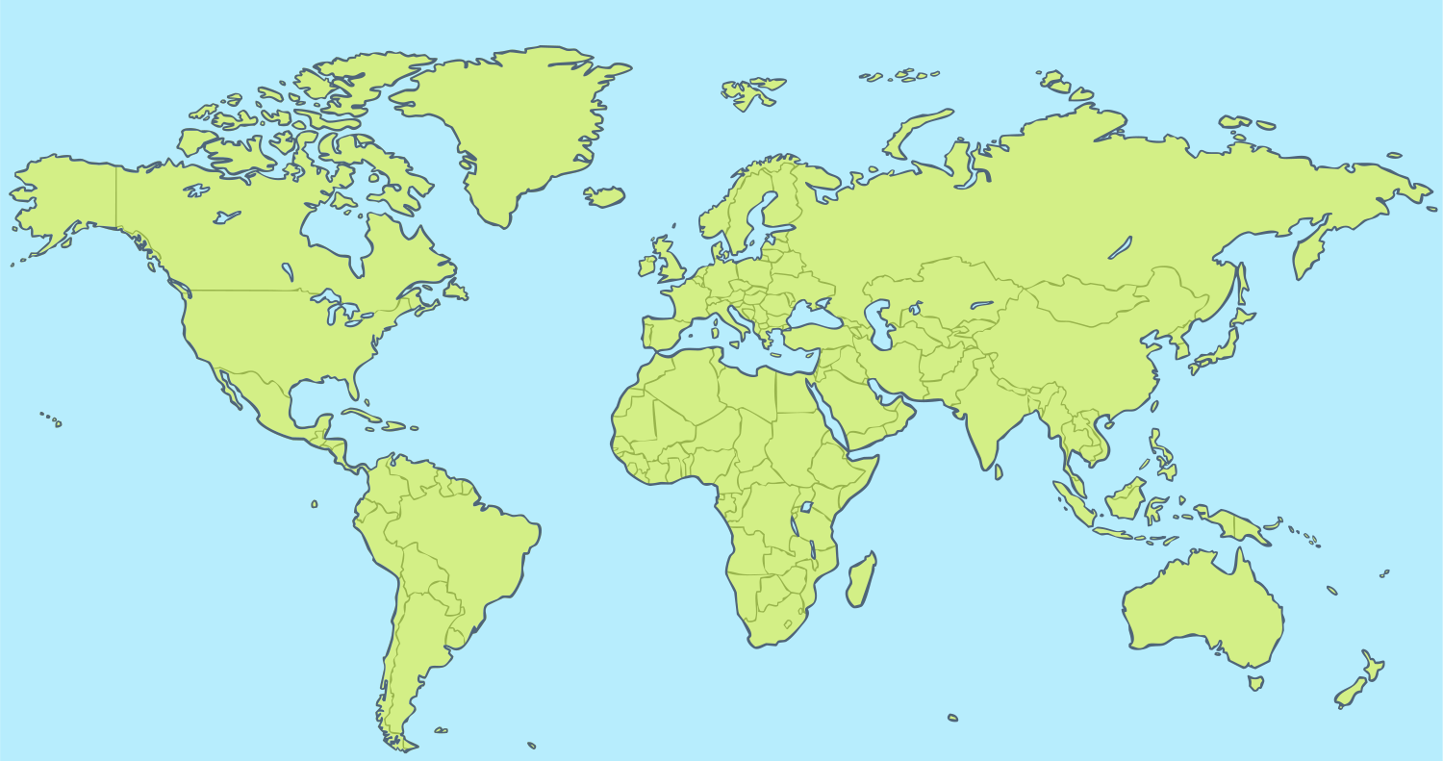
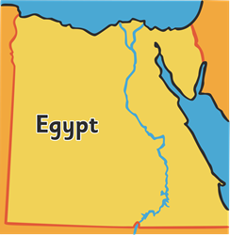
Ancient Egypt:
Where and When?
Can you find Egypt on the map?

Slide 7
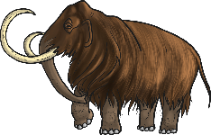
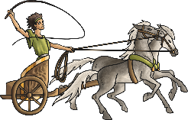

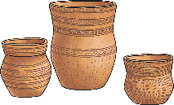
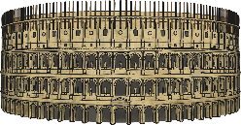
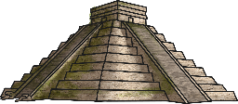
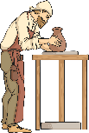
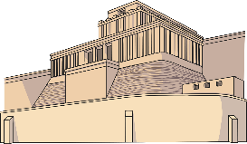
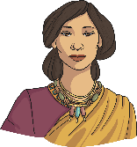



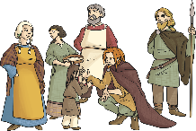

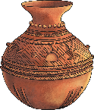
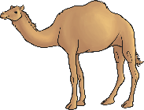

Ancient Egypt:
Where and When?
In 3100 BC, King Menes united two Egyptian kingdoms and built an empire that lasted until 30 BC, when the Romans took over by force.
What other periods of history do you know of that were before, during or after this time?
Stone Age
Bronze Age
(2800 BC)
Ancient Greece
(800 BC)
Roman Empire
(58 BC)
Maya
(250 AD)
Anglo-Saxons
(AD 410)
Ancient Egypt
3100 BC
30 BC
Ancient Sumer
(3100 BC)
Indus Valley
(2500 BC)
Shang Dynasty
(1650 BC)
Iron Age
(700 BC)
Benin
(AD 110)
Islamic Empire
(AD 610)

Slide 8
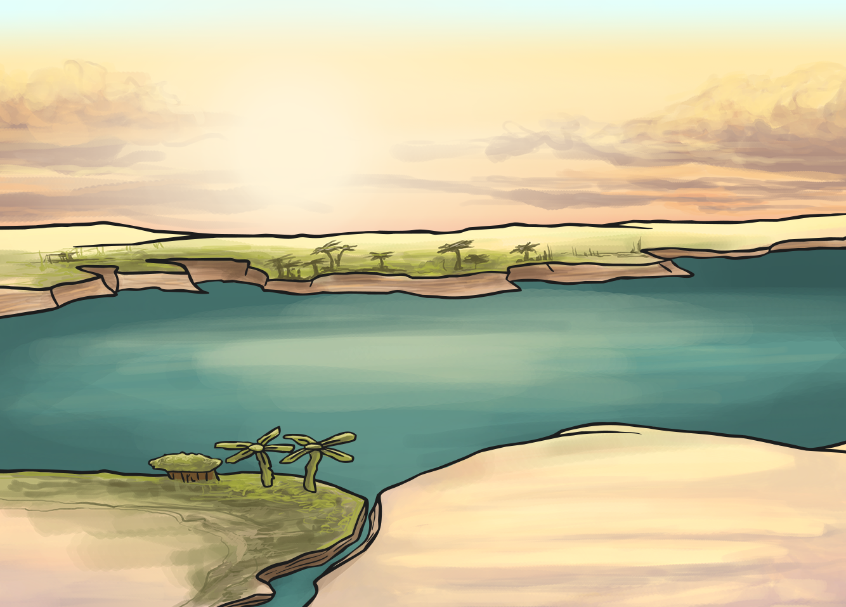
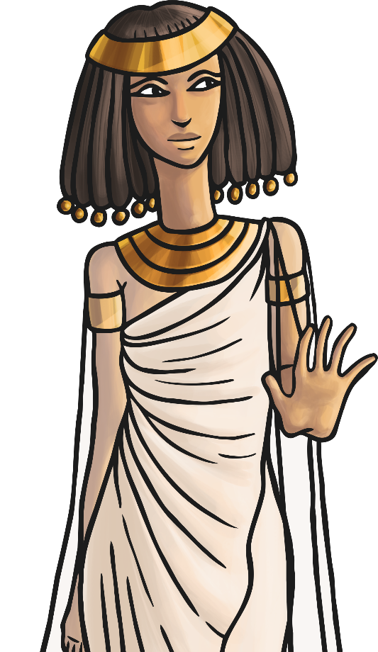
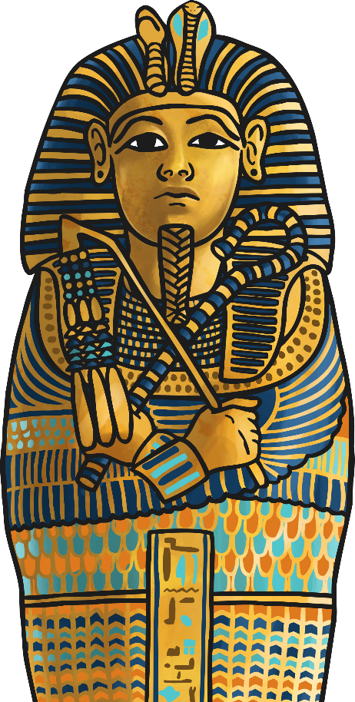

Who Were the
Ancient Egyptians?
Click the play button below to find out more about this ancient civilisation.

Slide 9
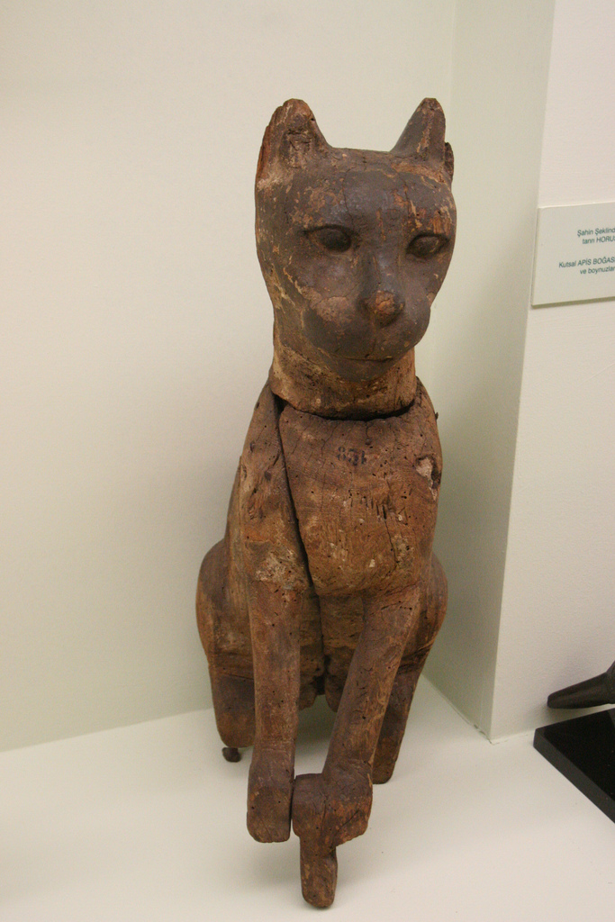
Ancient Egyptian Life
Life in ancient Egypt depended on a person’s wealth (money) and education.
We find out information about ancient Egyptian people from the objects that they left behind.
On your whiteboards, answer these questions:
What can we learn about the ancient Egyptians from this artefact?
What questions could we ask?
Photo courtesy of firepile(@flickr.com) - granted under creative commons licence attribution

Slide 10
Ancient Egyptian Life
What can we learn about the ancient Egyptians from this artefact?
What questions could we ask?
What is it?
What do you think it was used for?
Where do you think it may have been found?
Who might it have belonged to?
What might it be made from?
What does it tell us about ancient Egypt?
Photo courtesy of firepile(@flickr.com) - granted under creative commons licence attribution

Slide 11
Ancient Egyptian Life
What is it?
It is a statue of a cat.
What do you think it was used for?
It might have been made to look like a real cat that someone had as a pet.
Where do you think it may have been found?
It might have been found in a pyramid.
Who might it have belonged to?
It probably belonged to someone rich because it’s not something you would need in your daily life, so it was a luxury.
What might it be made from?
It looks like it might be made from wood.
What does it tell us about ancient Egypt?
I think it tells us that cats were important to the ancient Egyptians because they wouldn’t have made statues of them otherwise.
Photo courtesy of firepile(@flickr.com) - granted under creative commons licence attribution

Slide 12
Ancient Egyptian Life
What else would you like to know about this object?
Photo courtesy of firepile(@flickr.com) - granted under creative commons licence attribution

Slide 13
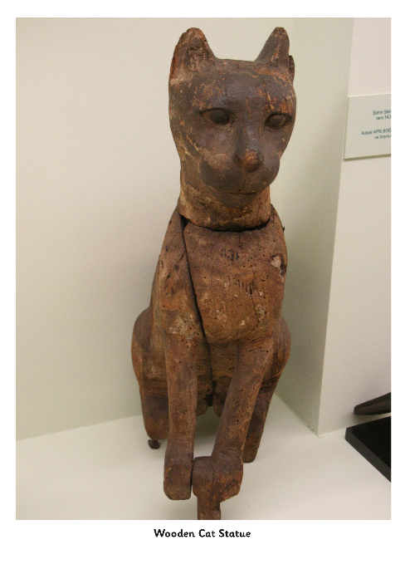
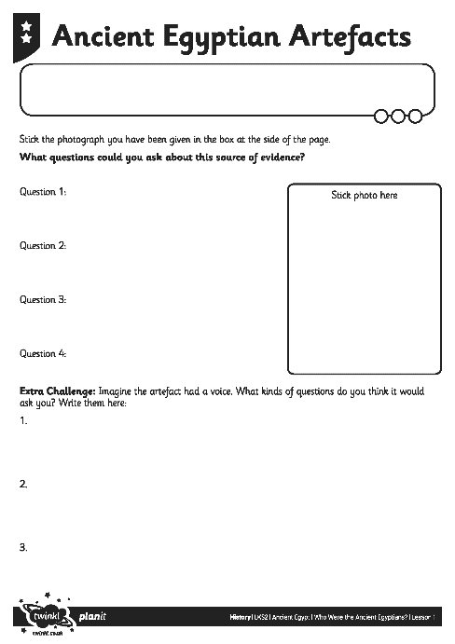
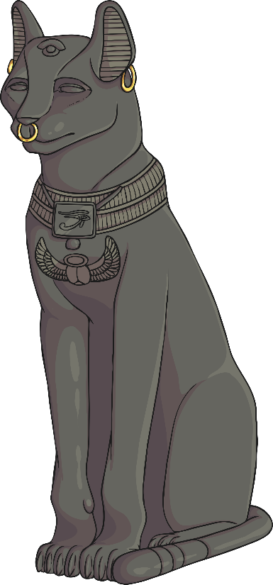
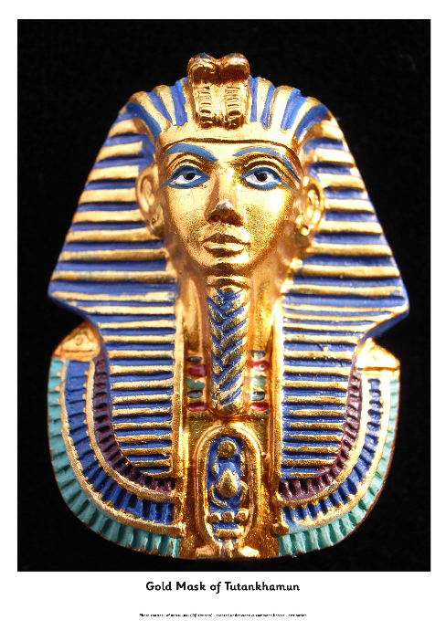
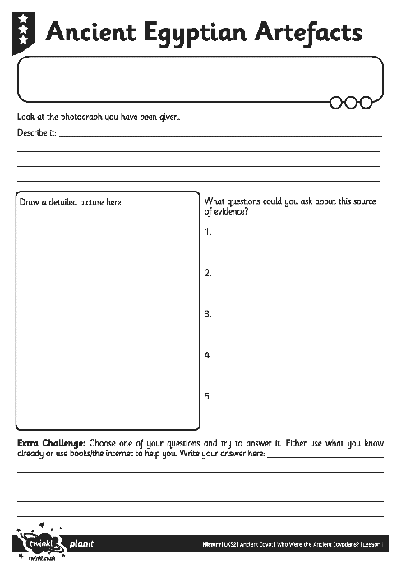
Ancient Egyptian Artefacts Activity
Look at the photograph you have been given.
Follow the instructions on your Egyptian Artefacts Activity Sheet.
Make sure you have a go at the extra challenge if you have one.

