Slide 1


Science
Scientists and Inventors
Year One
Science | Year 4 | Scientists and Inventors | Discovering Oxygen | Lesson 5

Slide 3
Aim
I can describe the properties of oxygen gas.
I can explain how oxygen was discovered.
Success Criteria
I can describe the scientists who discovered oxygen.
I can explain how the discovery of oxygen changed scientific ideas.
I can conduct an experiment to demonstrate oxygen’s properties.

Slide 4

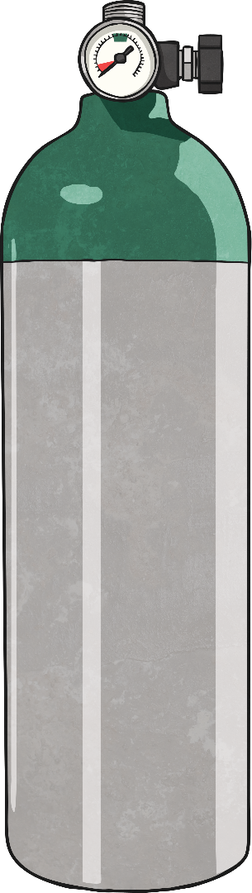

Oxygen
What is oxygen? What is it useful for?
Oxygen is a gas at room temperature. It is the third most common element and is needed by most forms of life on Earth. Animals and plants take in oxygen for respiration. Oxygen makes up around 21% of the air around us.

Slide 5
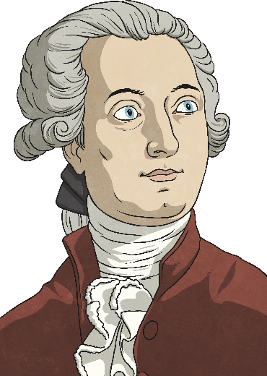
Who Discovered Oxygen?
Two scientists were mainly responsible for the discovery of oxygen:
Antoine Lavoisier and Joseph Priestley.
Antoine Lavoisier 1743-1794
Antoine Lavoisier was born into a wealthy French family. His father was a lawyer and Lavoisier inherited a large fortune at the age of five when his mother died. He was very interested in science at school and although he received a law degree, he never became a lawyer. Instead, he worked in various government jobs and was elected to the Royal Academy of Science in 1764. In 1775, he set up a laboratory in Paris where he could conduct experiments. It was in this lab that Lavoisier made many of his important discoveries to do with chemistry.

Slide 6
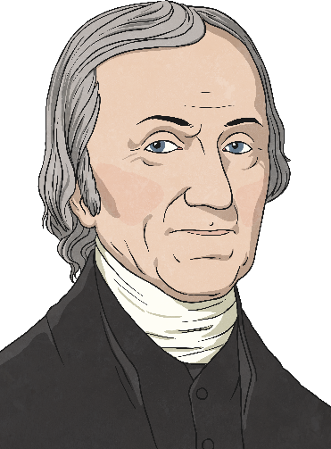
Who Discovered Oxygen?
Two scientists were mainly responsible for the discovery of oxygen:
Antoine Lavoisier and Joseph Priestley.
Joseph Priestley 1733-1804
Joseph Priestley was an English chemist and theologian (someone who studies God and religion). He was born in Yorkshire and was the eldest of six children. From the age of one, he lived with his grandfather and then his aunt and uncle. He attended the best local schools. In 1755, he became a religious minister in Suffolk. He became interested in the sciences and conducted experiments while he was working as a minister. Between 1767 and 1770, he presented five papers to the Royal Society explaining his experiments. In the 1770s, he began his experiments into what he called 'different airs' and this is when he made most of his discoveries.

Slide 7

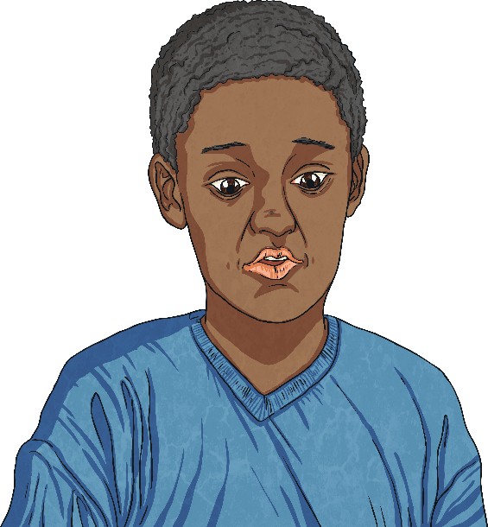
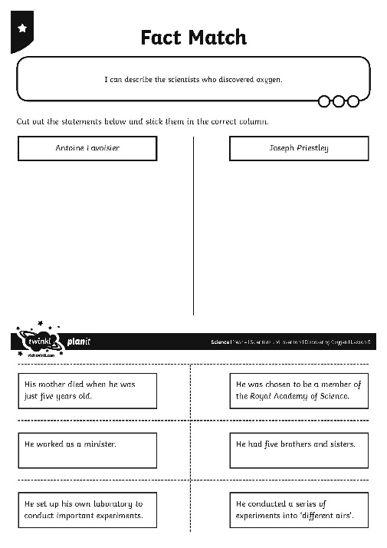
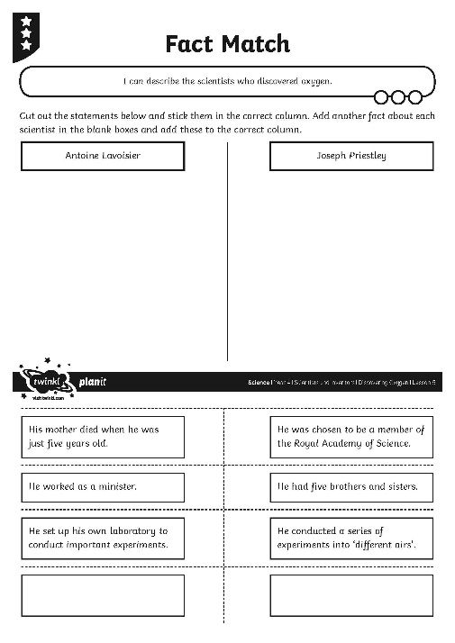
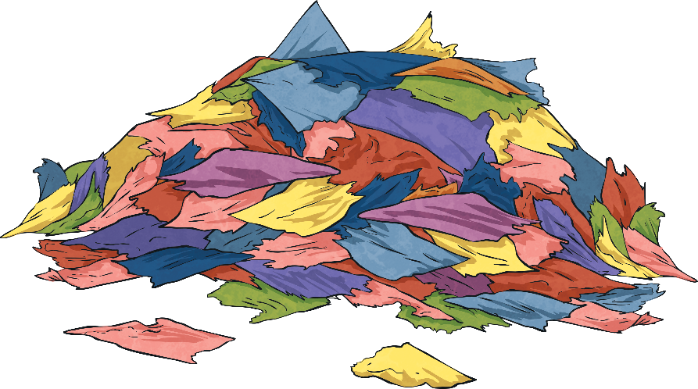
Fact Match
Sort the statements on your Fact Match Activity Sheet according to whether they are about Joseph Priestley or Antoine Lavoisier.

Slide 8
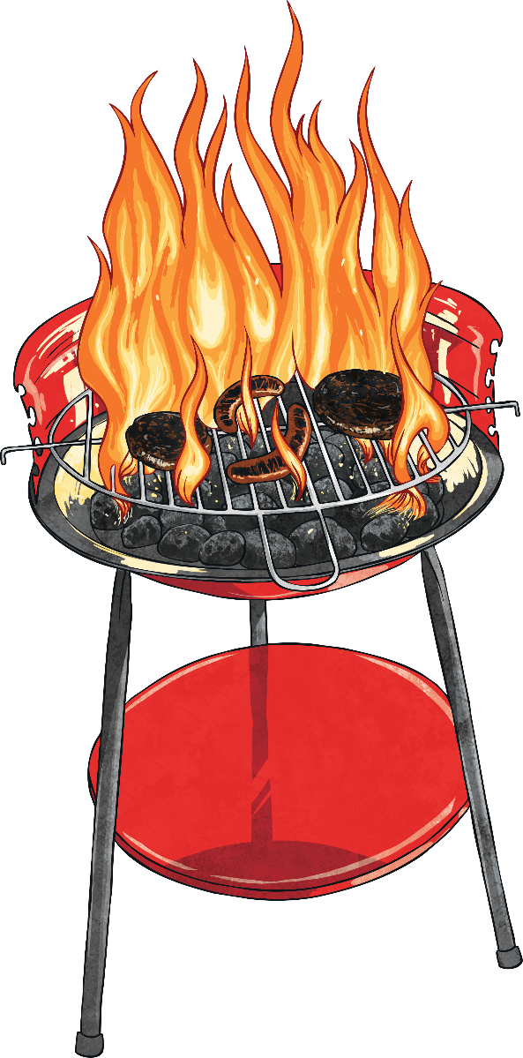
Phlogiston Theory
In the 1700s, scientists believed in a theory called the 'phlogiston theory'. They thought that flammable objects contained a substance called phlogiston that caused the objects to burn. The theory also stated that when objects burned, the phlogiston inside them left the object, so the object should become lighter.
However, experiments showed that actually, some objects gain mass when they burn, becoming slightly heavier. Phlogiston theory could not explain this.
It was not until Antoine Lavoisier's work that the problems of phlogiston theory were solved.

Slide 9
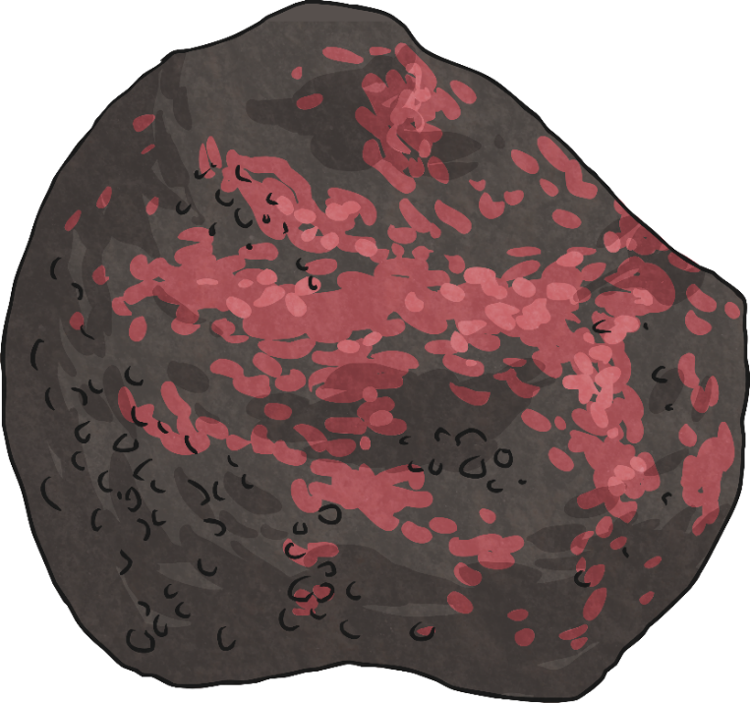
Discovering Oxygen
In 1774, Joseph Priestley conducted his most famous experiment. He used a large glass lens to focus a ray of sunlight onto a piece of mercury calx (we now know this as mercury oxide) in a glass container.
The mercury calx emitted a gas that was captured in the glass jar. When tested, this gas caused a flame to burn intensely. Priestley breathed some of this gas in, and reported that it made his chest feel 'light and easy’.
He called the gas he discovered 'dephlogisticated air'.
Mercury calx, or oxide, looks like a red rock.

Slide 10
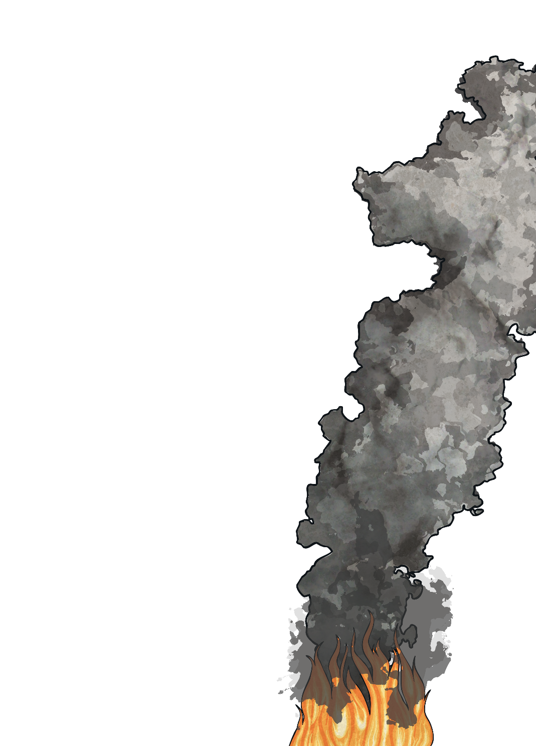
Discovering Oxygen
Priestley met Lavoisier on a trip to France. He told Lavoisier about his experiments and the gas he had discovered.
Lavoisier used this information as the basis for his own experiments and ideas. His work would finally disprove the phlogiston theory.
He found that when objects burn, they do not lose phlogiston, they actually combine with the gas that Priestley had discovered. Lavoisier realised that phlogiston simply did not exist!
He called the gas oxygen.
Priestley's and Lavoisier's work changed scientific ideas forever.

Slide 11

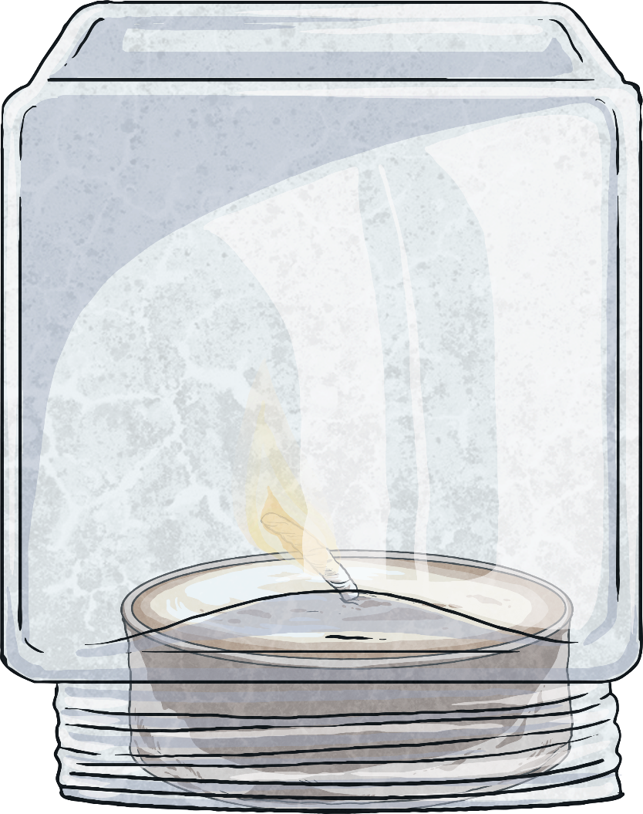
Oxygen and Burning
We now know that oxygen combines with a fuel to burn. Objects cannot burn without oxygen.
You will conduct a mini investigation similar to Priestley's experiment to prove that objects need oxygen to burn.
Watch your teacher light a candle and place a glass over it.
What do you think will happen?

Slide 12
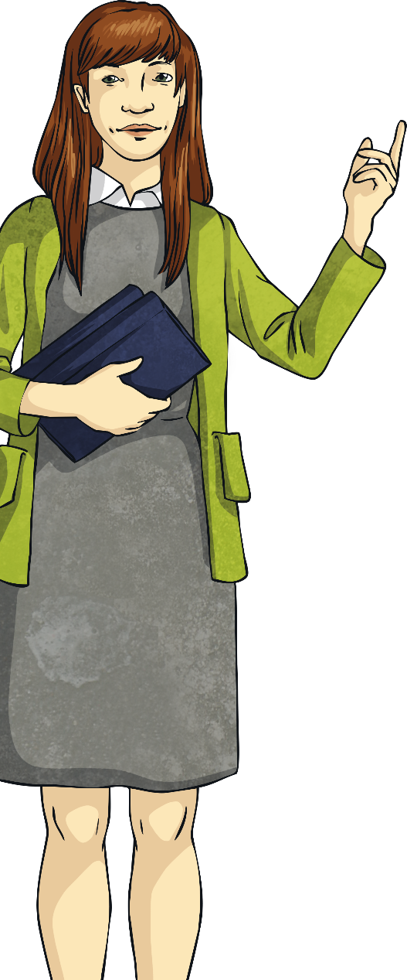
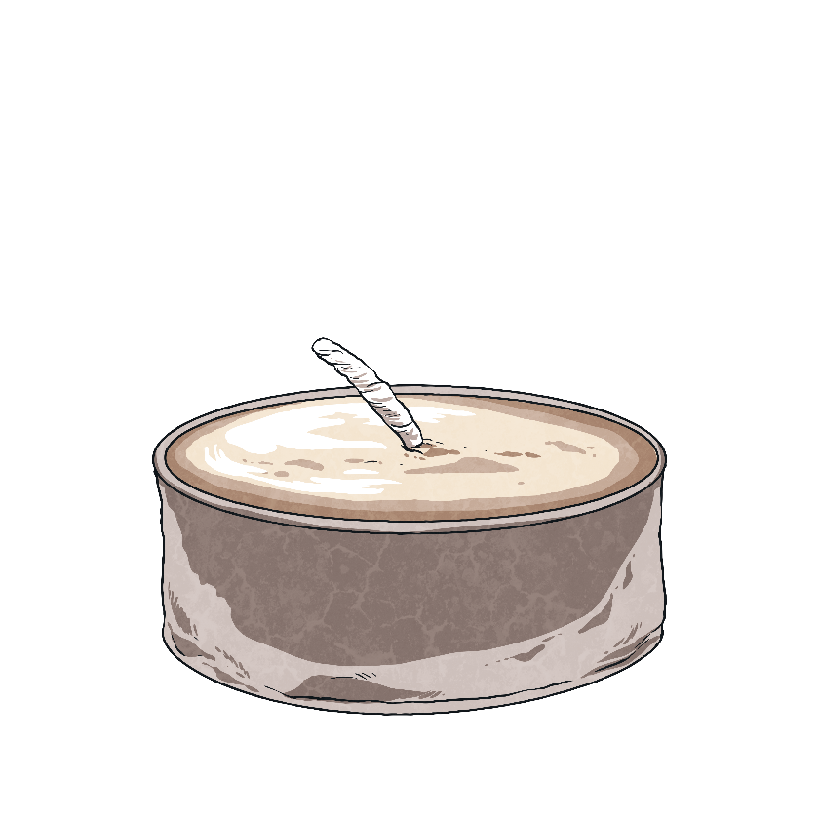
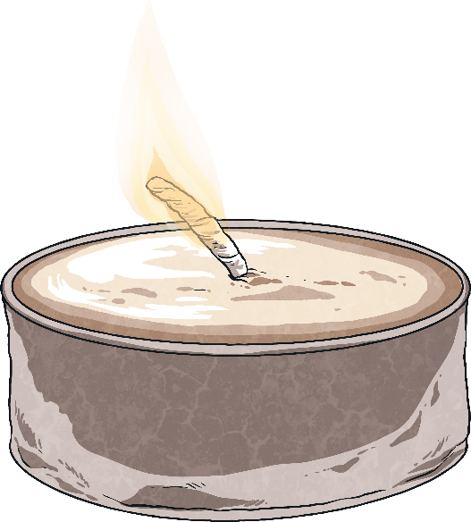
Oxygen and Burning
The candle went out!
Can you explain why this happened?
The candle cannot burn without oxygen. When the glass covers it, the candle uses all the oxygen in the glass until it is all used up and the candle goes out.
Watch your teacher again. This time, use your stopwatch to time how long it takes for the candle go out.

Slide 13
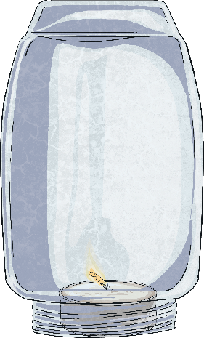

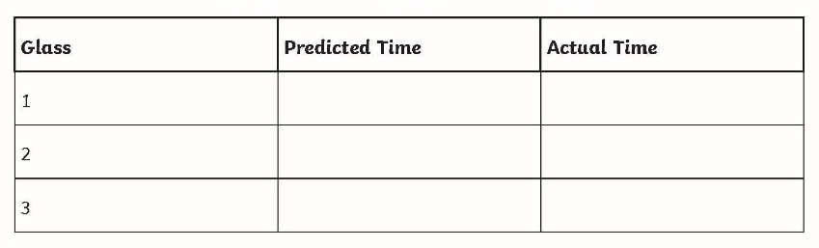
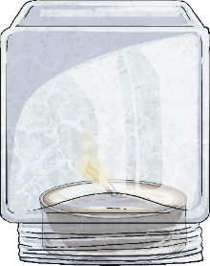
Oxygen and Burning
Your teacher will have three glasses or jars of different sizes, numbered from 1 to 3. How long do you think it will take a candle to go out when covered by each glass?
Complete the table on your Oxygen and Burning Activity Sheet with your prediction for each glass.
Now, watch your teacher try it out!
Complete your table with the actual times.

Slide 14

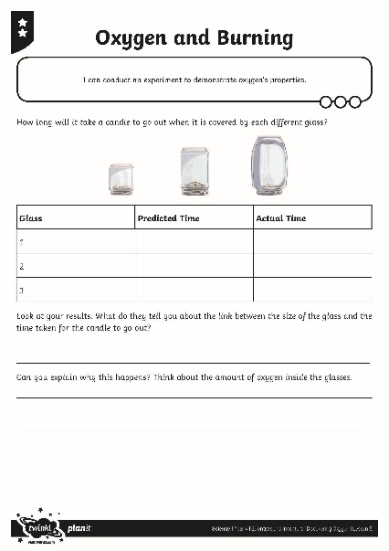
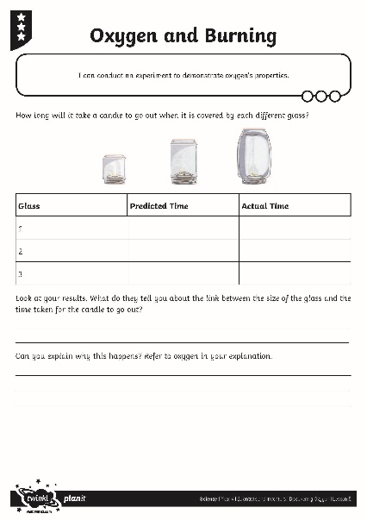
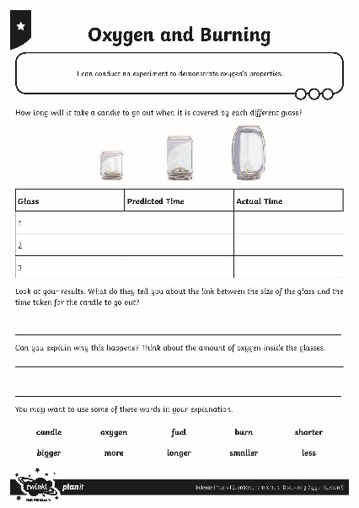
Oxygen and Burning
Did you discover that the smallest glass or jar made the candle go out more quickly and that the largest glass or jar made the candle go
out slowest?
Explain why you think this happened on your Activity Sheet.

Slide 15
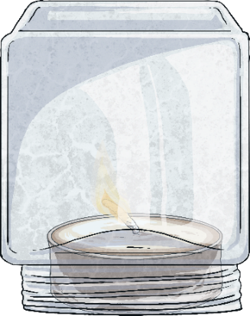
New Predictions
When scientists like Lavoisier or Priestley complete an experiment, they look at their results and make new predictions based on what they have found out.
Look at your results.
How long do you predict the candles under these glasses will take to go out? Remember, the more oxygen a flame has, the longer the flame will last. The less oxygen a flame has, the shorter
the time the flame will last for.

Slide 16
Aim
I can describe the properties of oxygen gas.
I can explain how oxygen was discovered.
Success Criteria
I can describe the scientists who discovered oxygen.
I can explain how the discovery of oxygen changed scientific ideas.
I can conduct an experiment to demonstrate oxygen’s properties.

