Slide 1
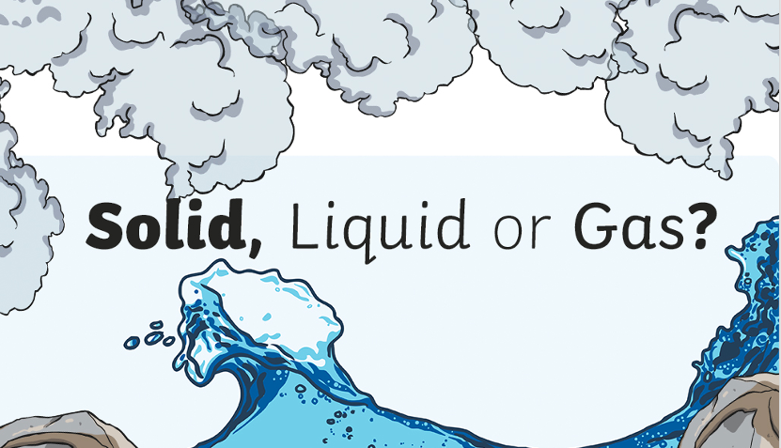

Slide 2
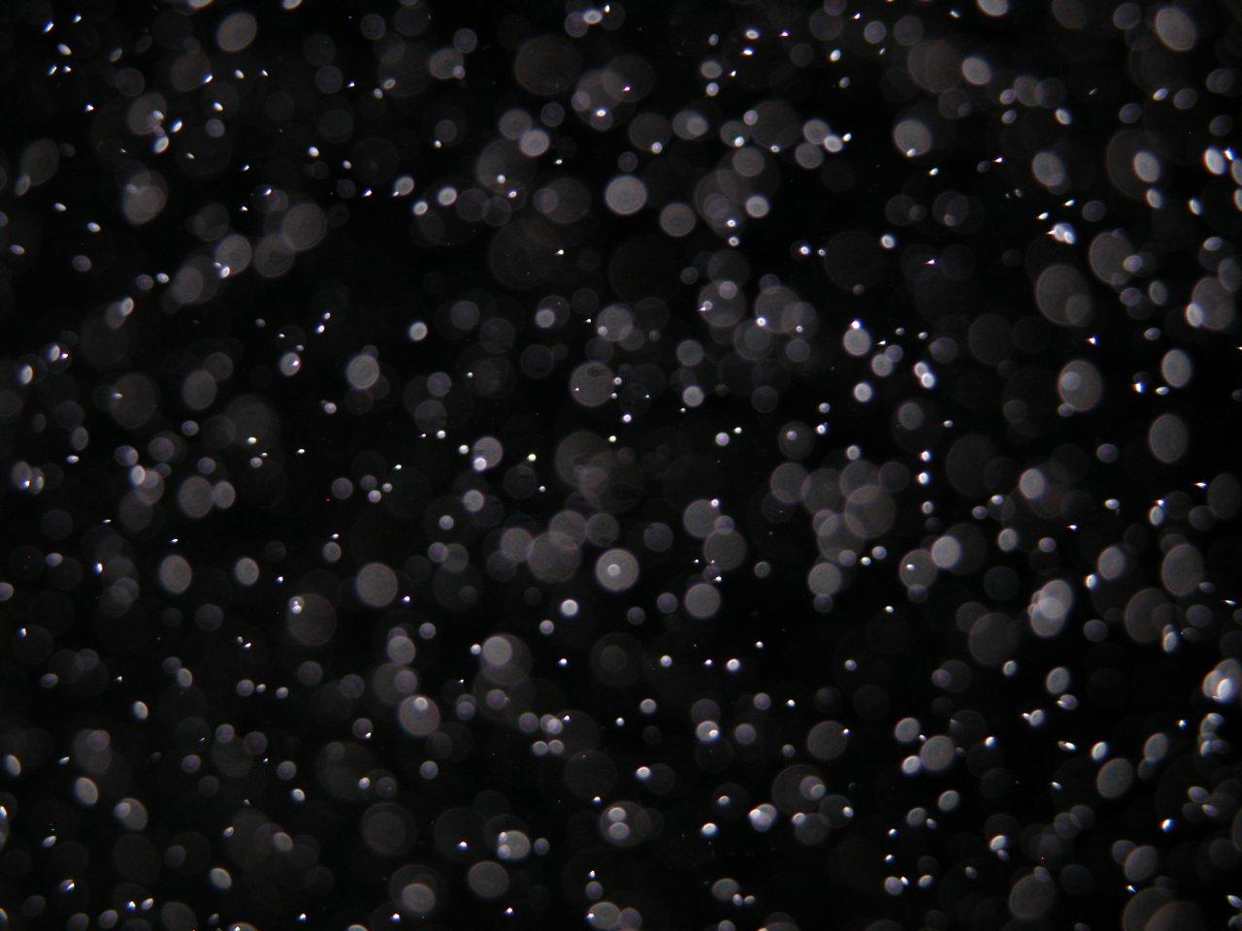
Everything on Earth is made up of tiny particles, too small to be seen.

Slide 3
All matter on Earth is in the form of Solid, Liquid or Gas.

Slide 4
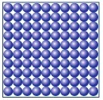
Solid
The particles are very close to each other and vibrate in position but they don’t move past one another.

Slide 5
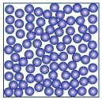
Liquid
The particles are close together and but are always moving. They can slide past one another.

Slide 6
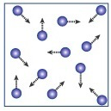
Gas
The particles are very far apart and are constantly moving. They don’t interact with each other but just hit and bounce off one another when they collide.

Slide 7
Watch the animation to show you.
https://www.acs.org/content/acs/en/education/resources/k-8/inquiryinaction/fifth-grade/particles-solid-liquid-gas-diving.html

Slide 8
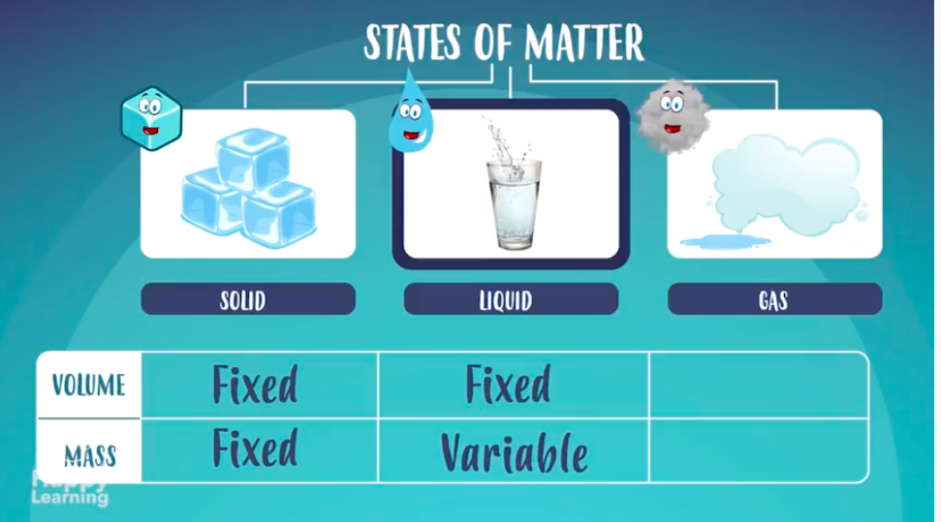
Let’s find out a bit more about states of matter.
Watch the YouTube video up to 1 minute 58 seconds. Don’t continue to watch when they begin to talk about changes of matter.
https://www.youtube.com/watch?v=DE3LCPfP8N8

Slide 9
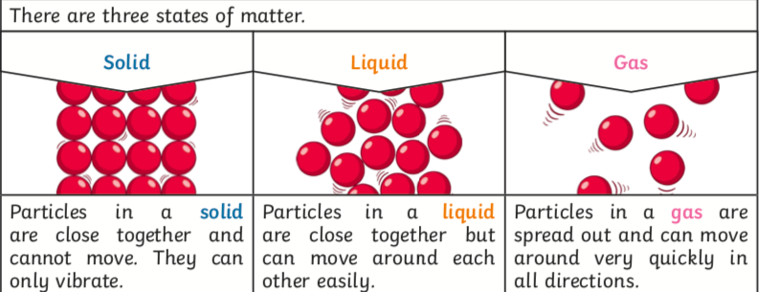

Slide 10


