Slide 2
LO: To learn about rules and behaving responsibly

Slide 3
Watch the video using the link below or by playing the video file:
https://plprimarystars.com/resources/do-the-right-thing/film-behaviour

Slide 4
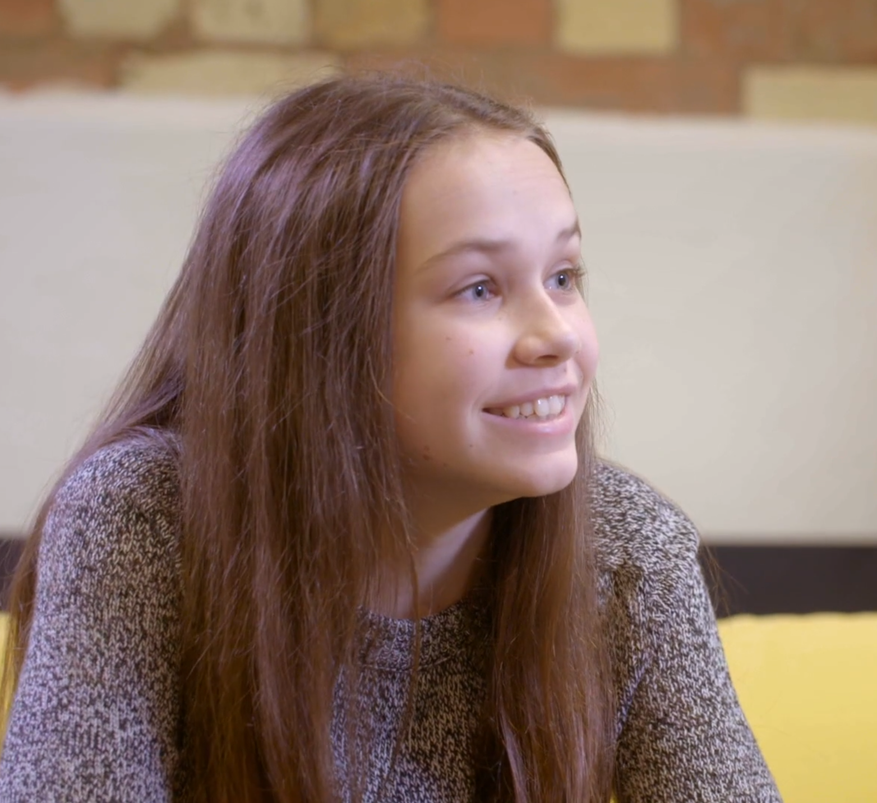

Rules help keep us safe…
What rule do you think Farrah
had broken?
Why is that an important rule?
What impact did her behaviour
have on herself and her parents?
Do you feel her consequence
was fair?

Slide 5

Activity 1:
Choose one of the rules.
Fill in your rule card according to what your school’s rules are.
Then write a list of what might happen if you broke the rules.

Slide 6
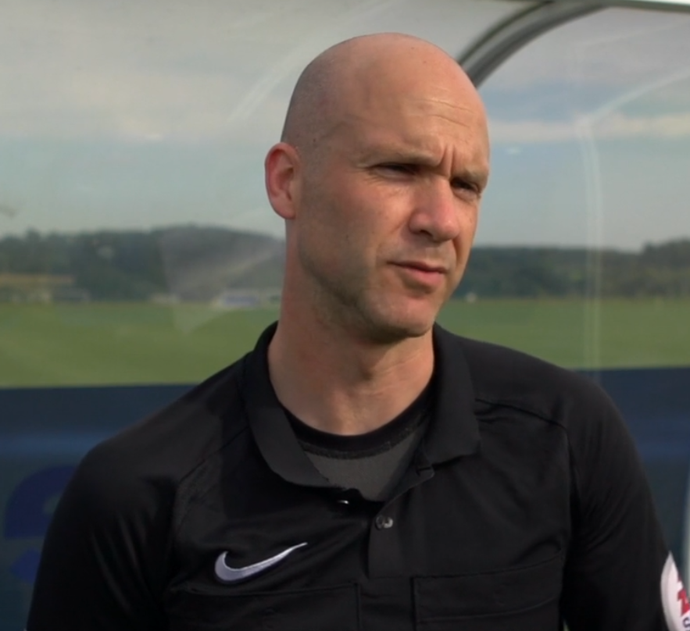
Supporting responsible behaviour…
What strategies did the match officials say helped them to
manage difficult situations?

Slide 7
Activity 2:
Read the scenarios…
What might the people in the scenario be feeling?
What would responsible behaviour look like in this scenario?
Make a suggestion about how the pupils involved could manage their feelings and behaviour.

