Slide 1
ASH CLASS
Home Learning – Maths – Statistics
Learning Objectives:
To be able to interpret and present data using bar charts, pictograms and tables.
To be able to solve one-step and two-step questions [for example, ‘How many more?’ and ‘How many fewer?’] using information presented in scaled bar charts and pictograms and tables.

Slide 2
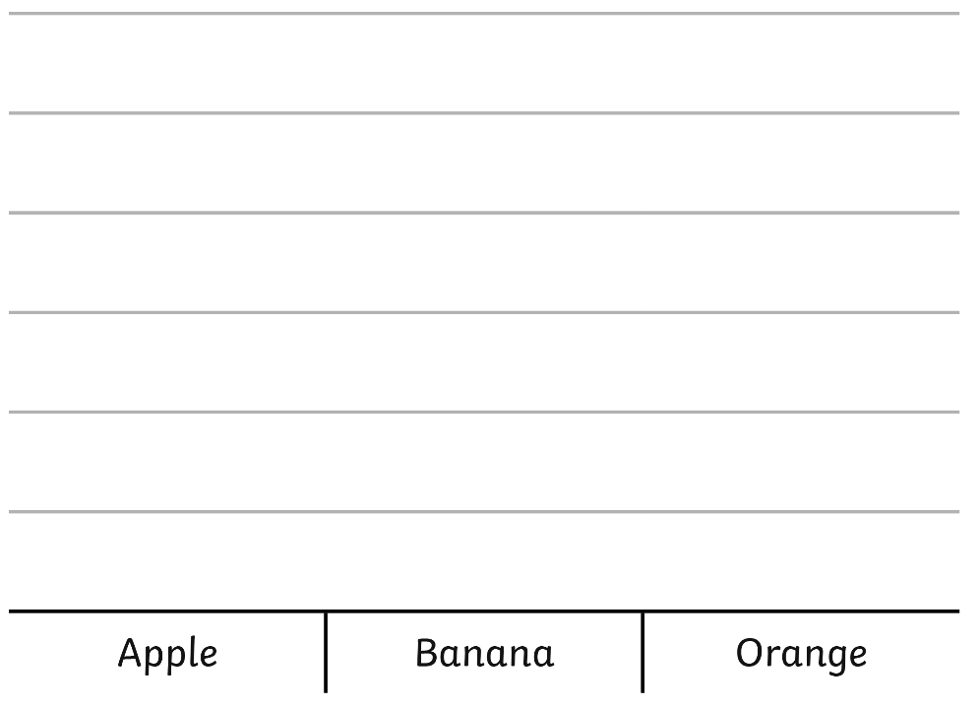



Simple Pictograms
A pictogram uses pictures or symbols to represent data. The simplest form of pictogram uses one picture or symbol to represent one value.

Slide 3
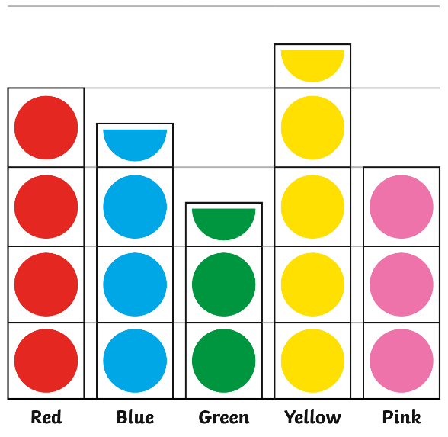
Scaled Pictograms
A pictogram uses pictures or symbols to represent data. The scaled pictogram uses one picture or symbol to represent two or more values.
= 2 children
This pictogram shows each circle is worth 2, therefore half a circle is worth 1.
So 8 children chose red, 7 chose blue, 5 chose green, 9 chose yellow and 6 chose pink.

Slide 4
Watch the video about how to interpret (read and understand) a pictogram using the link below: https://www.bbc.co.uk/bitesize/clips/zg4d2hv

Slide 5
Pictograms
A pictogram uses pictures or symbols to represent information.
A Pictogram to Show How the Children in KS2 Travel to School
A key shows the value (how much) that is represented by one picture or symbol.
Key:
= 2 children
It is important to know the value of the whole picture or symbol in a pictogram, as part symbols are often used to show different values.
For example, if a whole symbol represents the value of 2, half of that symbol would be worth 1.
Walk
Bicycle
Car
Bus
Tram
Train
Other
Types of Transport
A Pictogram to Show How the Children in KS2 Travel to School
Key:
= 4 children
In both of these pictograms, the data is the same but the value of the symbol is different.
Walk
Bicycle
Car
Bus
Tram
Train
Other
Types of Transport

Slide 7
Block Graphs
What does a block graph show?
A block graph is a information that has been put into a visual graph, represented in blocks.
What must a block graph have?
A block graph must always have a title explaining what it shows.
Blocks must be carefully drawn to show the data.
There must be no gap between each bar.
Each bar must be the same width.

Slide 8
Block Graphs
How do you represent the data in a block graph?
A number line is marked on the vertical (top to bottom) axis (y).
The categories are organised on the horizontal (across) axis (x).
Each axis must have a label explaining what it shows.

Slide 9
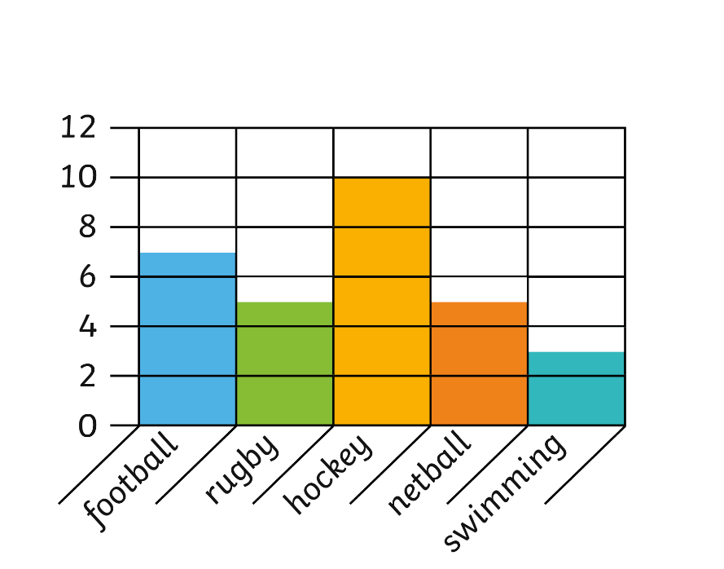
Block Graphs
Class A carried out a survey about their favourite activities. They recorded the data in this block graph.
Class A’s Favourite Activities
As you can see, the vertical (top to bottom) axis is a number line going up in 2s. Therefore, blocks where only half is shaded counts for 1.
So you can see, 7 children chose football, 5 chose rugby, 10 chose hockey, 5 chose netball and 3 chose swimming.
Children
Activities

Slide 10
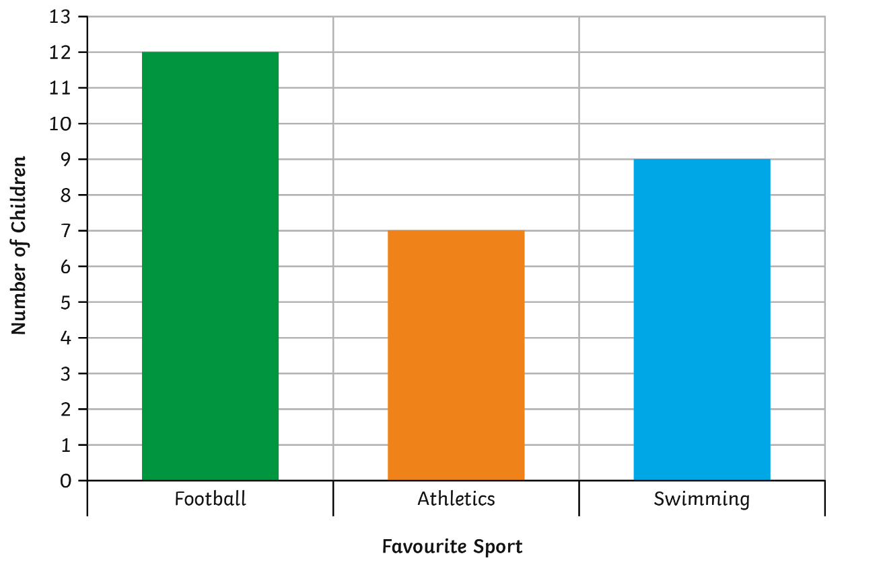
Simple Bar Charts
Bar charts use bars on a grid or scale to represent information. The simplest bar chart has a scale of one place on a grid representing one value. Bar charts can be horizontal (across) or vertical (top to bottom).
This bar chart shows that 12 children liked football the most, 7 children liked athletics most and 9 preferred swimming.

Slide 11
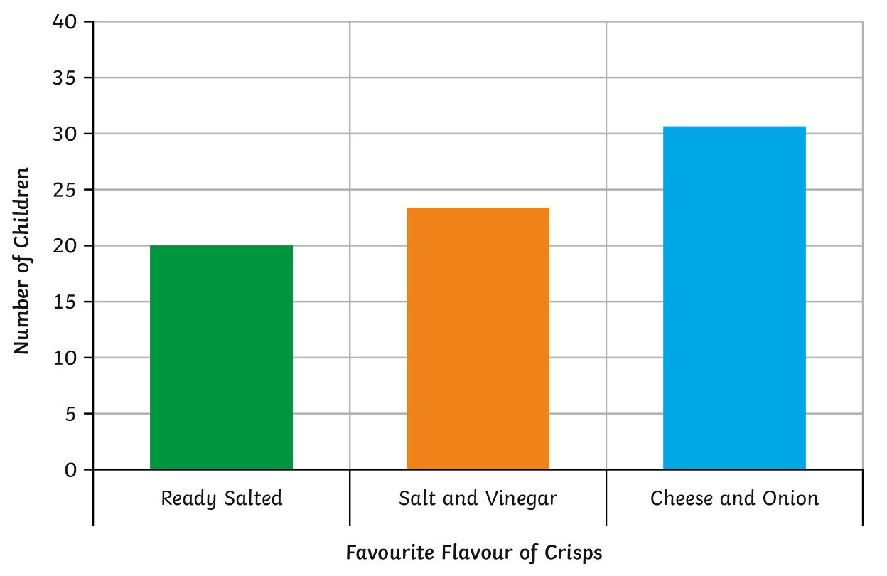
Scaled Bar Charts
Bar charts use a bar to represent the data. Scaled bar charts have a scale of one place on a grid representing two or more. Bar charts can be horizontal (across) or vertical (top to bottom).
This bar chart goes up in 5s.
That means 20 chose Ready Salted, 23 chose Salt & Vinegar and 31 chose Cheese and Onion.

Slide 12
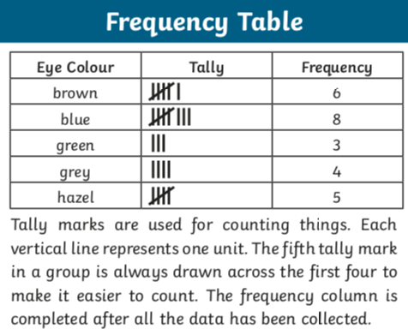
Tally Charts

Slide 13


Tally Charts
Tally charts are a great way to collect and present information. They are easy to read and record. They also make it simple to find a total.
In a tally, you just put a line to show one -
If you have already got four -
you draw a line diagonally
across for number 5 -
= 21

Slide 14
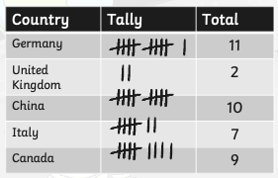
Tally Charts
For example, this chart shows the countries who have sent people into space.

