Slide 2
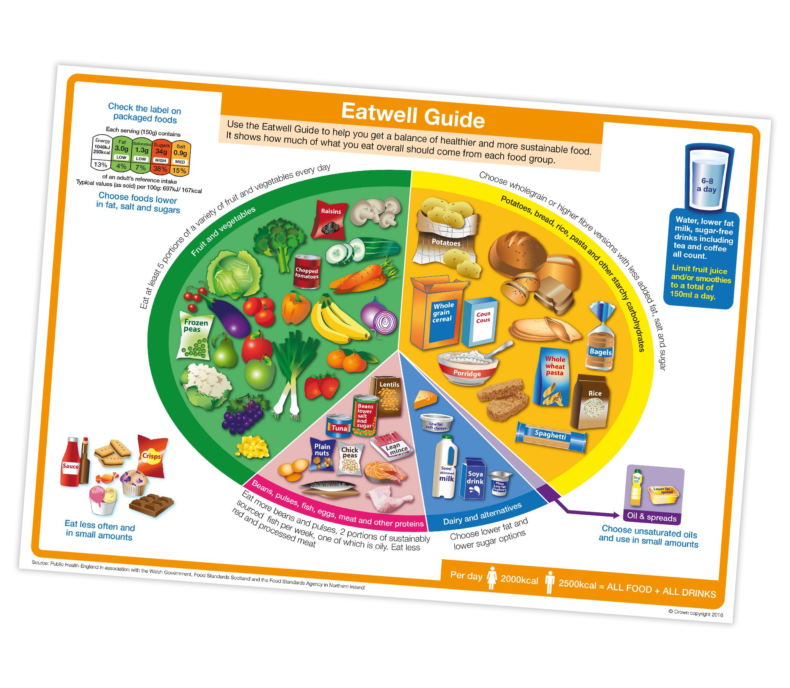

What food groups can you name?
What does each food
group give you?

Slide 3
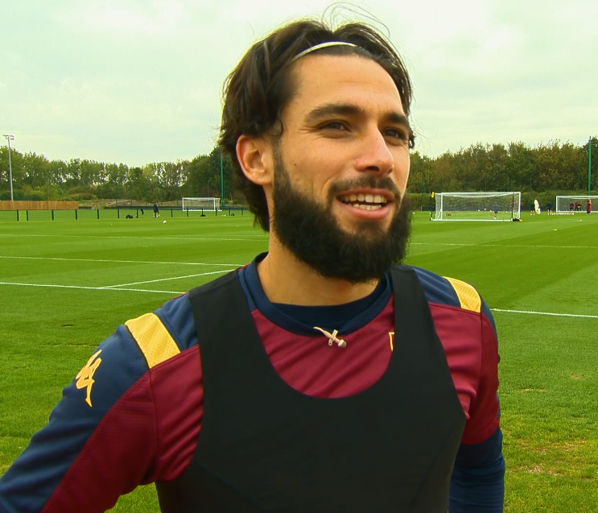


Watch the ‘Nutrition around the world’ film.
Consider:
What different examples of foods
do the people in the film mention?
What things do team staff have to think about when preparing food for footballers from different countries?
What types of food are important
for footballers to perform well?

Slide 4
My full-time Meal
Select a player from the Premier League or the FA Women’s Super League, from anywhere in the world.
Design a meal for him or her, making sure that you plan in the types of food they may have eaten in their home country. Use the Fact Cards to help you.
Consider any dietary requirements they may have, and make sure that you have planned a balanced meal, with plenty of fruit and vegetables, protein and carbohydrates.
Plan your meal using My full-time plate activity sheet.
You can use the Eatwell Guide to help you and your own research.

Slide 5


