Slide 2


Acrostic Examples
What is each poem about?
R
O
A
L
D
D
A
H
L
Revolting rhymes
Oompa-Loompas
Angry farmers
Lazy aunts
Dangerous witches
Dream blower
Adventurous animals
Horrible headteacher
Lickable wallpaper
I
C
E
C
R
E
A
M
It’s my favourite food
Cold as the inside of a fridge
Every sunny day
Can’t wait
Running to the van
Empty out the money
‘Any sauce on that, love?’
Mmmmmm, yummy!

Slide 3
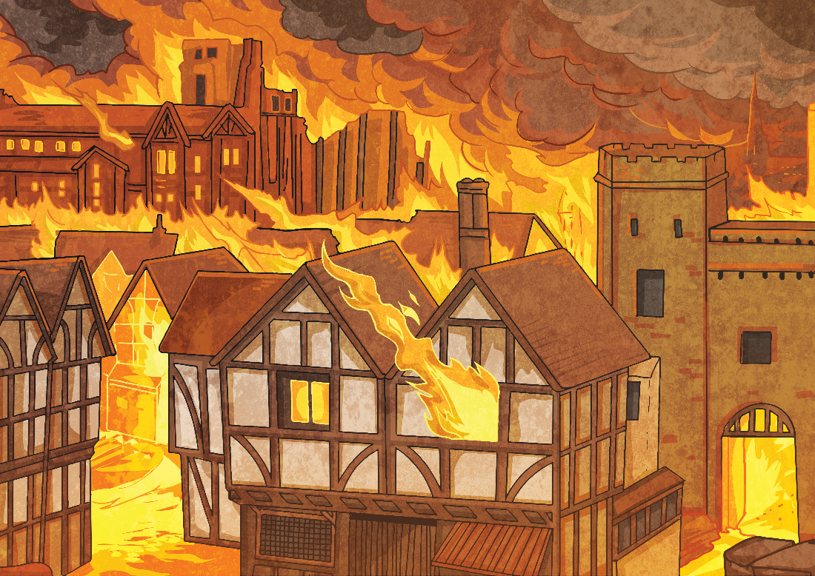
Acrostic Examples
What is the poem about?
Gigantic flames
Remember 1666
Every child knows
Ash floated everywhere
Thousands of homes destroyed
Flames all around
Inside the bakery
Red sky
Everything covered in soot
Over the city
From house to house
Lots of people escaped
On foot, by boat and carriage
Nearly every house
Demolished
On Pudding Lane – Help! Help! But
Not many people died.
G
R
E
A
T
F
I
R
E
O
F
L
O
N
D
O
N

Slide 4
Acrostic Features
What did you notice?
Poetic devices may be used.
The first letter of each line spells out the poem’s theme vertically – what’s this one about?
alliteration
simile
I
C
E
C
R
E
A
M
It’s my favourite food
Cold as the inside of a fridge
Every sunny day
Can’t wait
Running to the van
Empty out the money
‘Any sauce on that, love?’
Mmmmmm, yummy!
Lines can be different lengths

Slide 5



Let’s Try It!
How can we write an acrostic poem?
First, we need to choose a theme. I know, let’s have…
fireworks!
Then, we think of lots of words or phrases associated with that theme…
night
spectacular
smoke
bonfire
pop
bang
fizz
noise
crackle
rocket
stars
explosion
sparkle

Slide 6


Let’s Try It!
How can we write an acrostic poem?
Next, we write the letters of our theme word(s) vertically
down the page in CAPITAL LETTERS…
F
I
R
E
W
O
R
K
S
fireworks

Slide 7
Let’s Try It!
How can we write an acrostic poem?
Finally, we use our list of words and phrases to create each line. Don’t worry if you can’t think of them in order – it’s fine to go back and add any missing lines afterwards.
F
I
R
E
W
O
R
K
S
lames flicker in the bonfire
watch the sparks fly up
ockets zoom into the night
verywhere the smell of smoke
aiting for the next explosion
ohh... Ahhh… Wow!
oaring crowds of onlookers
aleidoscope of colours
eems to go on forever

Slide 8
Your Turn!
On the website is a printable to write an acrostic poem about..
Summer!
Plan your poem first, make a word bank of all the things that make you think about summer, then draft your poem. Once you think you’ve got it, write it up in best on the template!
S
U
M
M
E
R

