Slide 2
The Big Questions

Slide 3


What is mindfulness and how do we encourage positive thoughts and feelings?
How can we be mindful in our everyday lives?

Slide 4
Reconnecting

Slide 5

Right Here, Right Now
Wherever you are, whatever you are doing, pause as if you have been paused like a video.
Now, whilst completely still, try to really notice things…
What can you see?
What can you hear?
How are you feeling?
Do you have any thoughts in your head right now?

Slide 6
Exploring

Slide 7
Busy Lives, Busy Minds
Every day we are bombarded with sights, sounds and sensations.
Let’s think of a typical day and what our senses have to cope with, often all at once.
Sights | Sounds | Sensations
Faces and other people’s body language Colours Signs and posters Movement Looking out for danger! | Voices and instructions Traffic Music Sirens and bells Movement of others Birdsong, leaves rustling and other sounds in nature | Feeling hot or cold Feeling tired Feeling hungry or thirsty Feeling itchy Being uncomfortable or in pain Needing the loo!

Slide 8
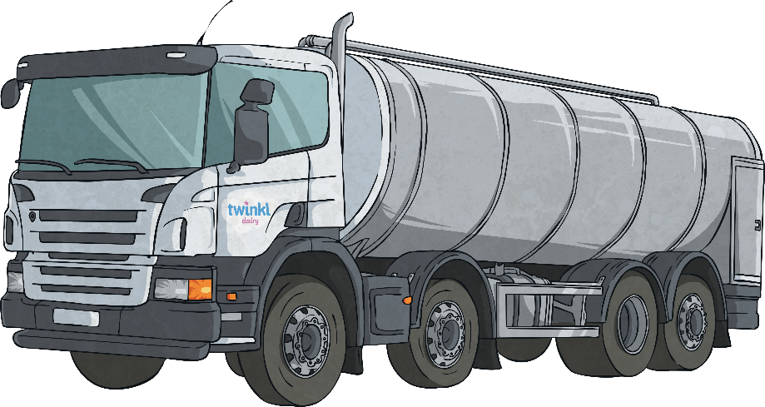



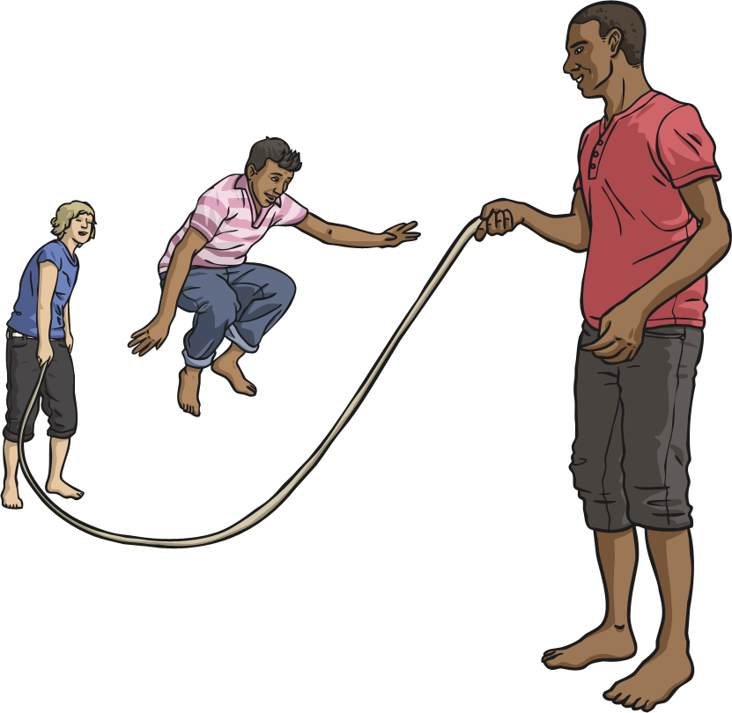
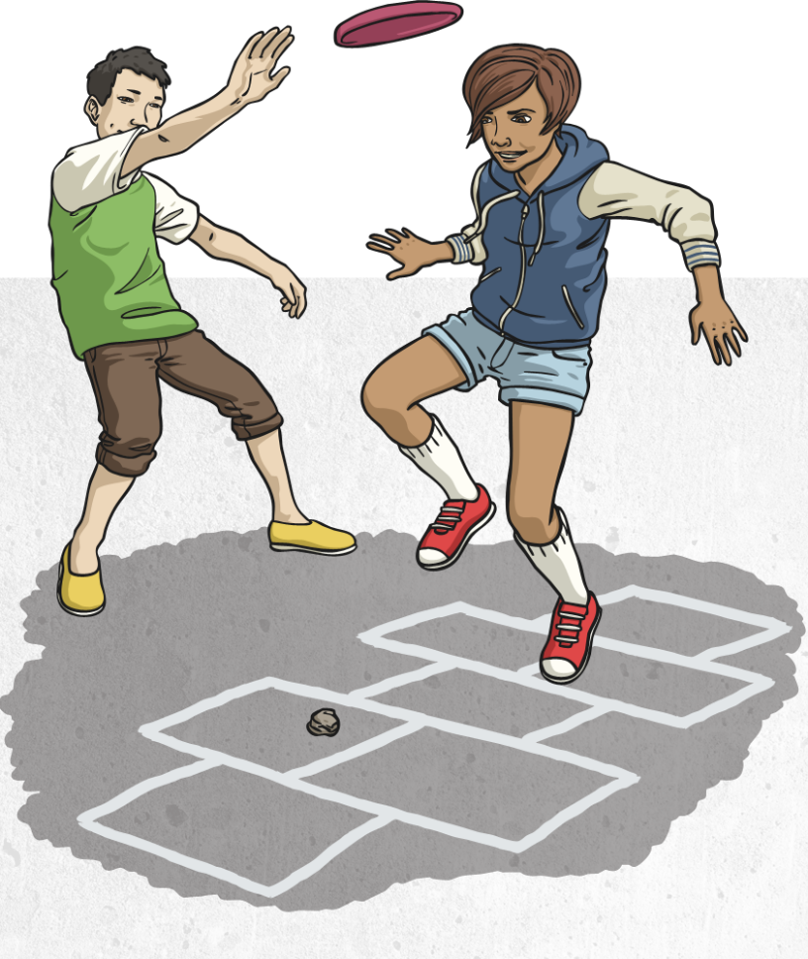
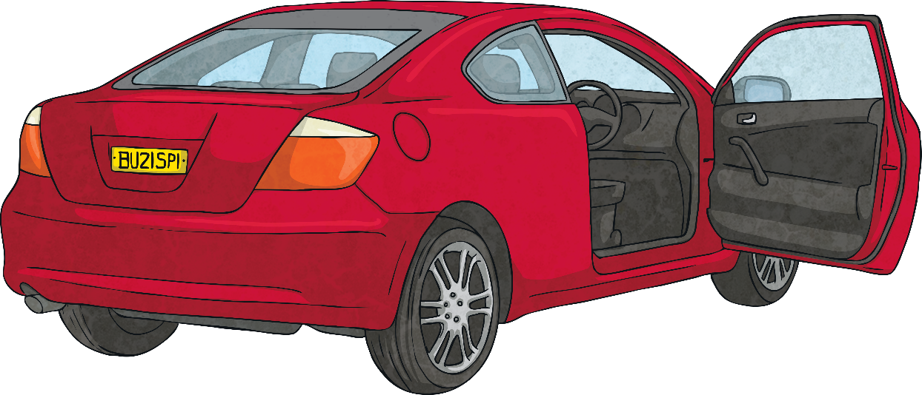
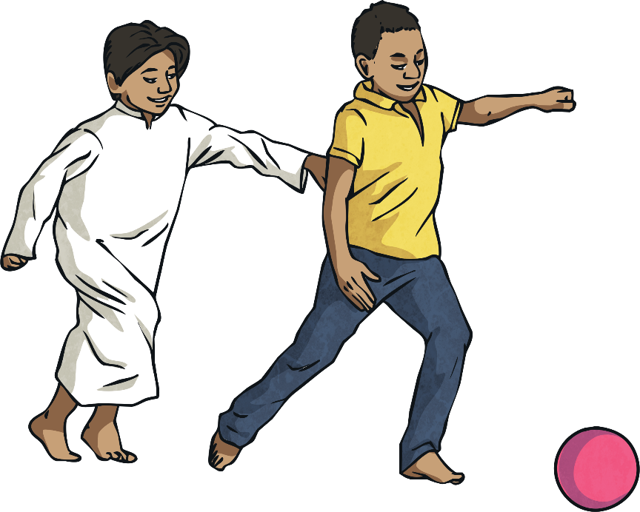
Busy Lives, Busy Minds

Slide 9
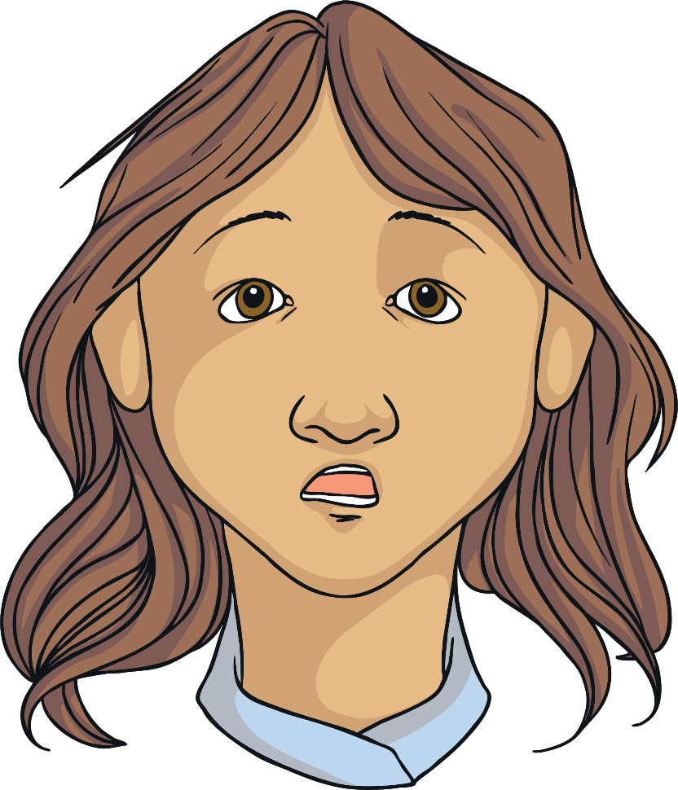
Busy Lives, Busy Minds
While our eyes, ears and other senses are busy trying to cope with all these things going on around us, our brains are busy too.
We are constantly processing thoughts and feelings.
We are trying to learn new information.
We might be following instructions.
We might be trying to remember things.
We have problems to solve and decisions to make.
Sometimes we feel like we just need a break. So, what can we do to help us take time out from our busy lives and make room for positive thoughts and feelings?

Slide 10
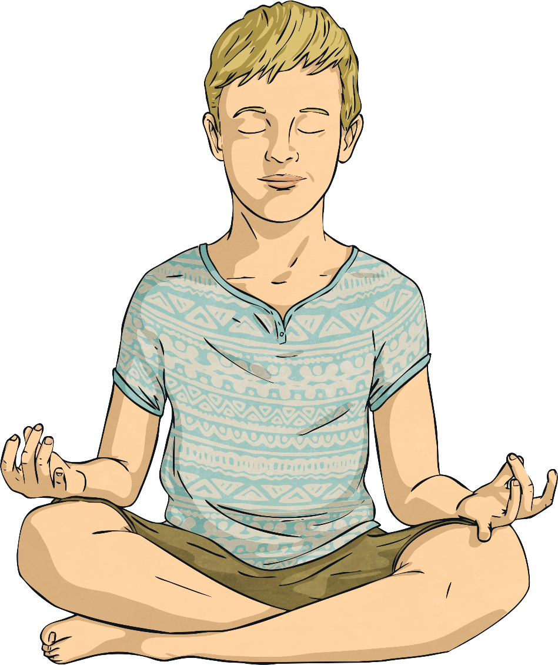
Being Mindful
Have you ever heard of the terms ‘mindful’ or ‘mindfulness’ before? What do you think these words mean?
Mindfulness, or being mindful, means being conscious or aware of something. It means focusing on the present moment so that we can acknowledge and accept our thoughts, feelings and the sensations in our bodies.

Slide 11
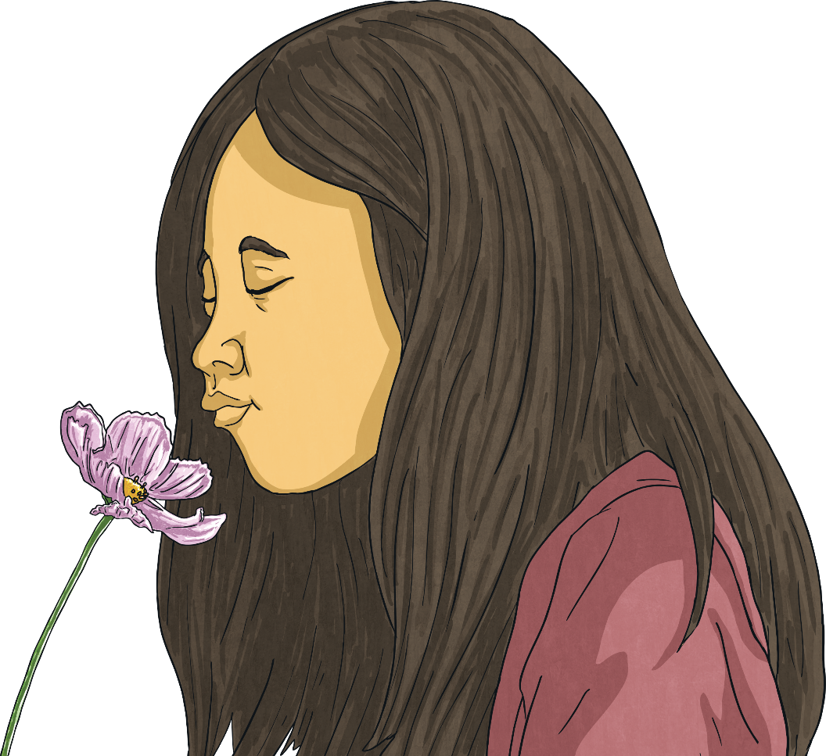
Being Mindful
Can you think of any ways to be mindful? Perhaps you have practiced some mindfulness activities before – at home or at school.
Well done if you thought of some ways to be mindful! You might be surprised to learn that there are actually a lot of ways to be mindful and a lot of the techniques need only take a few minutes.

Slide 12
Being Mindful
Now it’s time to take a look at the Being Mindful Challenge Cards included in this lesson pack. As you look at each card, consider
the following:
Have you ever tried this technique?
Do you think this technique would be easy or difficult for you?
When might this technique work for you?
Are there times when this technique would not be useful?
Now you have looked through all of the cards, choose one of the activities to try. If there is an activity you haven’t tried before, that would be a good one to choose.

Slide 13
Consolidating
Reflecting

Slide 14
Consolidating

Slide 15
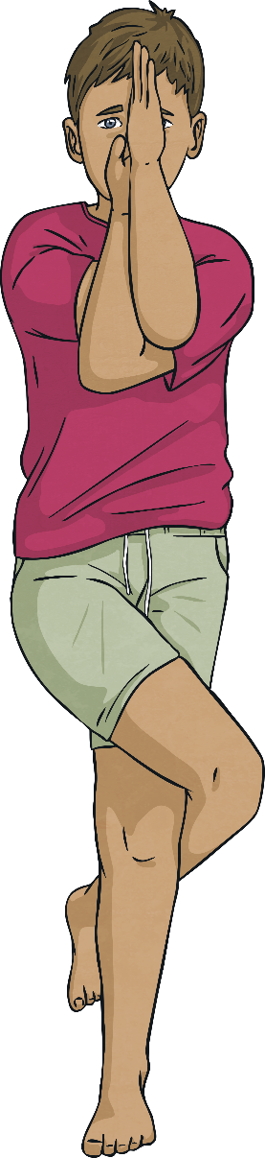
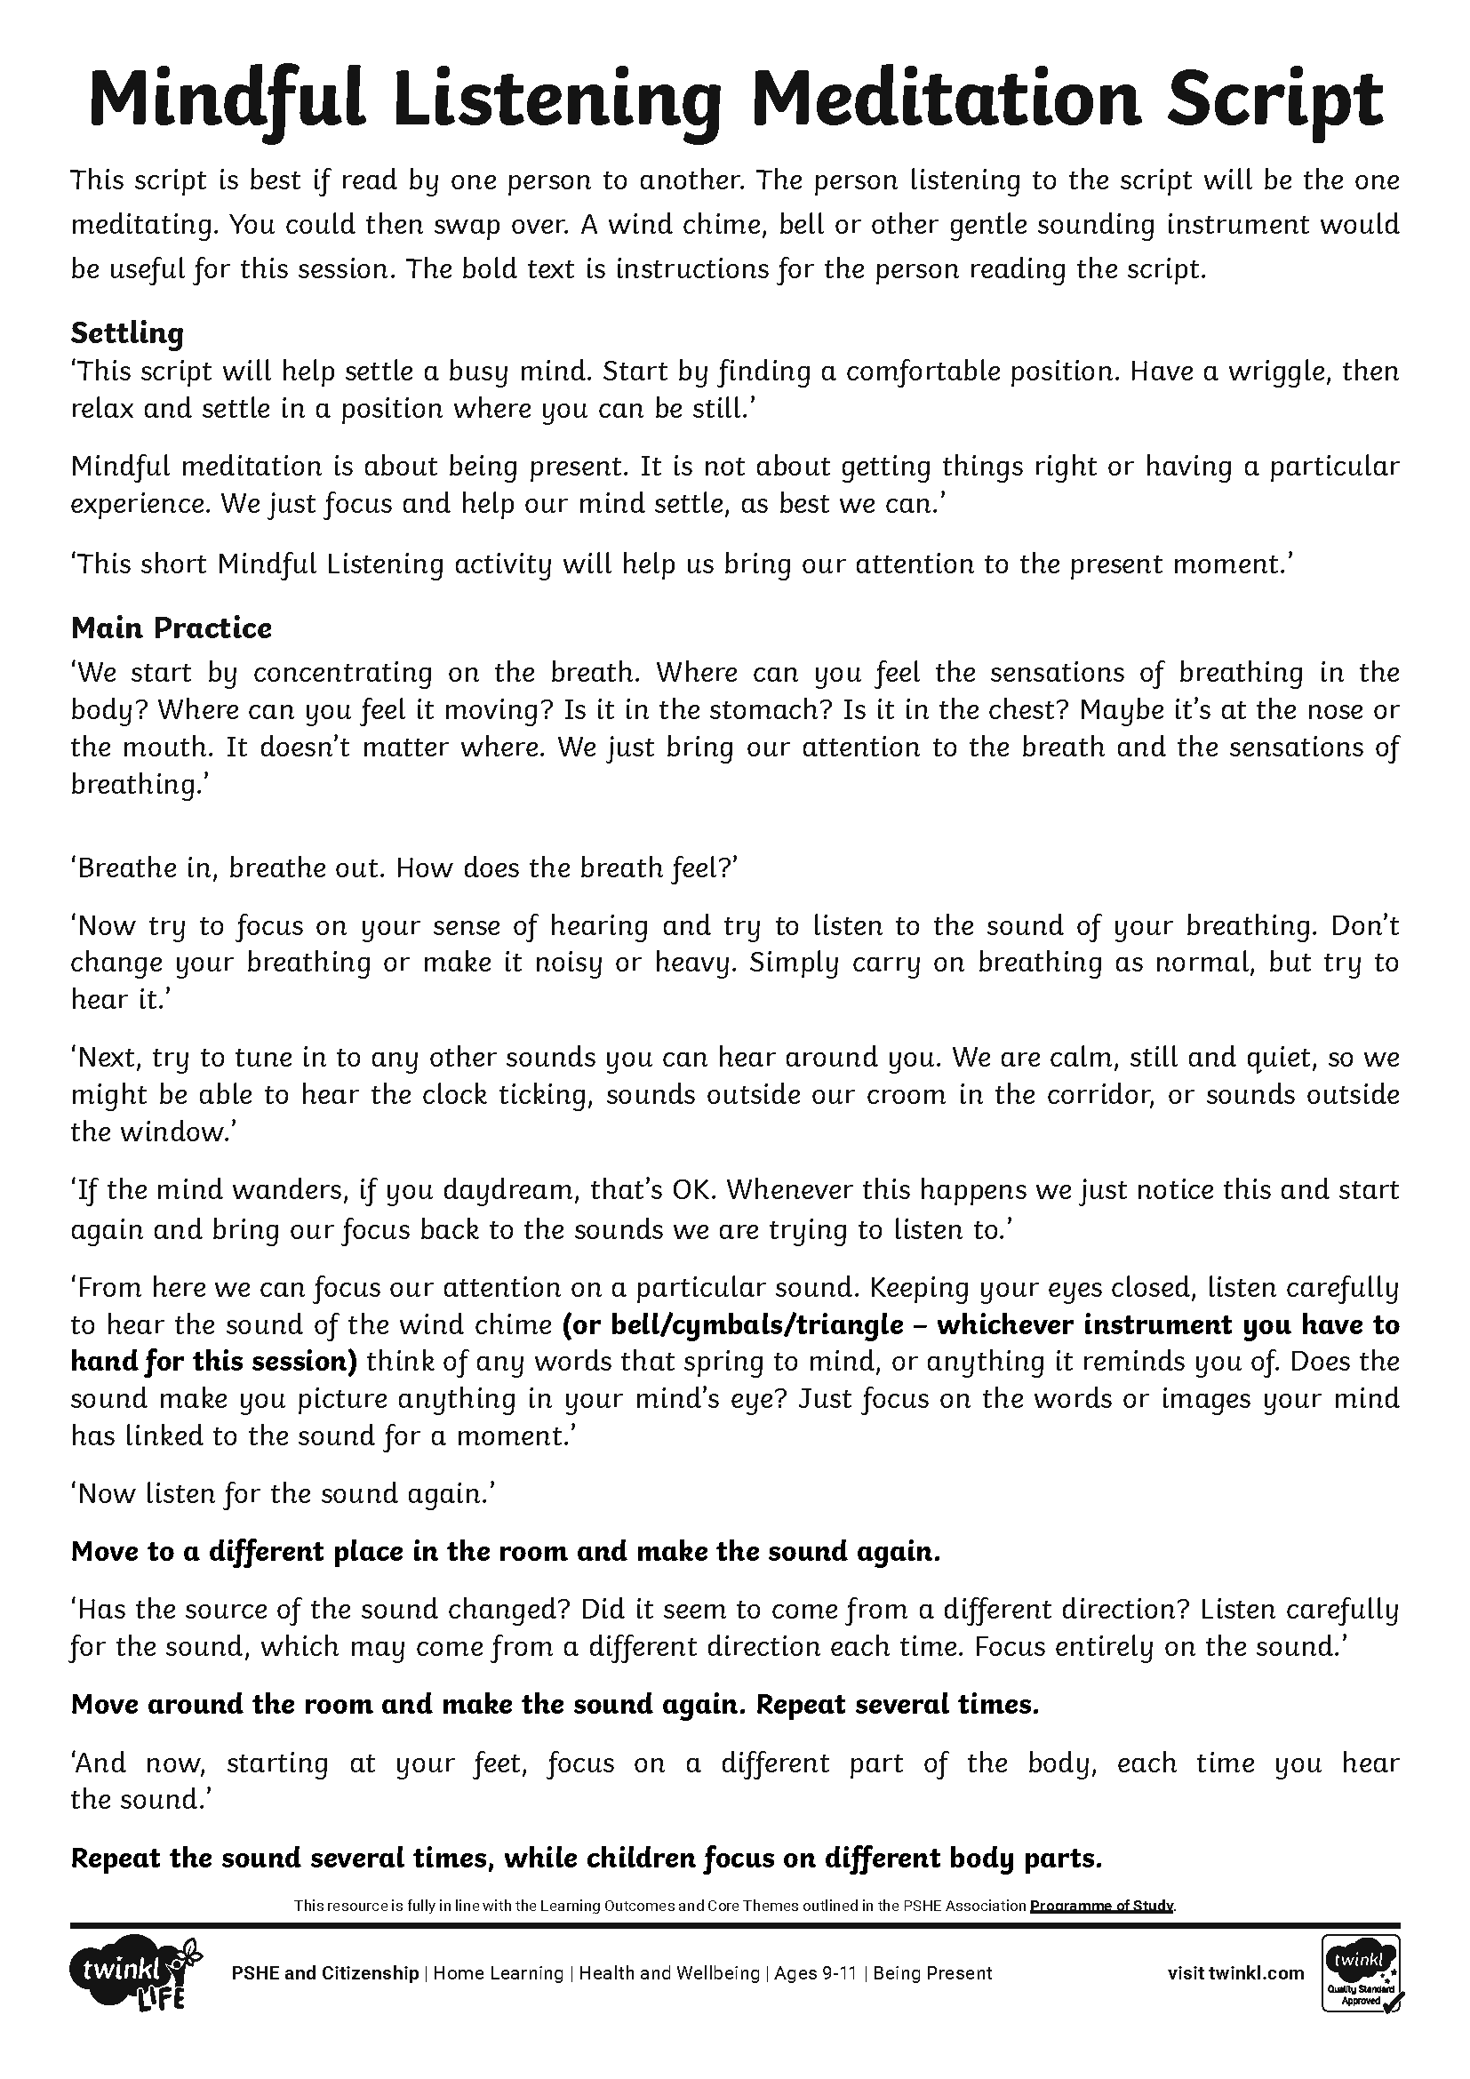
Mindful Listening

Slide 16
Reflecting

Slide 17
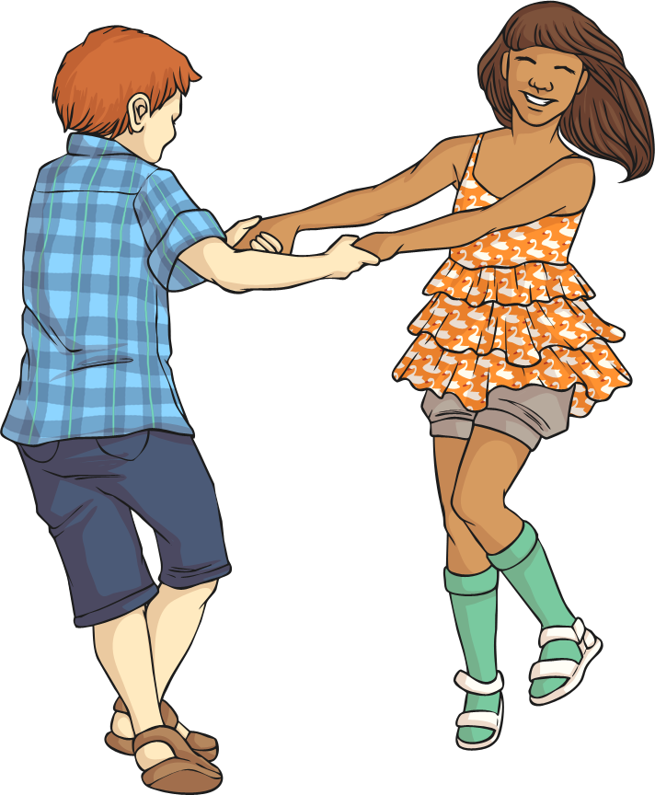
Mindfulness and Happiness
How do you think mindfulness links to happiness and positivity? See if you can jot down some ways in which mindful activities can help us to maintain positive mental health.

Slide 18
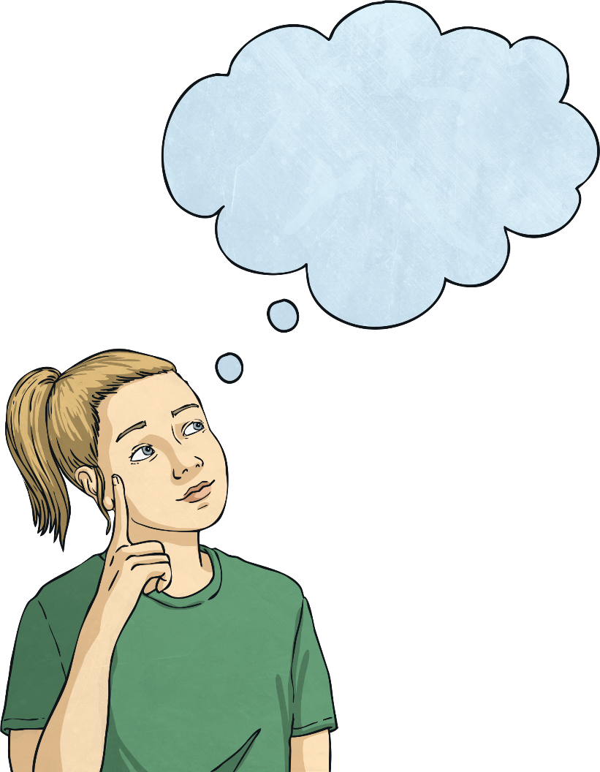
Mindfulness and Happiness
Lots of research has been conducted in the field of positive mental health and emotional wellbeing. There are four main ways mindfulness can be linked to happiness:
Mindfulness can provide us with an opportunity to address any negative or unhelpful thoughts that we might be having. If we stop and listen to these thoughts, we can talk back to them using reason and logic and try to think about how to look for the positives.

Slide 19
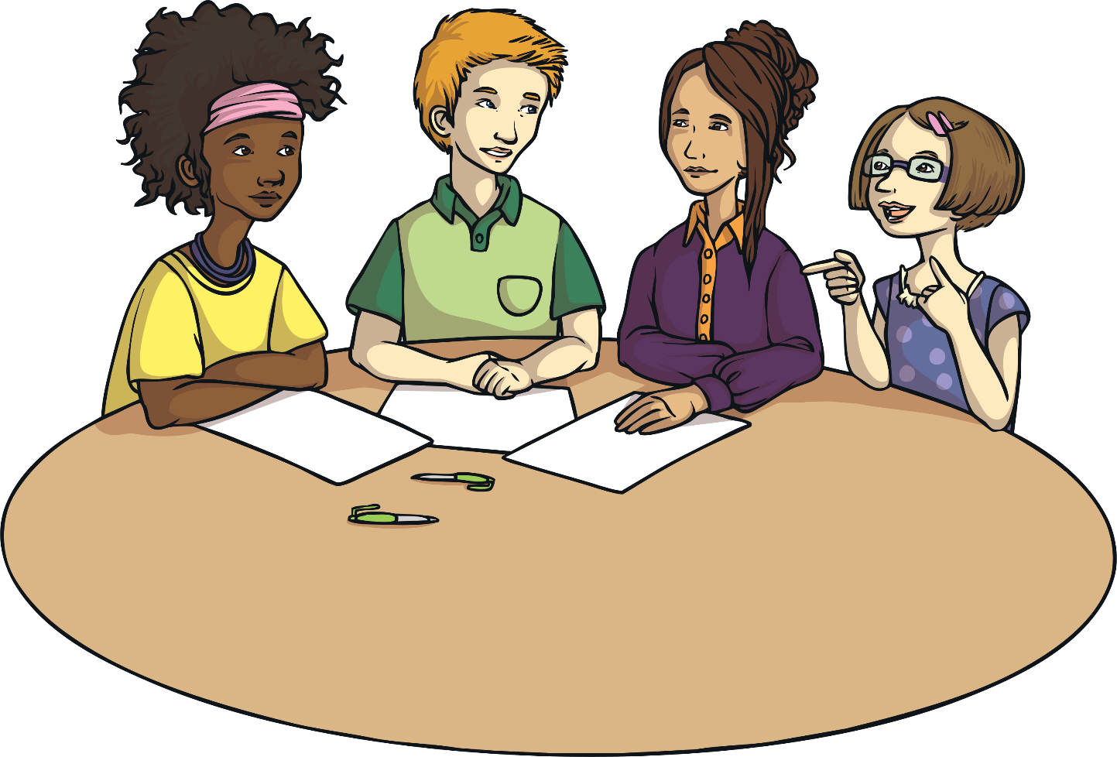
Mindfulness and Happiness
2. Mindfulness can help us to form better relationships with those around us. When we are better at listening and communicating, we form close and trusting relationships with others. Feeling connected to others can make us feel happier.

Slide 20
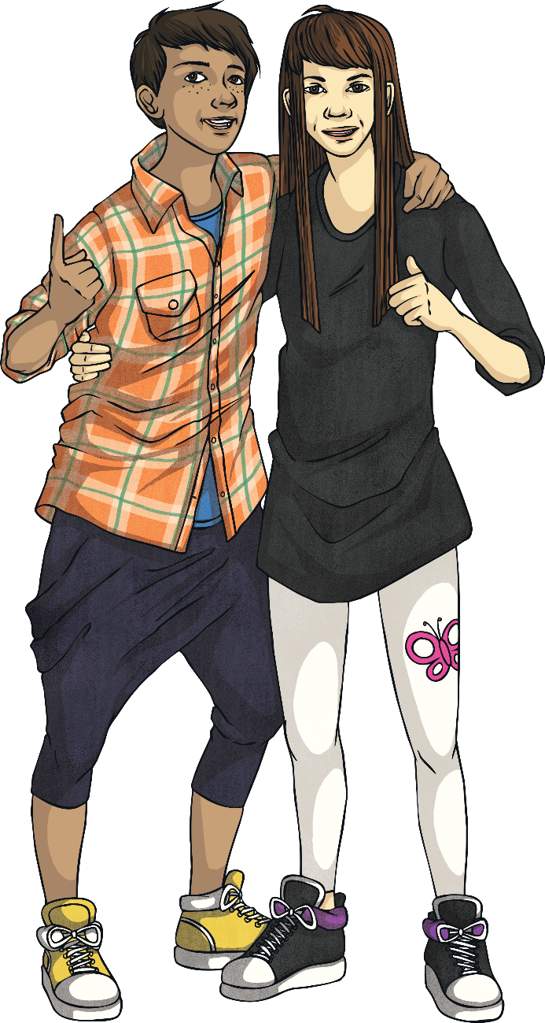
Mindfulness and Happiness
3. Mindfulness allows us to focus on what we have in our lives and be grateful. We often get swept up with wanting what we do not have, which leads to feelings of unhappiness. But being thankful for all we have can make us feel much happier.

Slide 21
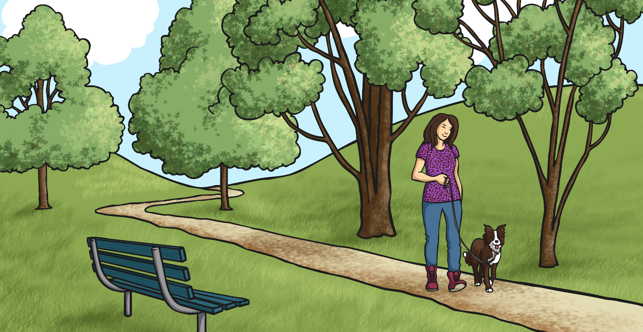
Mindfulness and Happiness
4. Mindfulness simply provides a short break from our busy lives, which can be stressful. It is hard to feel happy when we are stressed, so stopping for a moment and focusing on the now gives us a chance to calm down.

