Slide 2
Over the last 2 weeks there have been some activities based on your wellbeing. They looked at control and having a positive mindset.
Today will focus on kindness and then your plans for the future.
In a time like this, it is important to remember it will not be forever, it will end and life will be a bit more normal again.
Hopefully today’s work will help you think a bit about this.
This resource is fully in line with the Learning Outcomes and Core Themes outlined in the PSHE Association’s Programme of Study.

Slide 3




What Is Wellbeing?
When you try to look after your own wellbeing, you think about:
how comfortable you are (both physically and mentally);
how healthy you are (both physically and mentally); and
how happy you are.
If life changes, you may feel a lack of control, which can then make you feel unsettled. This can affect your wellbeing and how you feel. Changes can take you out of your comfort zone and make you see life a bit differently; all of which can be unsettling.

Slide 4
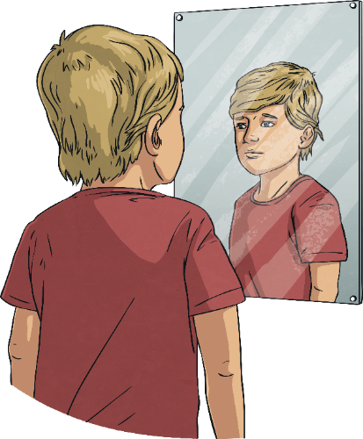
Be Kind
When change is happening in the world around you, or when things feel a bit more difficult, it is important to remember to be kind in what you think, say and do.
This includes being kind to others but also being kind to yourself.

Slide 5
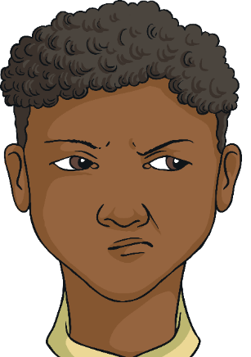
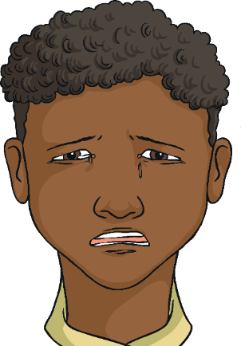

Be Kind
When choosing how to react and respond to other people, it is important to understand why they are behaving in a certain way, as well as their emotions or situation. This knowledge is important for helping you to understand their behaviour and words but also how to forgive and be kind, if necessary.
It is also important to have the same patience and understanding
with yourself.

Slide 6
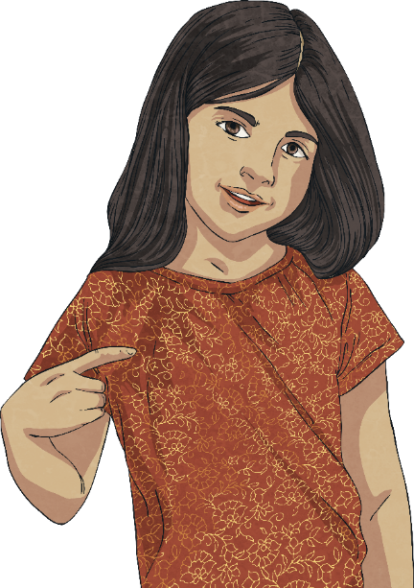
Be Kind
We often take the time to show gratitude to others but it is important, as part of self-care, that we show ourselves thanks and gratitude.
Remember to speak to yourself and about yourself in a way that you would with someone else you care about.
Often, people speak unkindly about themselves, in a way they would never speak about someone else.
It is important to know the effect we have on ourselves and our wellbeing when we do this.

Slide 7
Be Kind
The following checklist contains different ideas and suggestions of ways you can show yourself some self-gratitude.
Ask others to write a positive note about you and pop these in a jar to read to yourself
Plan a day for doing no homework at all and fill it with relaxing or fun games instead.
Buy yourself a treat with your pocket money.
Surround yourself with people who motivate and inspire you. This is both in person, in the news and online.
Write down positive thoughts about yourself and say these out loud
Spend some time reading a book or listening to your favourite music.

Slide 8
Ensure there is something or someone in your life that you care about and that needs your love and care; this could be family, pets
or plants.
Massage your hands or have a bath.
Do something which relaxes you and allows you to rest.
When someone pays you a compliment,
make sure you say ‘Thank you’ rather than responding with a self-criticism or by ignoring it. It is important to accept
a compliment.
Spend some time outside and enjoy the world around you.
Could you try to do one of these today?
If anyone says anything negative about you, or to you, try and think of a positive about yourself to balance that view.

Slide 9

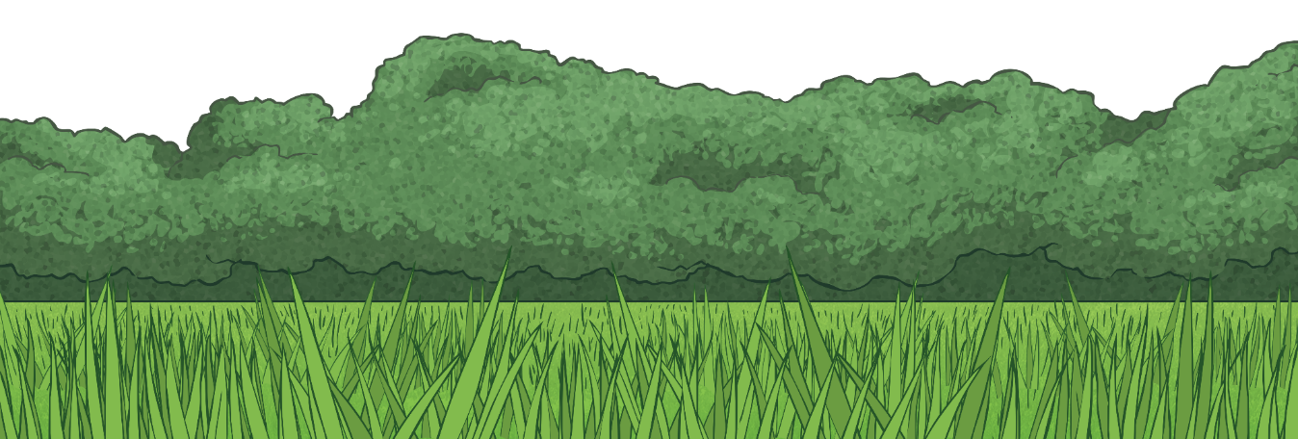
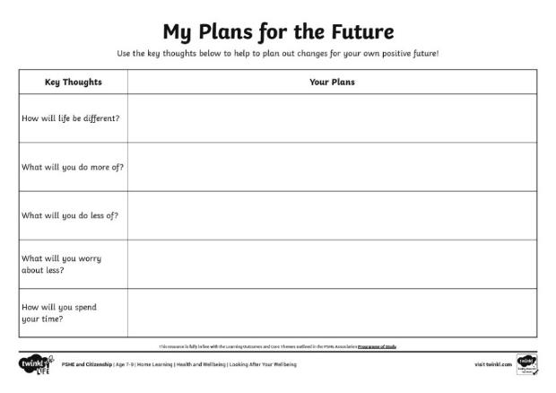
The Future
Whenever you are going through changes or a difficult time, it can feel hard to see beyond the day you are living in or to see that things can change.
While it can help to think about one day at a time, it can also be helpful to think about the future in a positive way as well.
Think about:
How will life be different?
What will you do more of?
What will you do less of?
What will you worry about less?
How will you spend your time?
Use the My Plans for the Future Activity Sheet to help you with these thoughts and ideas.
These thoughts can help you to see the positive that can come from even the most difficult situations.

