Slide 1

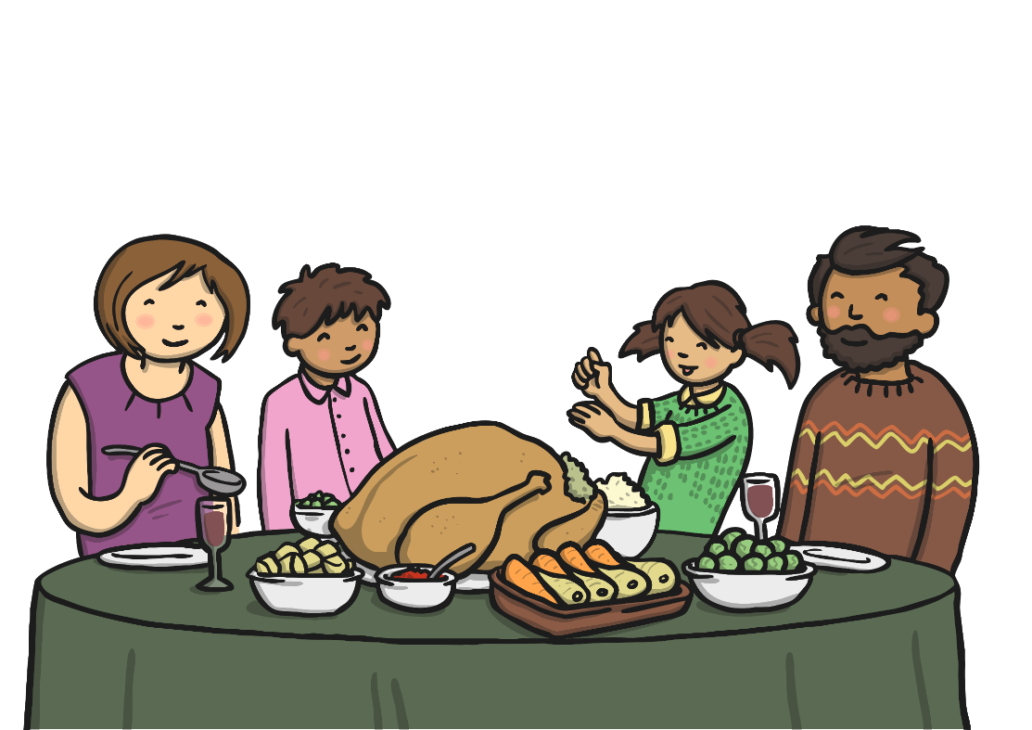
Statements
1
2
Statements are sentences which tell you a fact, opinion or idea.
Example:
A rainbow has 7 colours.
They are beautiful to look at.
Questions
2
Example:
What did you have for dinner?
Questions are sentences that ask you something.
They usually end with a question mark.

Slide 2



Commands
3
They are often urgent or angry, can be very short and contain
an imperative verb. Commands Imperative verbs are also known
as ‘bossy verbs’- they tell people what to do.
Example:
Help me! Stop it.
4
Exclamations
Example:
What big feet you have!
An exclamation is used when someone is surprised.
It always starts with ‘How’ or ‘What’ and contains a noun
and a verb.

Slide 3
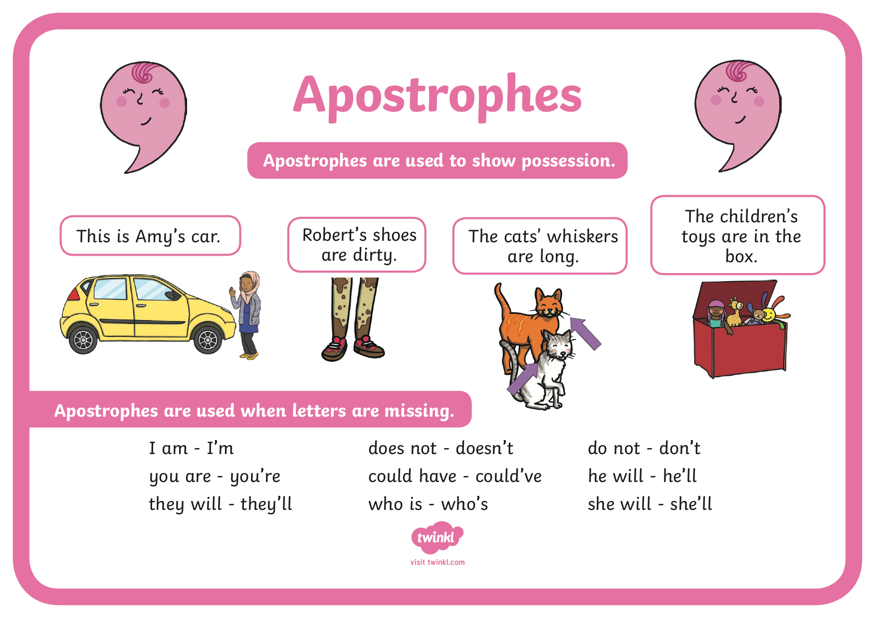

Slide 4


