Slide 1
Different Types of Poems
In this PowerPoint there are lots of different poem types. Have a look through and choose one you like. Then write your own Easter poem.

Slide 2
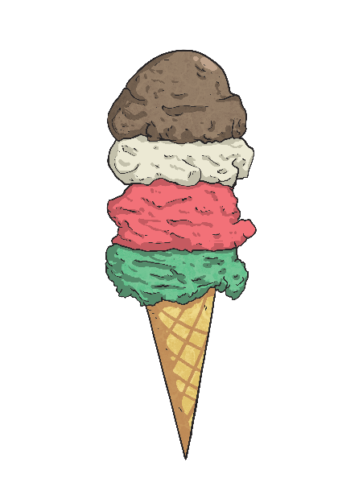
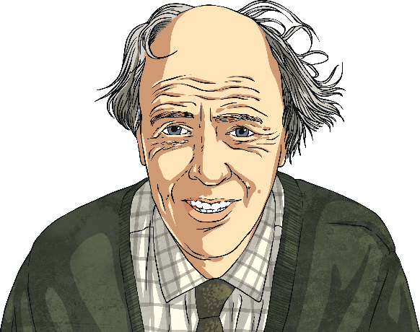
Acrostic Examples
What is each poem about?
R
O
A
L
D
D
A
H
L
Revolting rhymes
Oompa-Loompas
Angry farmers
Lazy aunts
Dangerous witches
Dream blower
Adventurous animals
Horrible headteacher
Lickable wallpaper
I
C
E
C
R
E
A
M
It’s my favourite food
Cold as the inside of a fridge
Every sunny day
Can’t wait
Running to the van
Empty out the money
‘Any sauce on that, love?’
Mmmmmm, yummy!

Slide 3
Acrostic Features
What did you notice?
Poetic devices may be used.
The first letter of each line spells out the poem’s theme vertically – what’s this one about?
alliteration
simile
I
C
E
C
R
E
A
M
It’s my favourite food
Cold as the inside of a fridge
Every sunny day
Can’t wait
Running to the van
Empty out the money
‘Any sauce on that, love?’
Mmmmmm, yummy!
Lines can be different lengths

Slide 4
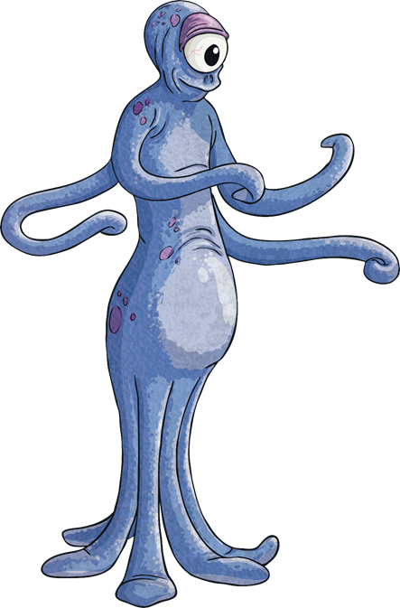
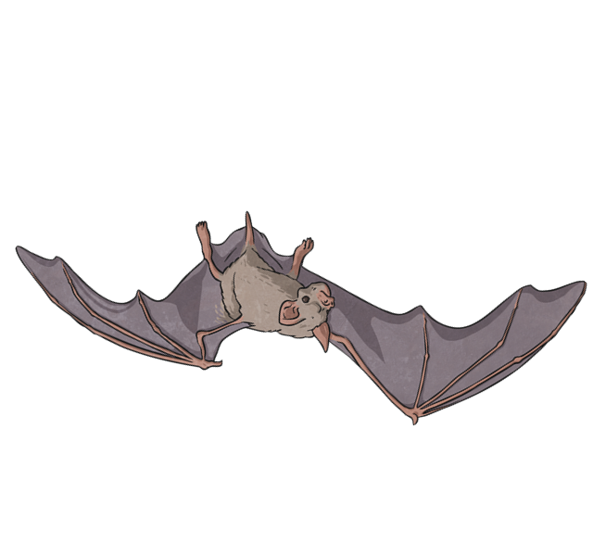
Limerick Examples
Limericks are light-hearted, funny poems with several common features.
Compare these two limericks.
There once was a young man from Ealing,
Who always would hang from the ceiling.
He couldn’t wear a hat,
But could hang like a bat,
And said, “What a wonderful feeling!”
There was an old Martian named Zed
With blue spots all over his head.
He sent out a lot
Of di-di-dash-dot-dot
But nobody knows what he said!

Slide 5
Limerick Features
What did you notice?
Lines 3 and 4 rhyme.
Lines 1, 2 and 5 rhyme.
There once was a young man from Ealing,
Who always would hang from the ceiling.
He couldn’t wear a hat,
But could hang like a bat,
And said, “What a wonderful feeling!”

Slide 6
Limerick Features
What did you notice?
Lines 3 and 4 are
shorter, with the
same number of
syllables (5-6).
There once was a young man from Ealing,
Who always would hang from the ceiling.
He couldn’t wear a hat,
But could hang like a bat,
And said, “What a wonderful feeling!”
Lines 1, 2 and 5 are longer and have approximately the
same number of
syllables (usually
8-10) in each.
Limericks follow a typical rhythm:
di DUM di di DUM di di DUM dum (3 beats)
di DUM di di DUM di di DUM dum (3 beats)
di DUM di di DUM (2 beats)
di DUM di di DUM (2 beats)
di DUM di di DUM di di DUM dum (3 beats)

Slide 7
Limerick Features
What did you notice?
First lines begin with typical phrases, like this one.
The second line gives more details about the subject.
There once was a young man from Ealing,
Who always would hang from the ceiling.
He couldn’t wear a hat,
But could hang like a bat,
And said, “What a wonderful feeling!”
Lines 3 and 4 give us some action about the subject.
The last line is the punchline, usually the consequences of lines 3 and 4.
The first line sets up the subject, so it usually ends with the name of a person or place.

Slide 8

What is a kenning?
Kennings are like riddles.
They describe something without ever saying what it is.
Read these phrases out loud. What could they be describing?
lip-licking
sauce-swirling
chin-dripping
cone-filling
flake-holding
tongue-freezing

Slide 9
What is a kenning?
How about these?
tail-wagger
face-licker
ball-catcher
house-guardian
furry-friend
cat-chaser

Slide 10
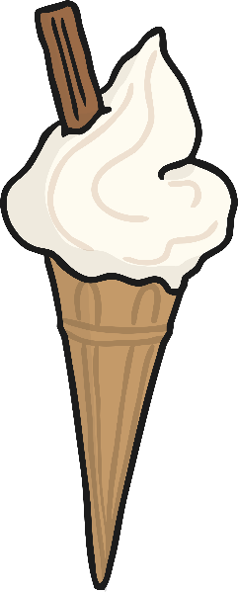
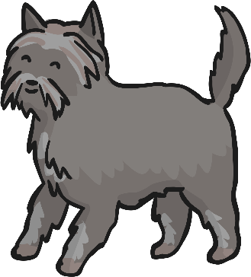
What is a kenning?
What did you notice about the phrases in each poem?
Each line of the poem is made of a two-word phrase.
The words are joined by a hyphen.
house-guardian
lip-licking
furry-friend
chin-dripping
Here the phrases are made up of a noun + a noun.
Here the phrases are made up of a noun + a verb (the verb usually ends in -ing).

Slide 11
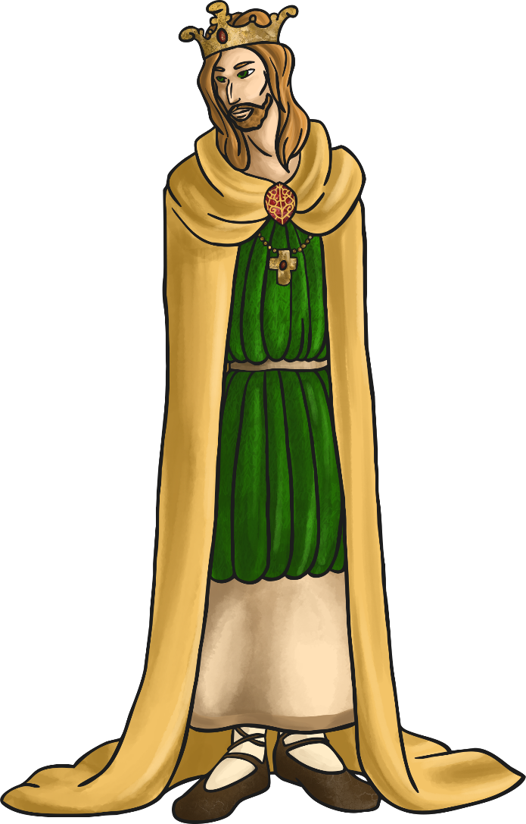
Did you know?
The two-word format for a kenning relates to the Old Norse tradition of naming things like weapons, e.g. Skull-Splitter or Blood-Taker.
Kennings came into our language via the Anglo-Saxon and Norse cultures. These people came from what is now Scandinavia and northern Germany.
The word ‘kenning’ derives from the Old Norse word ‘kenna eitt við’, which means ‘to express a thing in terms of another’.

Slide 12

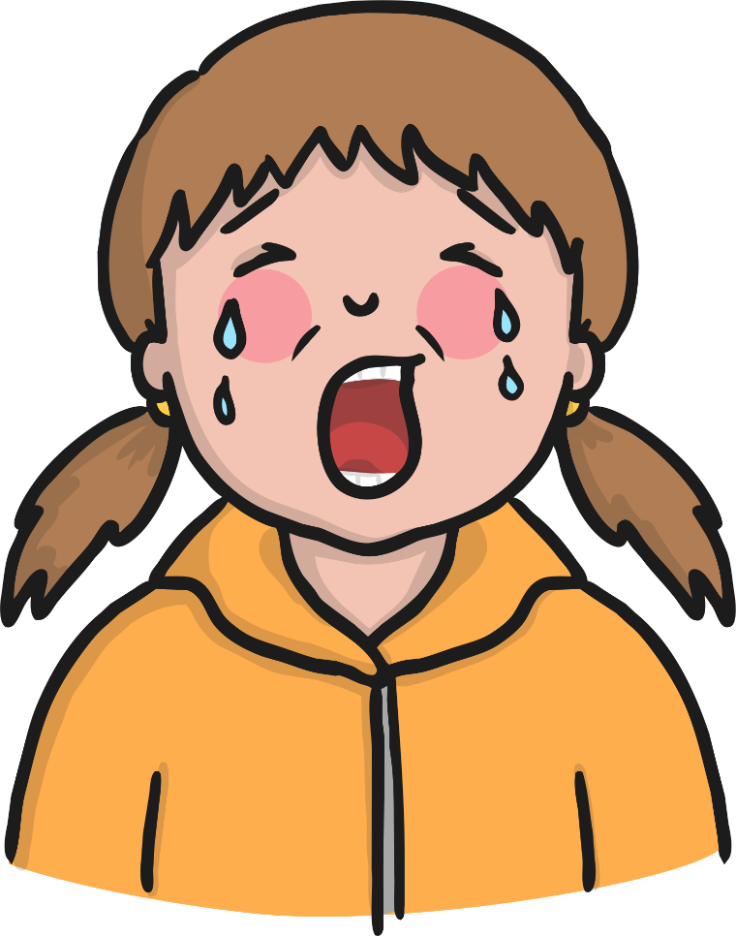
We even use them in everyday language!
How do we describe a very tall building?
A really sad film or story is often called a...
Oh look – here’s some alliteration! Other poetic devices can also be found in kennings.
sky-scraper
tear-jerker

Slide 13
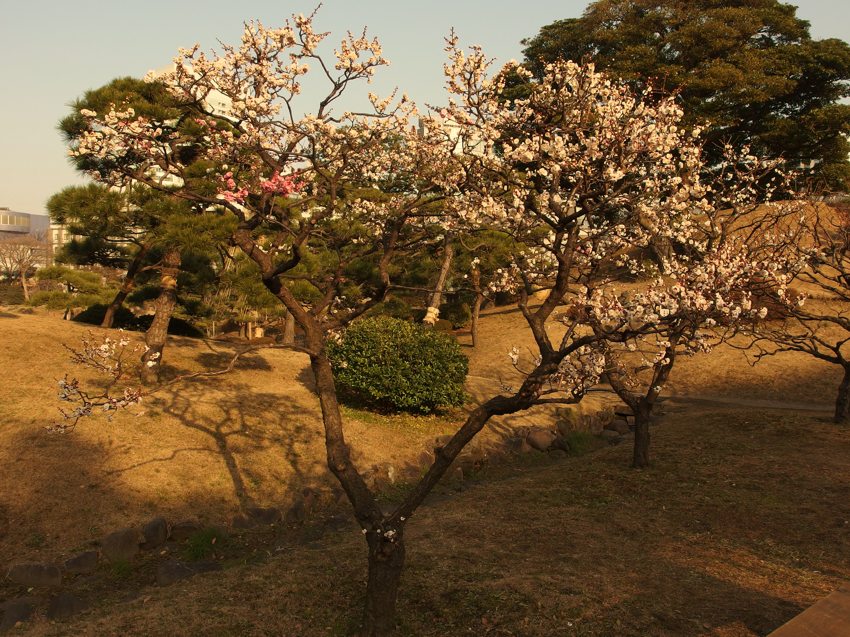
What is a Haiku?
Haiku poems are a traditional Japanese art form. Here’s one...
My two plum trees are
So gracious. See, they flower.
One now, one later.

Slide 14
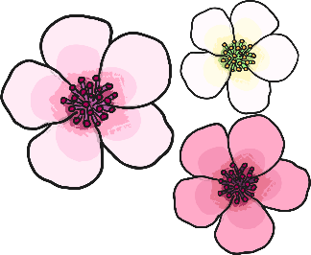
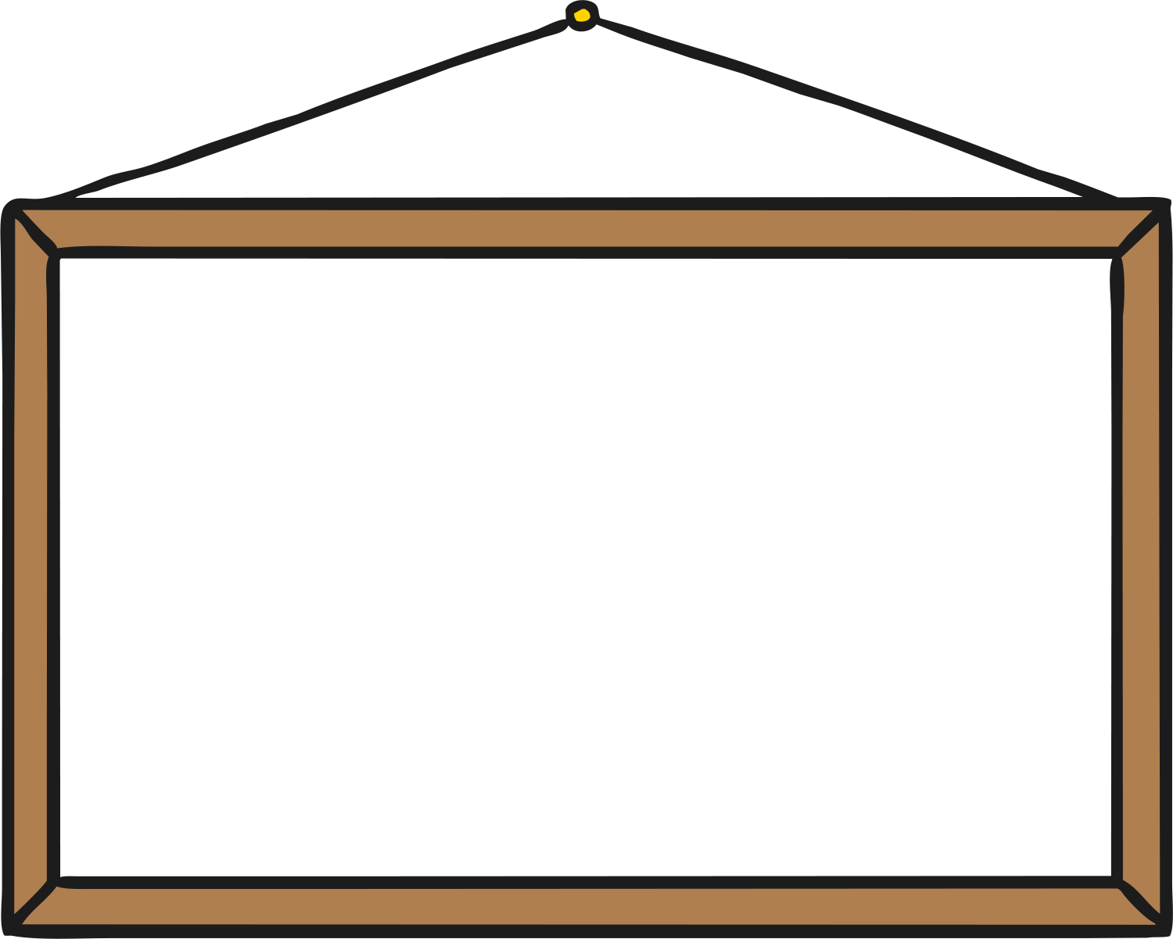
What is a Haiku?
What did you notice about the poems?
Think about:
the poem’s theme;
how many lines are in each poem;
how many syllables in each line.
Three lines in each poem.
My two plum trees are
So gracious. See, they flower.
One now, one later.
Winter is coming.
Snow will be arriving soon.
We should rake the leaves.
natural theme
5 syllables in first line
7 syllables in middle line
5 syllables in final line
Final line is a comment or observation on the theme.

Slide 15
What is a Shape Poem?
A shape poem is a poem that describes an object, person or animal.
The special thing about a shape poem is that the words of the poem form the shape of the object, person or animal being described.
Shape poems don’t have to rhyme!
Shape poems can use full stops and capital letters like sentences.
Shape poems often use alliteration or similes.

Slide 16
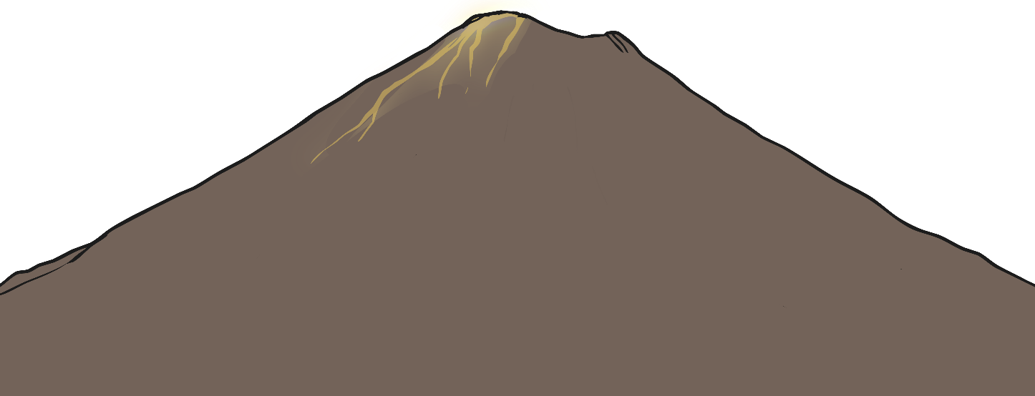
The Features of a Shape Poem
What did you notice about the shape poems we looked at?
Each line can be a different length or be curved to form the shape of the object that is being described.
Full stops and capital letters are used just like you would use in sentences.
A
huge rock
that rumbles
and roars, wrecking
the ground all around it.
It shoots sizzling, steaming, scorching lava
like a monster spitting out hot liquid into the air.
Like a smoking dragon, it finally starts to calm down.
The chaos stops and it goes back to being a deadly and dangerous rock.
sizzling, steaming, scorching
like a monster
Like a smoking dragon,
Alliteration can be used – this is lots of words
in a row beginning with the same letter.
Similes can be used – this is where we use the words ‘like’ or ‘as’ to compare two things to each other.
The lines don’t have to rhyme.

