Slide 1
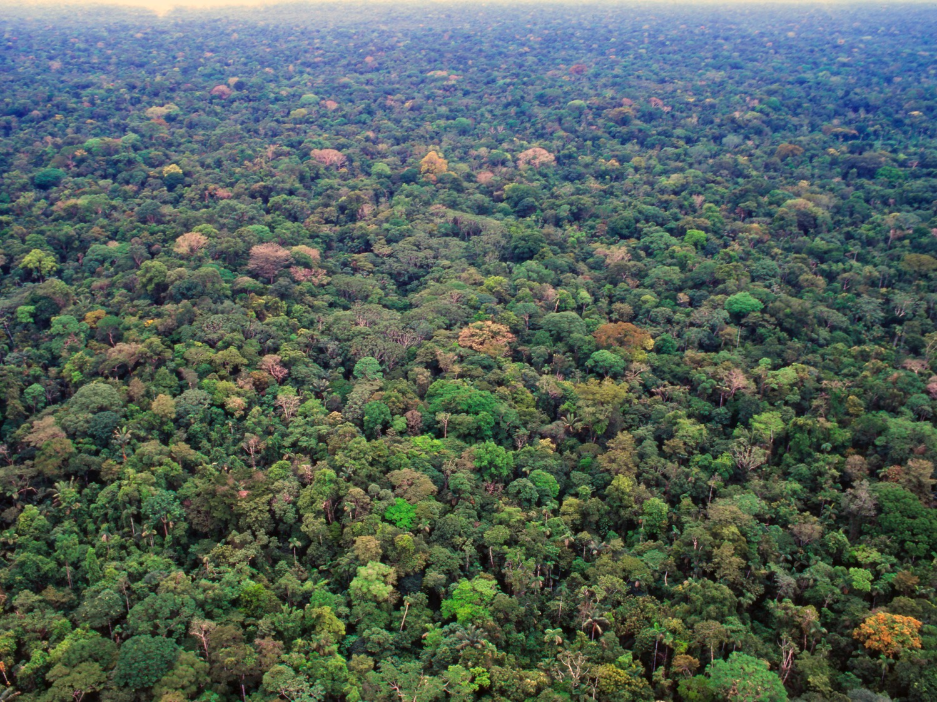
Welcome to the Amazon Rainforest
Notes:
Welcome to the Amazon Rainforest
The Amazon rainforest is the largest tropical rainforest in the world and covers over 5.5 million square kilometres. It’s so big that the United Kingdom and Ireland could fit in it 17 times. The Amazon is found in the continent of South America and spreads across most of the north west of Brazil, as well as parts of Bolivia, Peru, Ecuador, Colombia, Venezuela, Guyana, Suriname and French Guiana.
Photo Credit: ActionAid

Slide 2
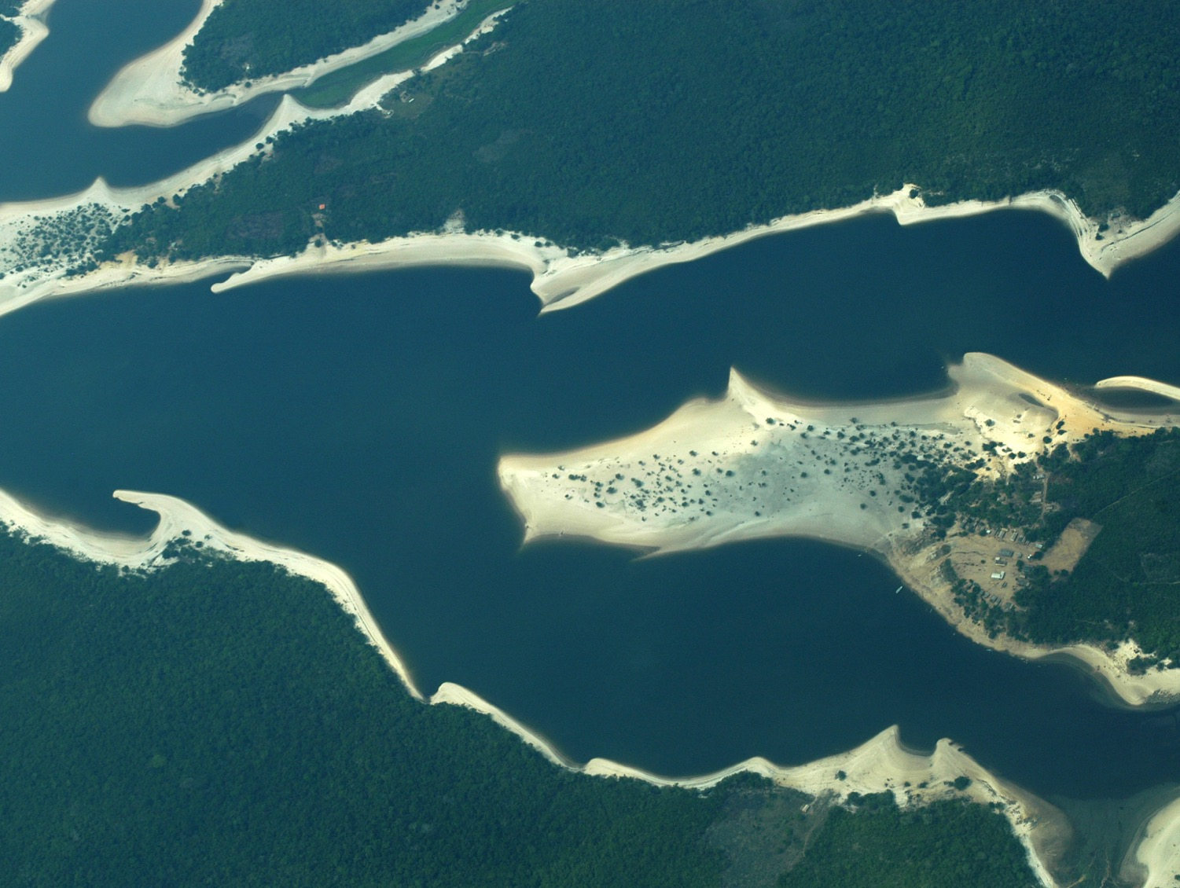
Notes:
River and Forest
This is an aerial view of the Amazon river surrounded by rainforest. The Amazon river is the widest and second longest river in the world. In places it is wider than six miles - that’s the length of over 15,000 buses parked one in front of the other!
The Amazon River is home to fish, dolphins, otters, turtles, snakes and caimans which are like crocodiles.
Photo Credit: Jenny Matthews/ActionAid

Slide 3
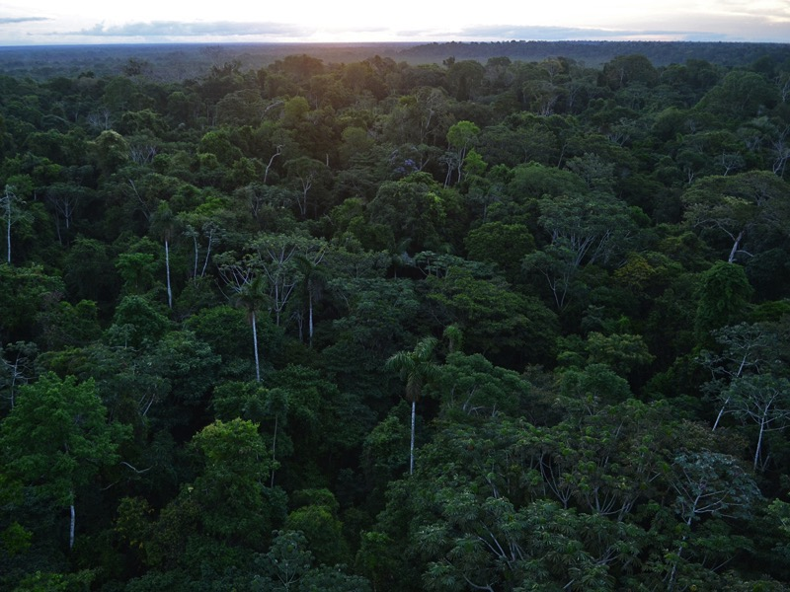
Notes:
Trees in the forest
Trees grow upwards very quickly in the hot, wet climate to form a green canopy. There are few branches in the middle layers. On the ground are shrubs and thick undergrowth which are filled with creepers - tall thin plants that wind upwards around the trees to reach the sunlight.
Photo Credit: Geoff Gallice/Flickr

Slide 4
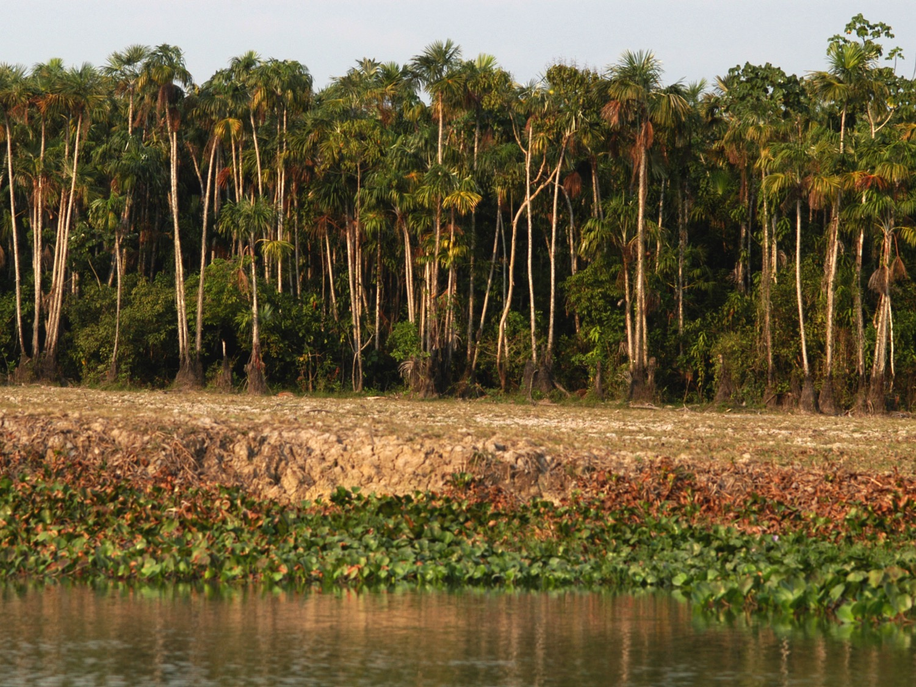
Notes:
Levels of the rainforest
In this photo you can see the different levels of the rainforest. At the bottom is the river and its banks and plants. In the middle you can see the bushes and shrubs of the shrub layer. There is then a gap where the leaves are thinner before the under-canopy and the canopy with the tallest trees.
Photo Credit: Jenny Matthews/ActionAid

Slide 5
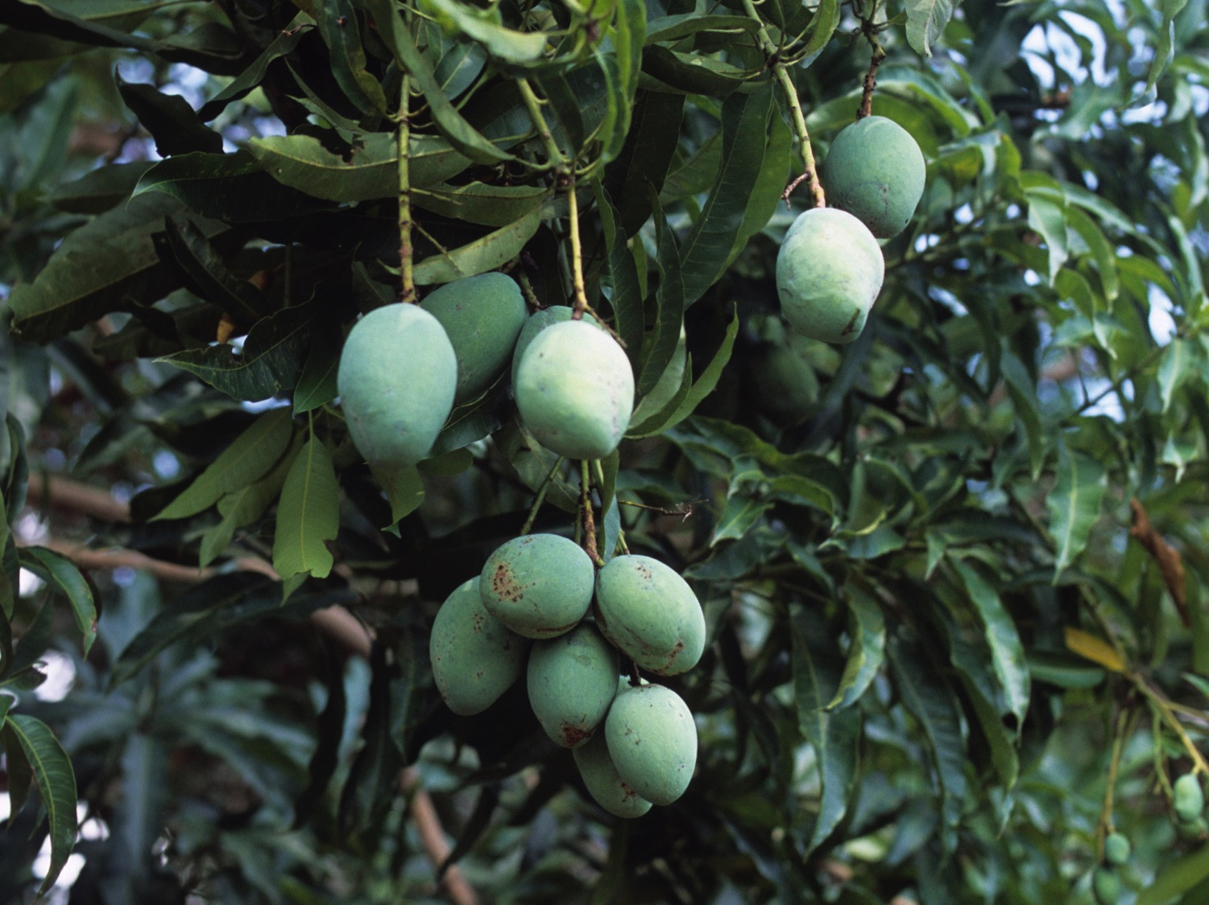
Notes:
Fruits and nuts
This a mango tree growing in the rainforest. Trees in the rainforest produce many different types of fruits and nuts including mangoes, passion fruit, bananas, cashew and brazil nuts, sweet potatoes and very hot chillis!
The acai berry looks like a red grape and is very popular to eat with the people who live in the rainforest.
Photo Credit: Jenny Matthews/ActionAid

Slide 6
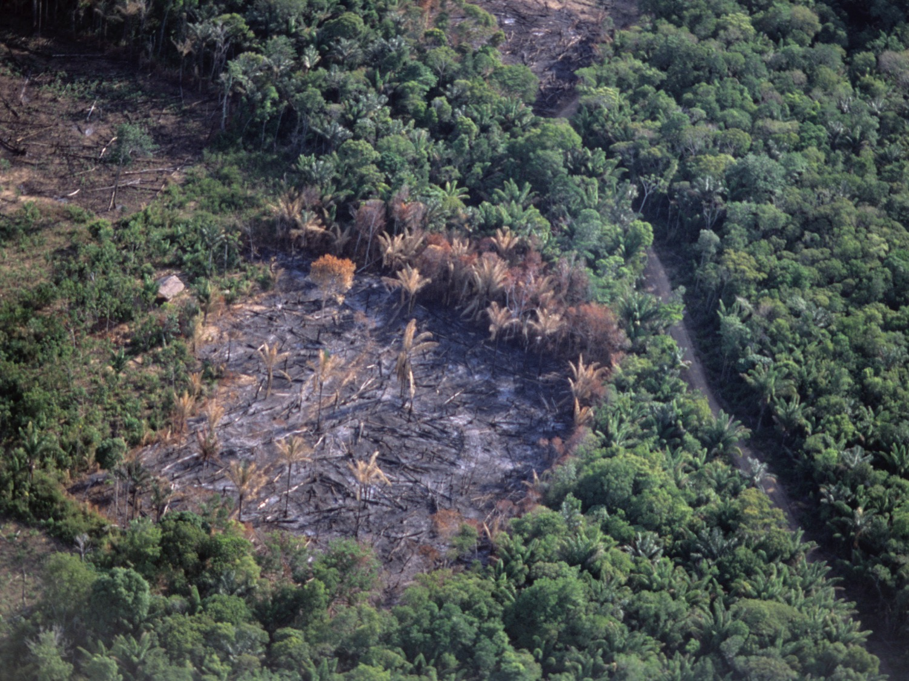
Notes:
Deforestation
In this picture you can see an area of the forest which has been cut down and cleared. This is also known as ‘deforestation’. Deforestation means the clearing of large areas of forest lands which are never re-planted. Trees are cut down for many reasons including:
To be sold as wood. This is called logging
To be used for farming
To make room for houses or roads
Photo Credit: Jenny Matthews/ActionAid

Slide 7
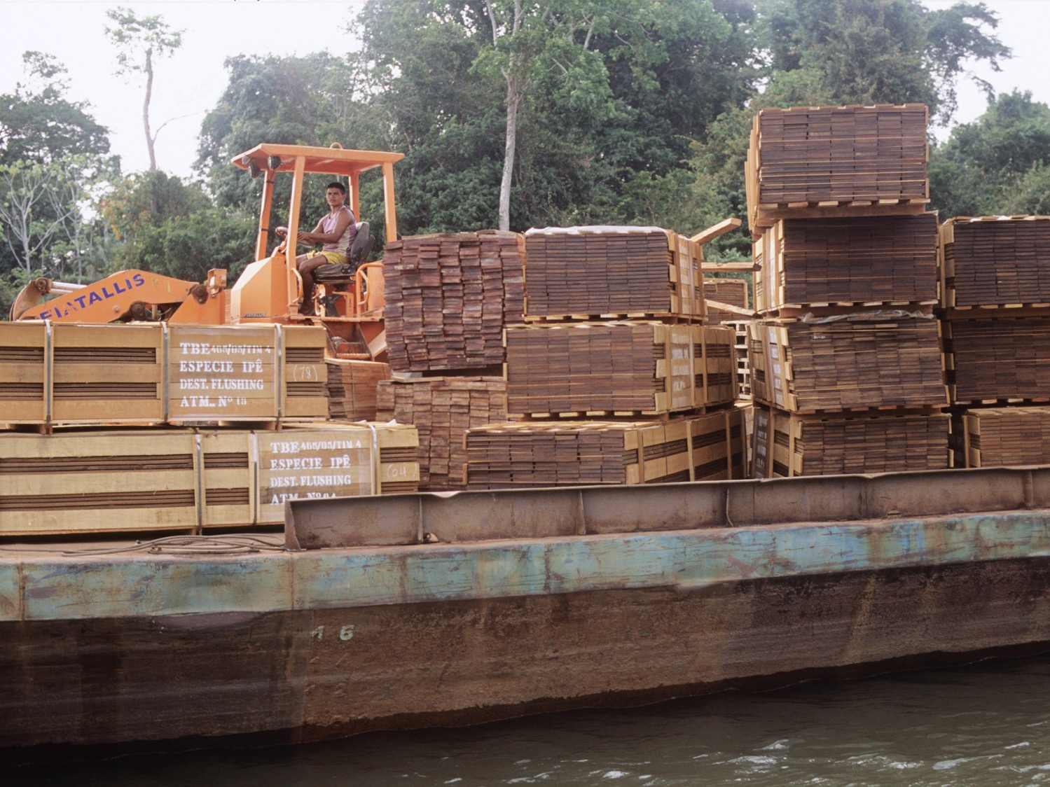
Notes:
Demand for timber
Today, logging is allowed with permission in the Amazon rainforest. It makes up a small percentage of deforestation here.
Brazil showed the best improvement of any country, cutting its deforestation rate by half in the period 2000-2012.
Photo Credit: Jenny Matthews/ActionAid

Slide 8
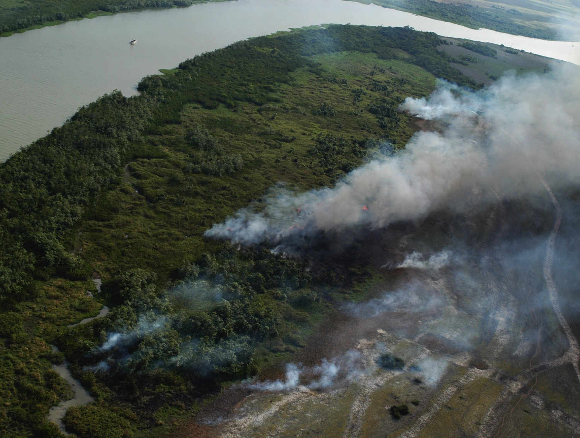
Notes:
Slash and burn
In this photo you can see a process known as ‘slash and burn’. Trees are cut down and the land is burnt in order to clear it to grow crops such as soya. However, the biggest cause of deforestation in the Amazon is cattle ranching. If you went to the Amazon today, you would find millions of cattle grazing on the land. Brazil is now the world’s largest exporter of beef. This is the meat which comes from cattle and is used to create foods such as steaks or burgers.
Photo Credit: Jenny Matthews/ActionAid

Slide 9
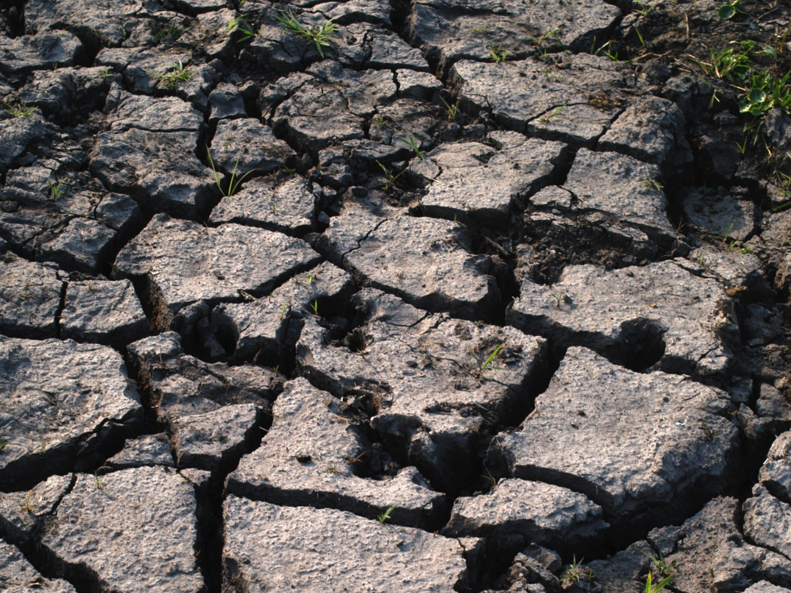
Notes:
Forest to desert
In both 2005 and 2010, the Amazon was struck by extreme drought. A drought is a long period of time when no rain falls. In a drought plants do not grow properly, rivers dry up and trees and wildlife die. In areas where trees have been cut down, hot winds blow away the soil which makes it difficult for plants to grow.
Photo Credit: Jenny Matthews/ActionAid

Slide 10
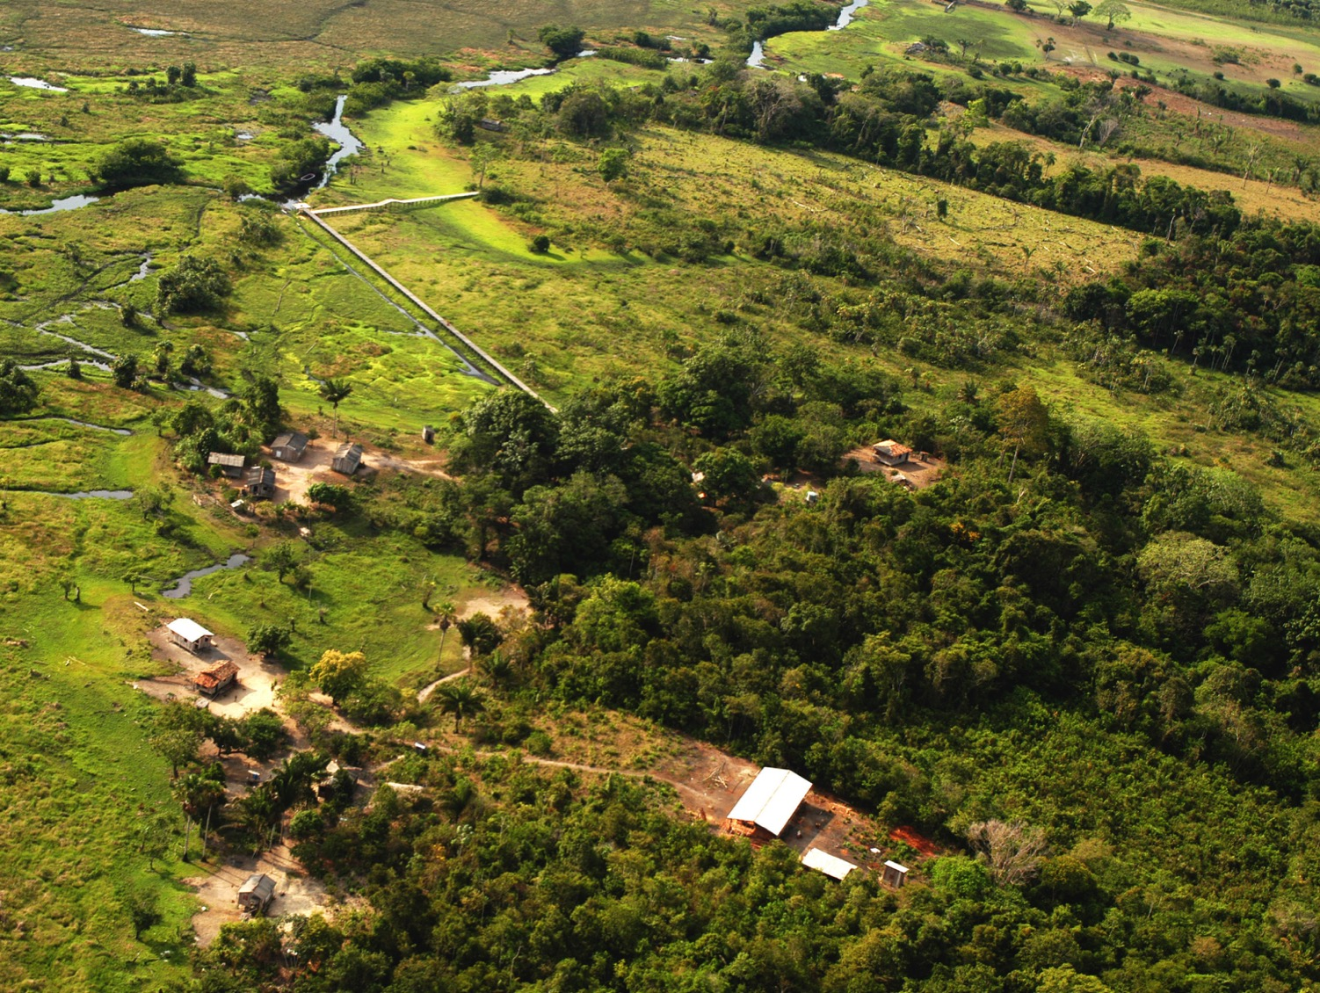
Notes:
Jacara
This picture is an aerial view of Jacara where a smaller river flows out of the Amazon River. This picture shows the river, the houses where people live, trees and grassland. It is hot and humid most of the year and rains almost every day. People use boats to travel to different places. They also use walkways which you can see in the middle of the picture. They are made of wood and raised above the ground to keep people safe from snakes!
Photo Credit: Jenny Matthews/ActionAid

Slide 11
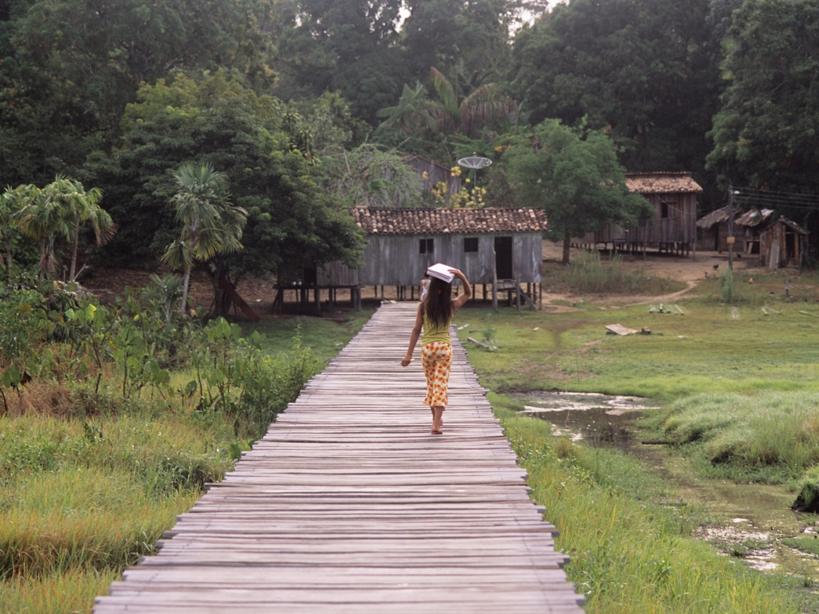
Notes:
Houses among the trees
The Gomez family live in the rainforest. Like most families in the area, they grow their own food or fish for it in the river. They have a small farm where they plant vegetables such as cassava, corn, beans and potatoes. Fruit like bananas, oranges and mangoes grows on the farm and around the house.
Photo Credit: Jenny Matthews/ActionAid

Slide 12
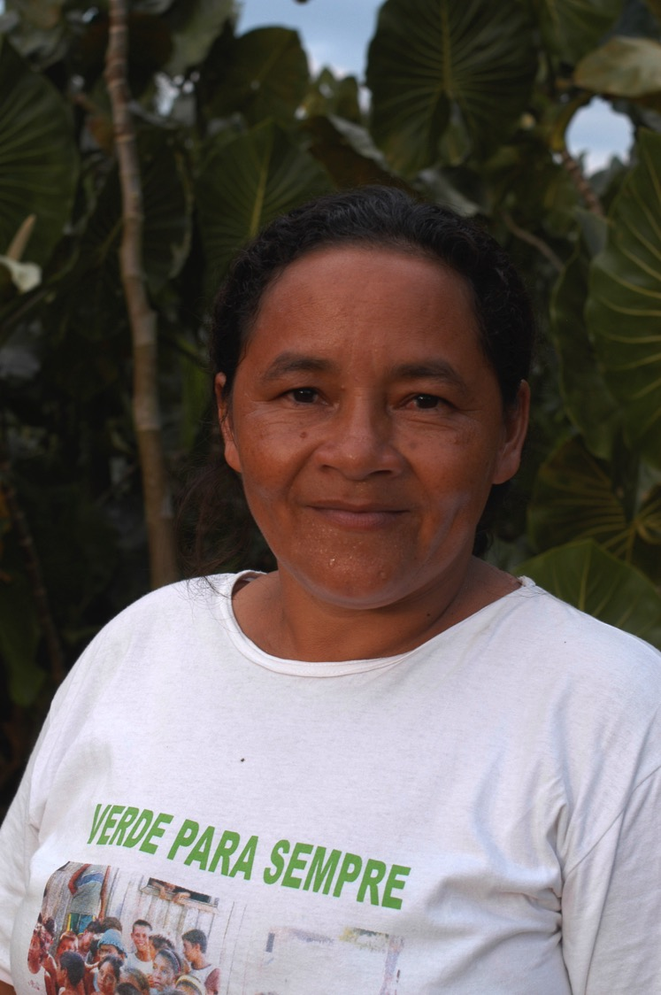
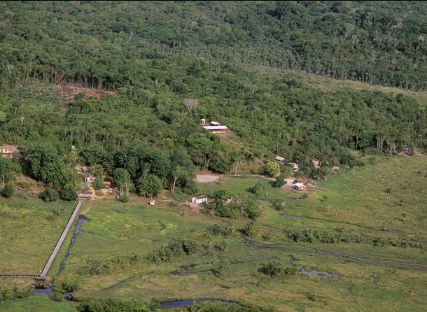
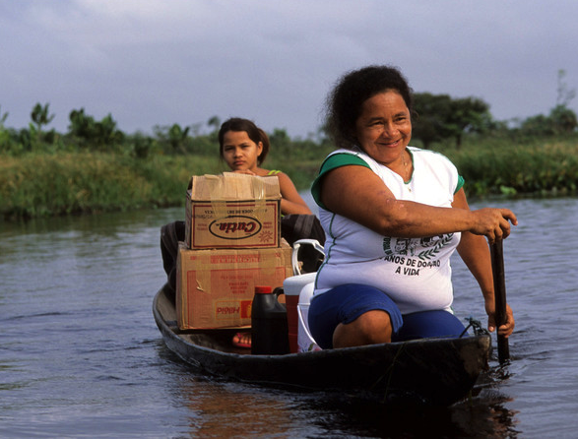
Notes:
Forever Green
Mum, Luiza, and other community members worked to protect their land by protesting to the government and campaigning against the loggers.
In 2004 the Brazilian government set up an ‘extractive reserve’. This means local families have collective rights to the land and natural resources.
Luiza’s T-shirt has the words, ‘Verde Para Sempre’ on it in Portuguese. This means, ‘Forever Green’ and is the name of the area of the rainforest where she lives.
Photo Credit: Jenny Matthews/ActionAid

Slide 13
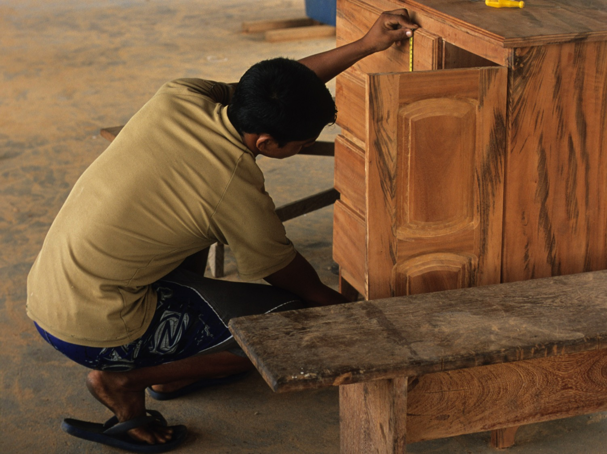
Notes:
Extractive reserve
The community the Gomez family live in is protected by the Brazilian government and is called ‘Forever Green’. It is an extractive reserve which means local families can use the land as long as they look after the rainforest.
They earn a living by collecting products such as nuts, fruit and rubber, and making furniture from fallen trees. This way they can support themselves whilst looking after the environment. In this photo, community members are making a cabinet out of wood from a fallen tree.
Photo Credit: Jenny Matthews/ActionAid

