Slide 1

Choose Your Destiny

Slide 2
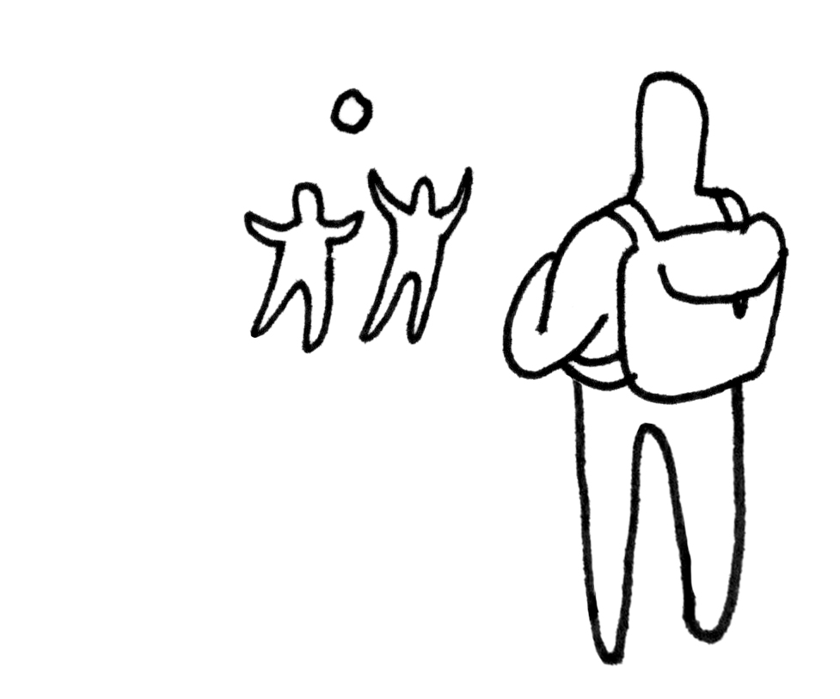
You’re walking to school on your own because your friend left earlier this morning. You now see your friend playing with someone else in the playground.
Do you…
Ignore your friend and refuse to speak to them (go to page 3)
2. Go and speak to your friend, asking who the new person is in a friendly way and ask if you can join in. (go to page 4)

Slide 3
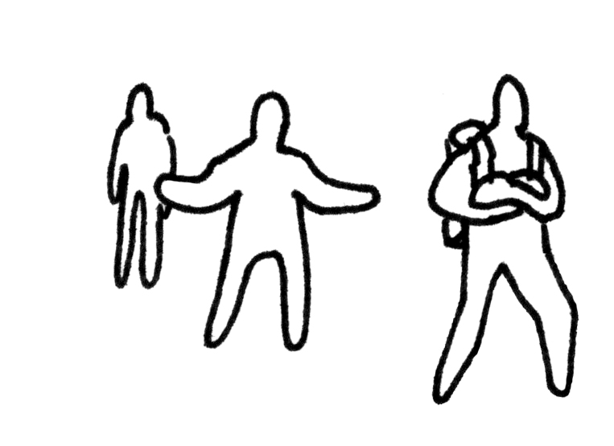
You ignore your friend and refuse to speak to them. Your friend was playing with someone else but they still want to play with you. They’re upset when you won’t speak to them and the two of you don’t play together for the next few days.
Page 3

Slide 4

Go and speak to your friend, asking who the new person is in a friendly way and asking if you can join in. The new person is great fun and now you have two friends to play with.
Page 4

