Slide 1
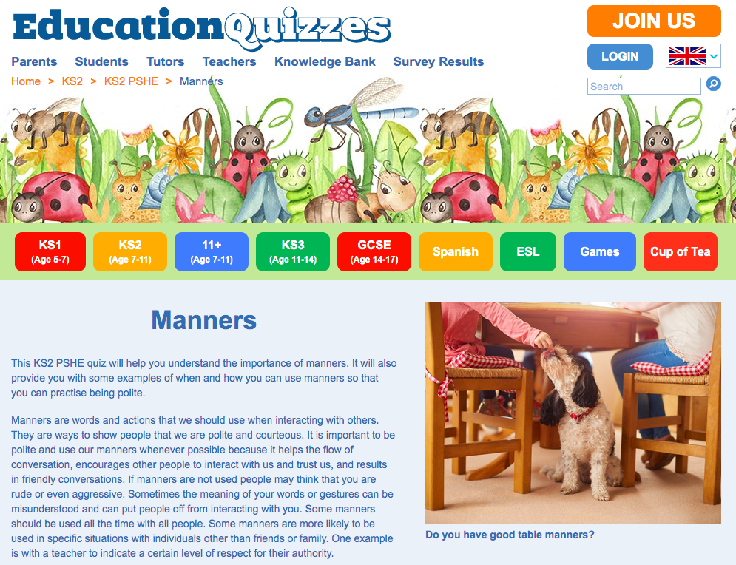
Why are manners important?
This KS2 PSHE quiz will help you understand the importance of manners. It will also provide you with some examples of when and how you can use manners so that you can practise being polite.
Click on the link below to take a quiz about manners!
https://www.educationquizzes.com/ks2/personal-social-and-health-education/manners/

