Slide 1
Marvellous
Maths!
In this little workbook there will be lots of opportunities to practise your addition, subtraction, multiplication and division skills!

Slide 2
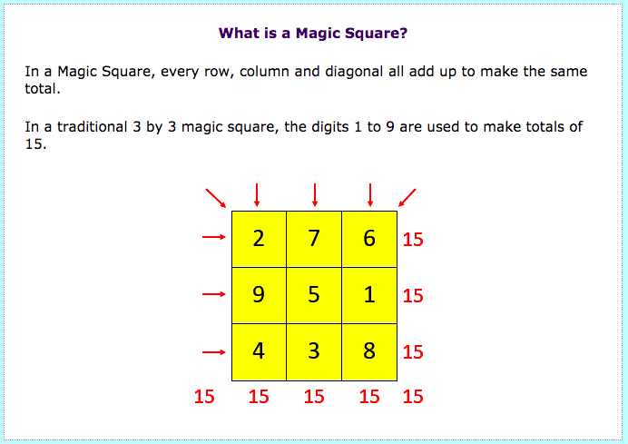
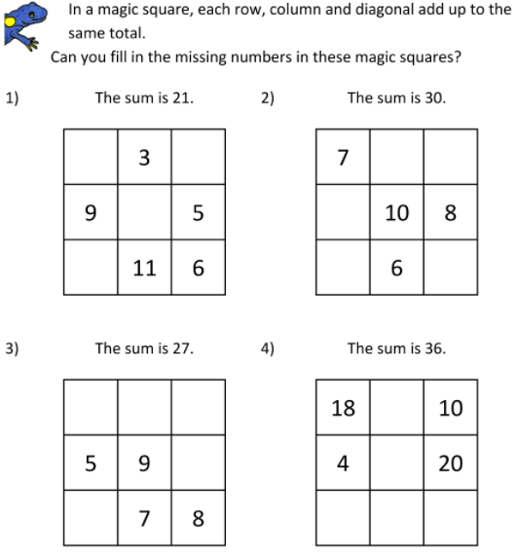
Addition

Slide 3
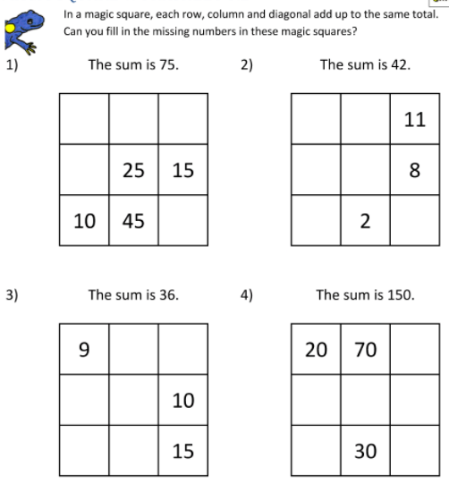
Addition

Slide 4
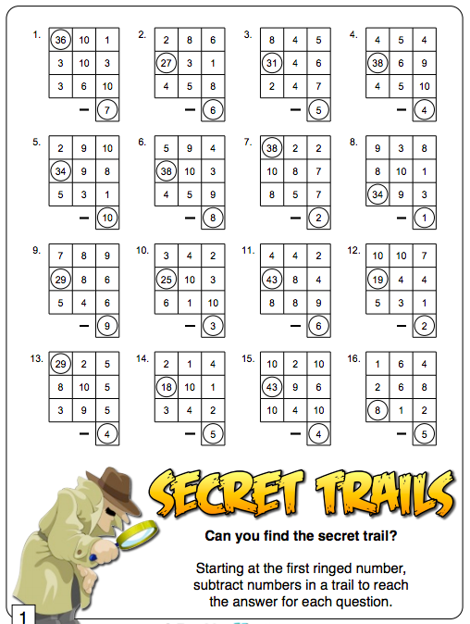
Subtraction

Slide 5
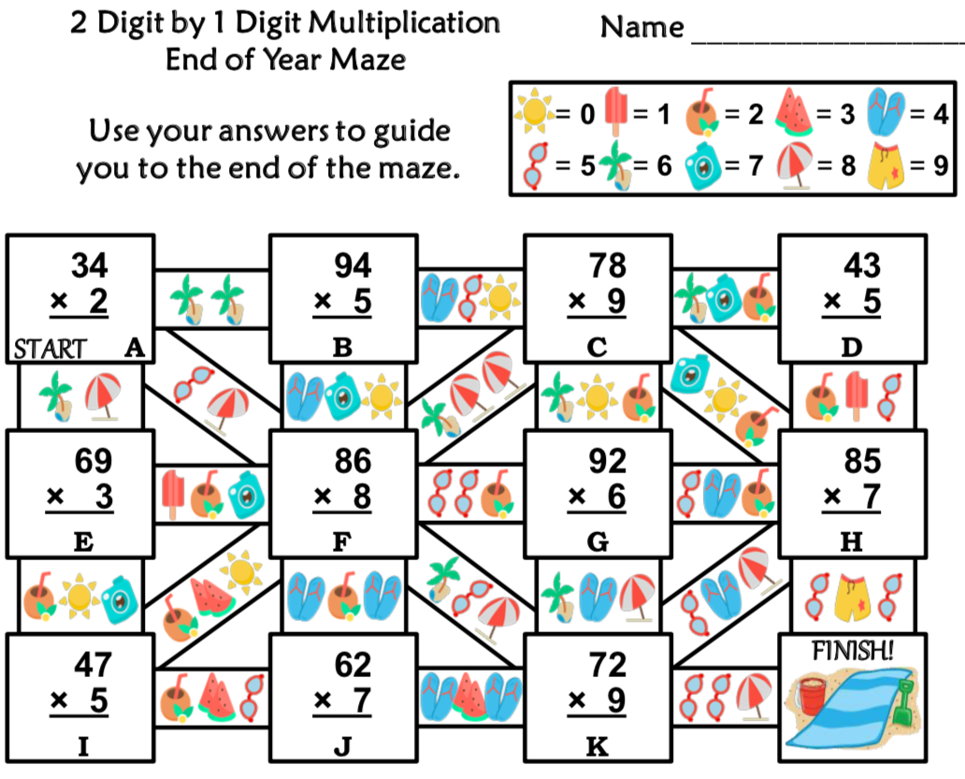
Multiplication
Work out the answer and then check which path you need to follow next. Remember: each digit represents a picture.
Example: if my answer was 70, I would look which picture goes with the digit 7 (blue camera) and then which picture goes with the digit 0 (sun).
I would then go down the path that has a blue camera and the sun on it. That will then led you to your next sum.

Slide 6
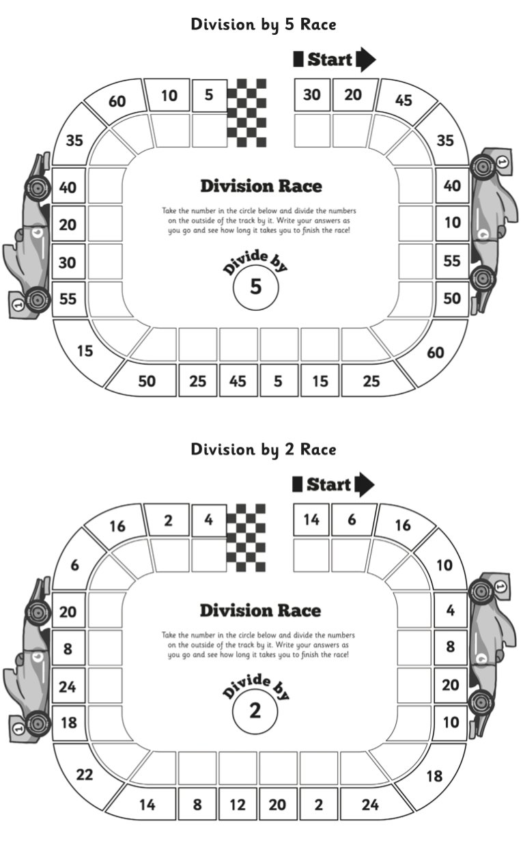
Division

