Slide 1
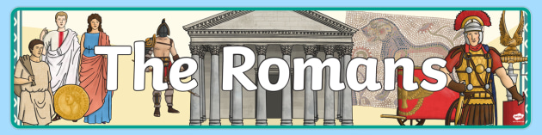
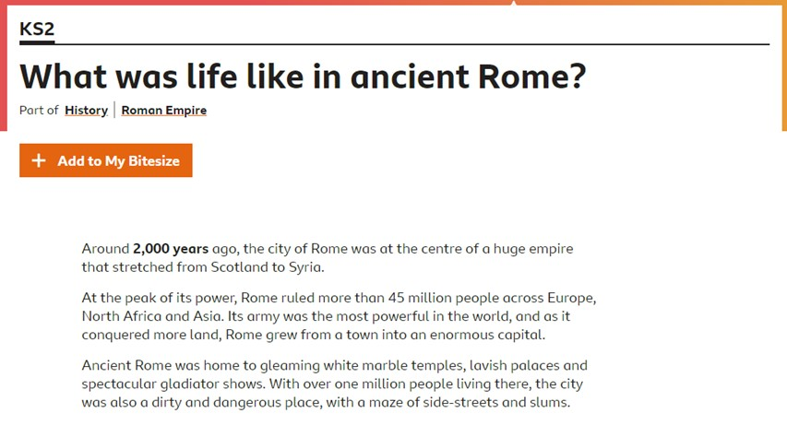
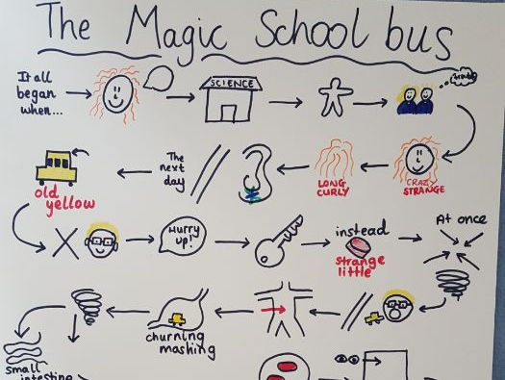
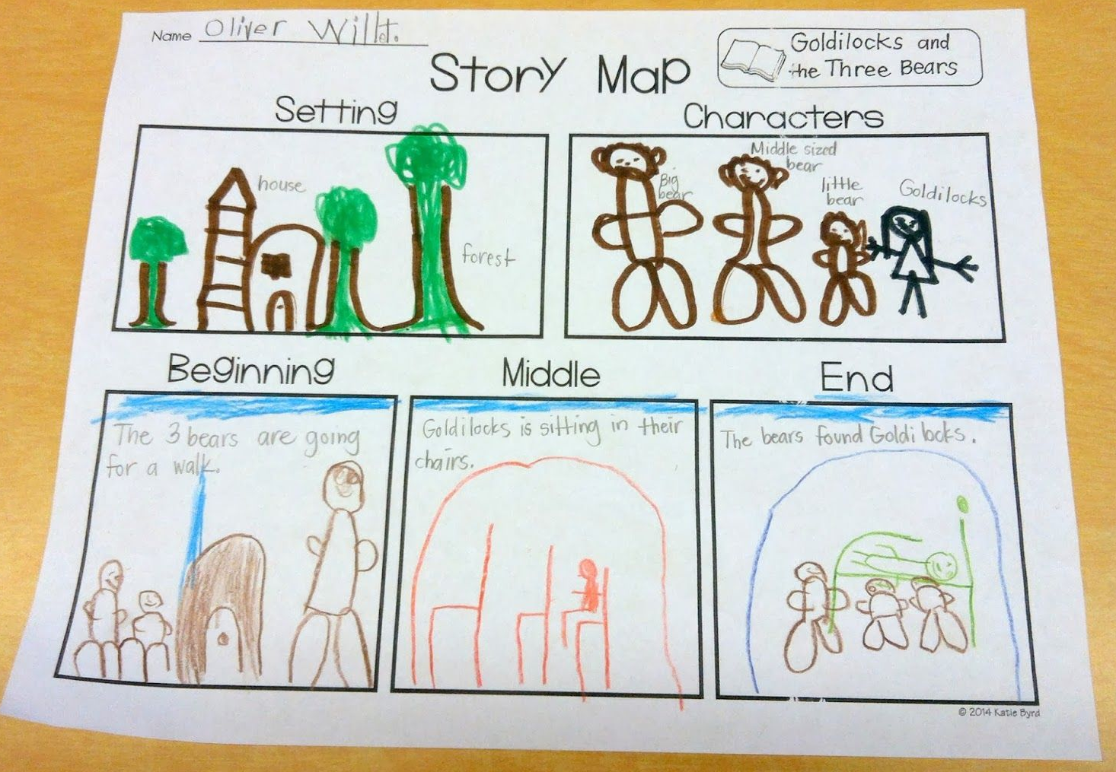
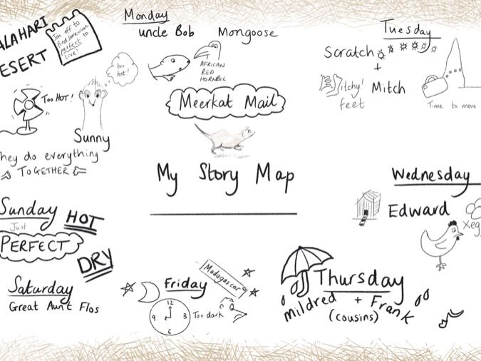
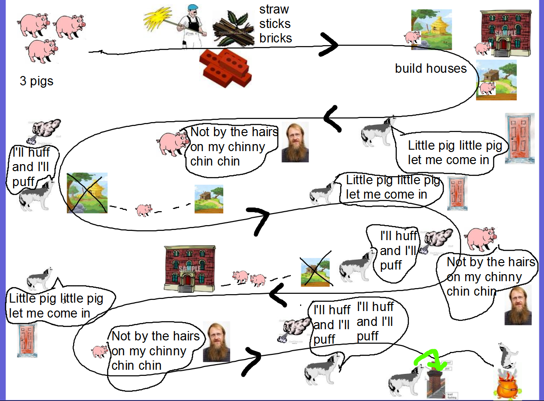
Task: Read the story of Romulus and Remus and try and retell the story as a story map.
Have a look at some of the examples below to help you.
https://www.bbc.co.uk/bitesize/topics/zwmpfg8/articles/z2sm6sg
Click on the link and have a read of the BBC Bitesize page about The Romans!

