Slide 1
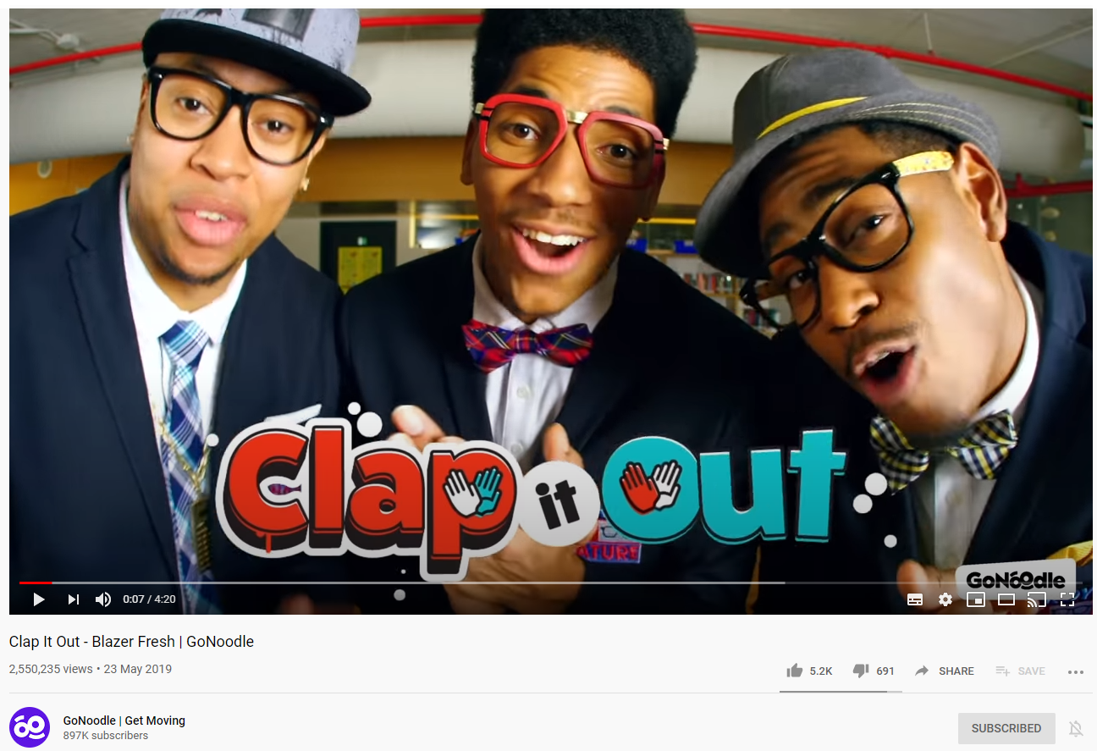
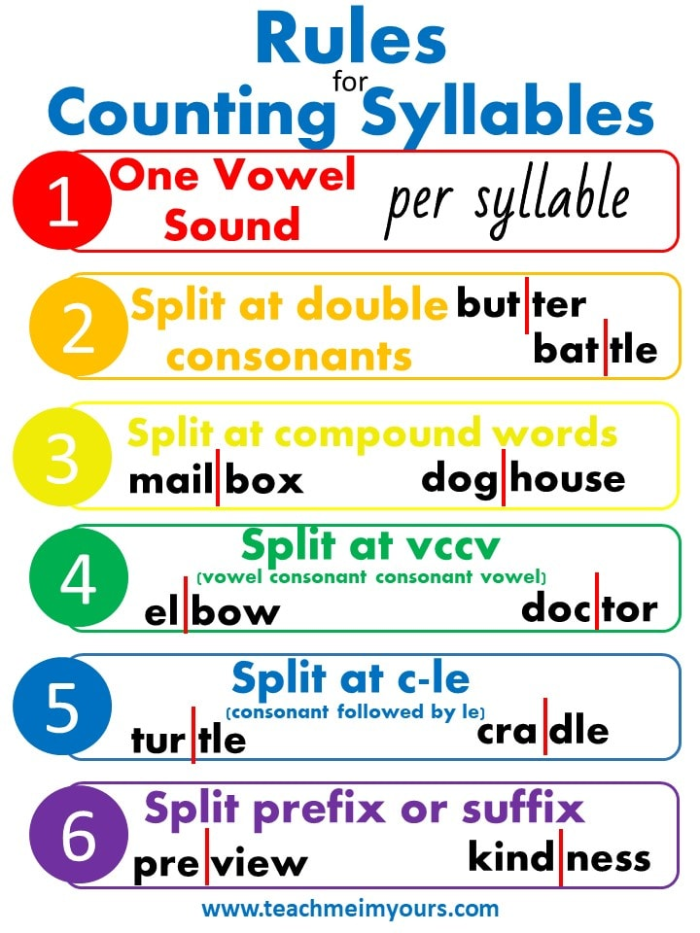

Syllables!
Watch (and dance!) to “Clap it Out” on GoNoodle then have a go at counting the number of syllables in each word on the next page.
https://www.youtube.com/watch?v=psUPYR235O8
Remember!
If you’re not to sure, watch the video again or ask an adult to help you to……
CLAP IT OUT !

Slide 2


