Slide 1
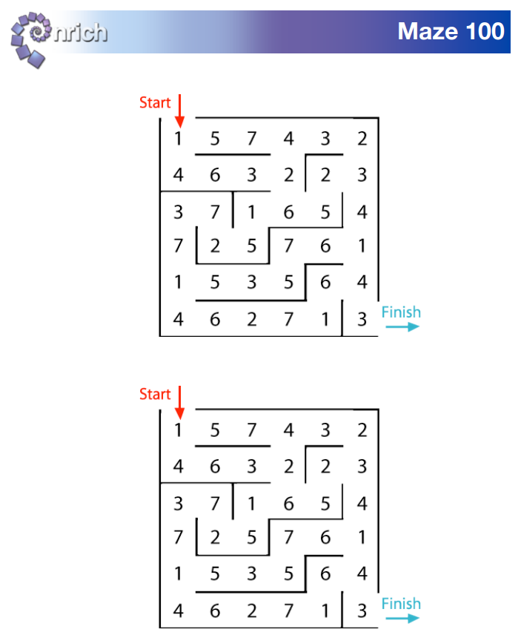
Maze 100
https://nrich.maths.org/91/note
In this maze there are numbers in each of the cells. You go through adding all the numbers that you pass. You may not go through any cell more than once.
Can you find a way through in which the numbers add to exactly 100?
What is the lowest number you can make going through the maze?
What is the highest number you can make going through the maze? (Remember you may not go through any cell more than once.)
Key questions
Tell me about your journey through the maze.
How are you choosing where to go next?
What do you notice about the structure of the maze?
How could you adjust your journey to get closer to 100 rather than starting again at the beginning?
How will you record what you have tried?
How is your recording supporting you to solve this challenge?
Extension
Is there more than one way through the maze that totals 100?
What is the highest total? Lowest total?
Extra support
Challenge learners to find an accurate total for their journey through the maze. Children may like to use a bead string, counters or pasta shapes to help with the addition and help keep a running total.

