Slide 1
Shape Puzzles
On the next few pages there are some different shapes puzzles. The aim is to work out the value of each shape (so how much each shape is worth).
To work these out you will need to:
Use your understanding of number and place value
Use your understanding of addition and subtraction
Remember that sometimes a symbol can represent a number
Vocabulary
Sum Add Total Row
Column Double Halve

Slide 2
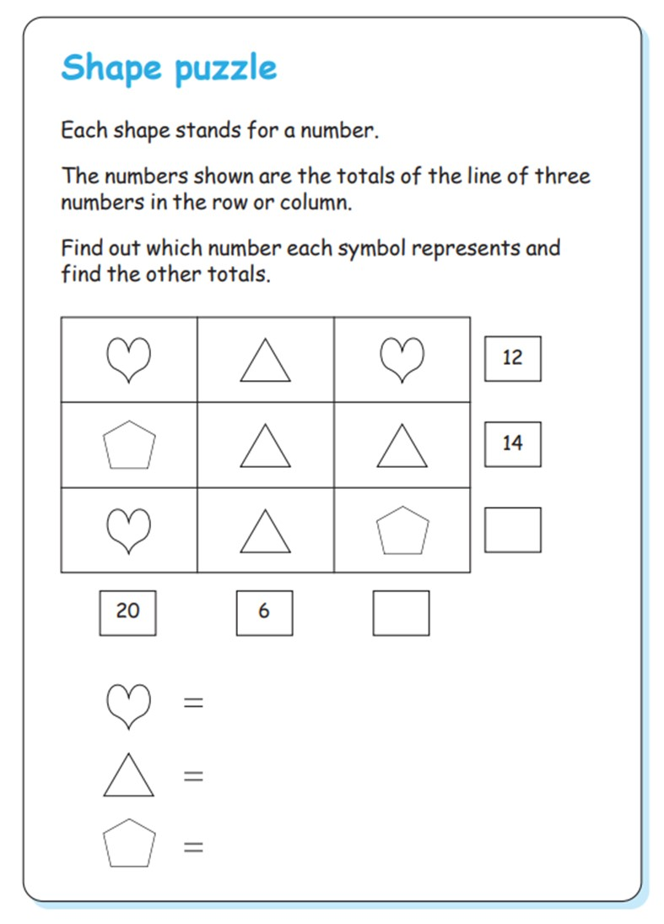

Slide 3
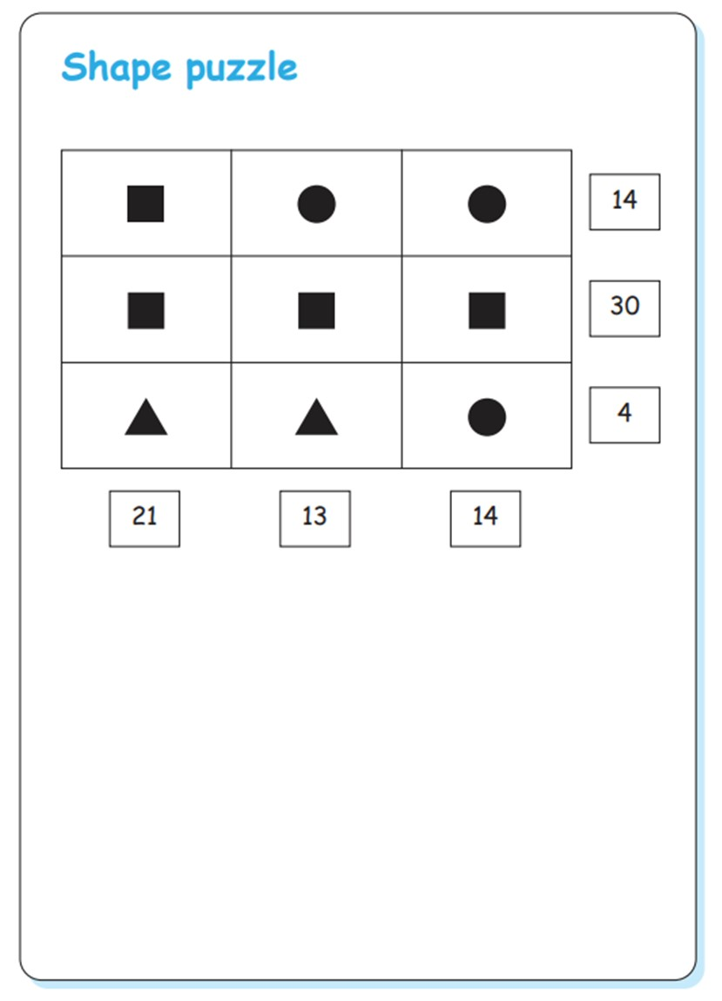
The square’s value is ________ .
The circle’s value is ________ .
The triangle’s value is ________ .

Slide 4
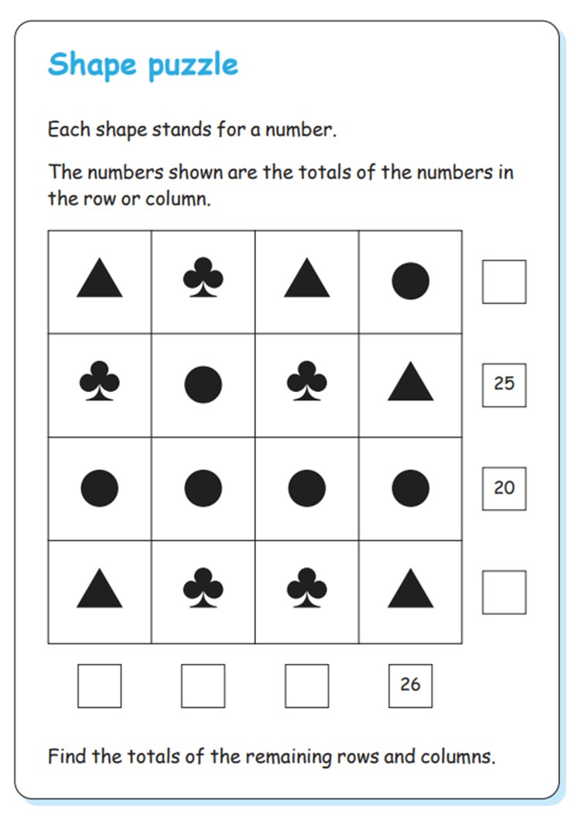
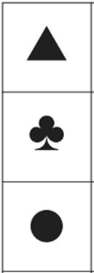
The triangle’s value is ________ .
The spade’s value is ________ .
The circle’s value is ________ .

