Slide 1

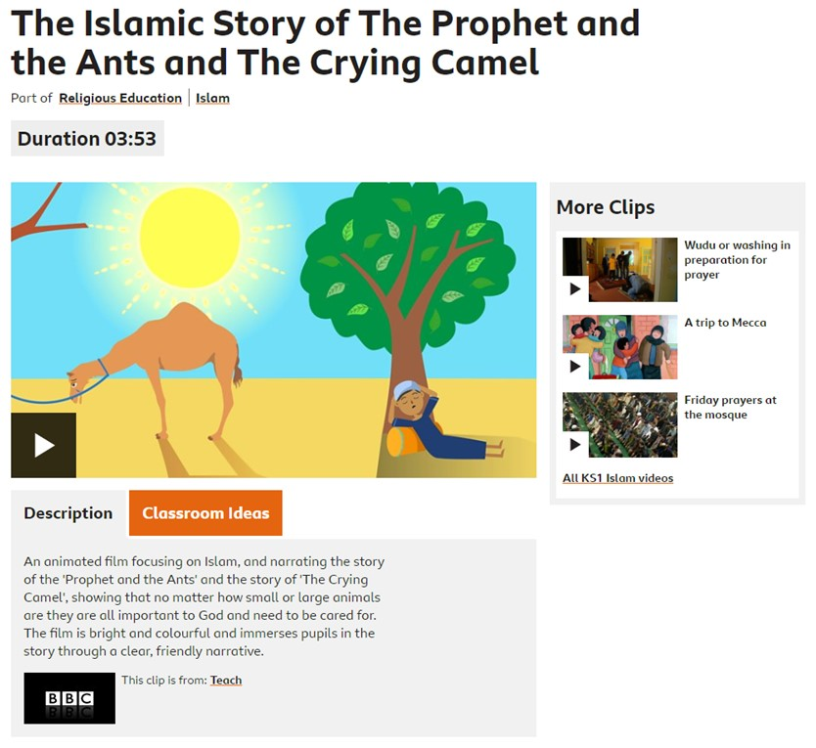
Islam: Click on the link below to watch the story
Key question: What is the moral of both of the stories? Do you agree with them?
Pick an animal and create a hotel for it. Think about:
The needs of the animal (bedding, food, drink, exercise, etc)
How you can make it the best hotel for them?
You may need to do some research about your chosen insect, animal or bird to help you to design your hotel. You can draw the hotel and label each room and area, explaining how this is something your insect/ animal/ bird would really like.
https://www.bbc.co.uk/bitesize/clips/z9tqb82

