Slide 1

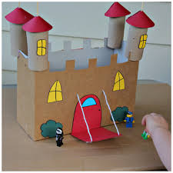
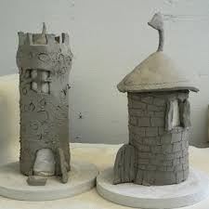
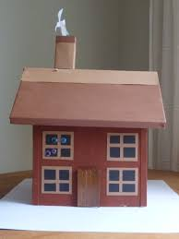
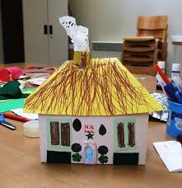
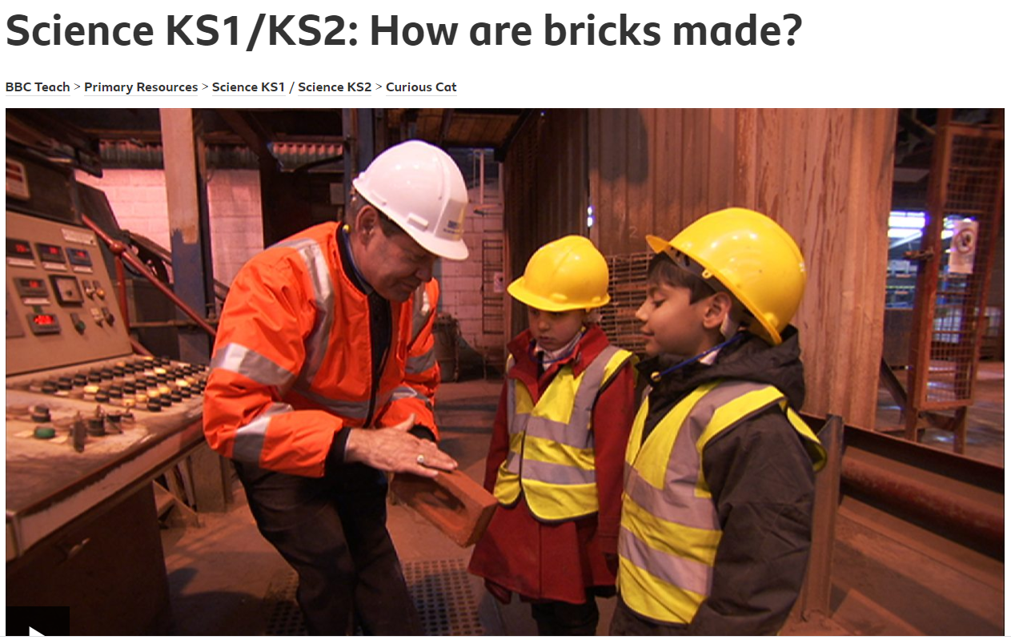
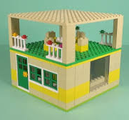
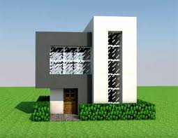
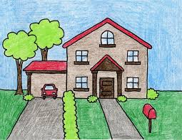
Try and use some recycled items from home to make your own little house! You could use:
Junk modelling items (like plastic bottles, cereal boxes, egg cartons, etc…),
You could make a house out of Lego,
You could use clay (if you have some)
You could even build your house on Minecraft
You could make a house out of an old shoebox
Or you can go old school and draw your house! It’s up to you!
Our new topic in Science is Materials! We will be looking at the different materials used to make houses and why they are most effective. Have a watch of the video below and then try and complete the activity on the right!
Can you write up, to explain your design to an adult? If this was a real house, what materials would each part ideally be made from? Why? E.g. If I lived somewhere that suffered with terrible rainfall, why would it not be a good idea for me to make a roof out of soft clay?
Remember to include:
At least four walls
Windows
A door
A roof
If you’re really proud of your creation, then remember you can take a picture, or make a video and send it to the class email address for us to see.
https://www.bbc.co.uk/teach/class-clips-video/primary-science-how-are-bricks-made/z4sygwx

