Slide 1
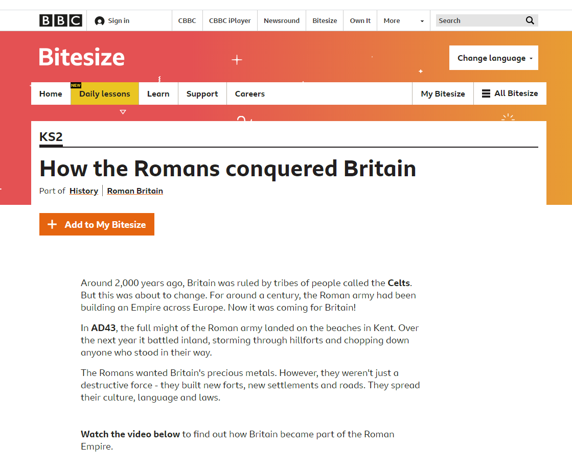
The Romans
Click on the link below to learn some interesting facts about The Romans!
https://www.bbc.co.uk/bitesize/topics/zqtf34j/articles/z9j4kqt

