Slide 1
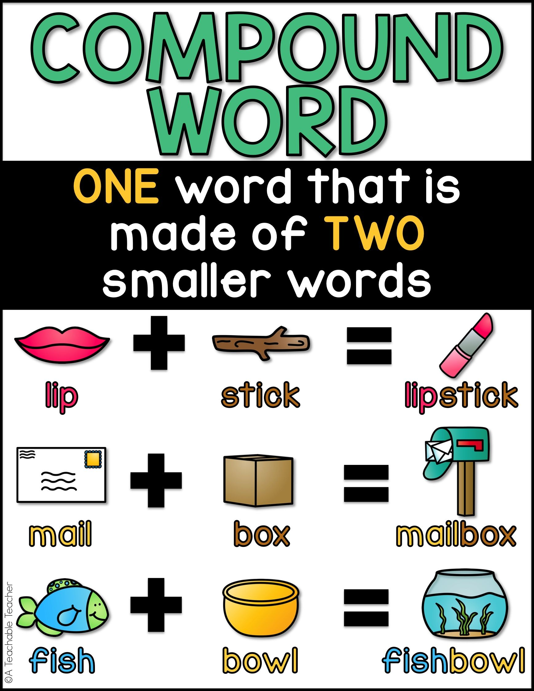
A compound word is a word that is made up of two other words. For example foot + ball gives us football.
The two words must be words in their own right, so you can not have words like Beaut + iful for beautiful.

Slide 2
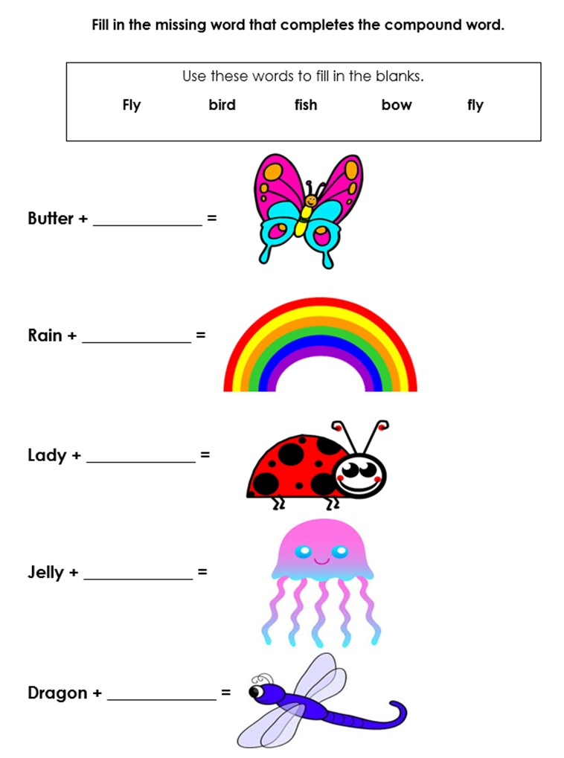

Slide 3
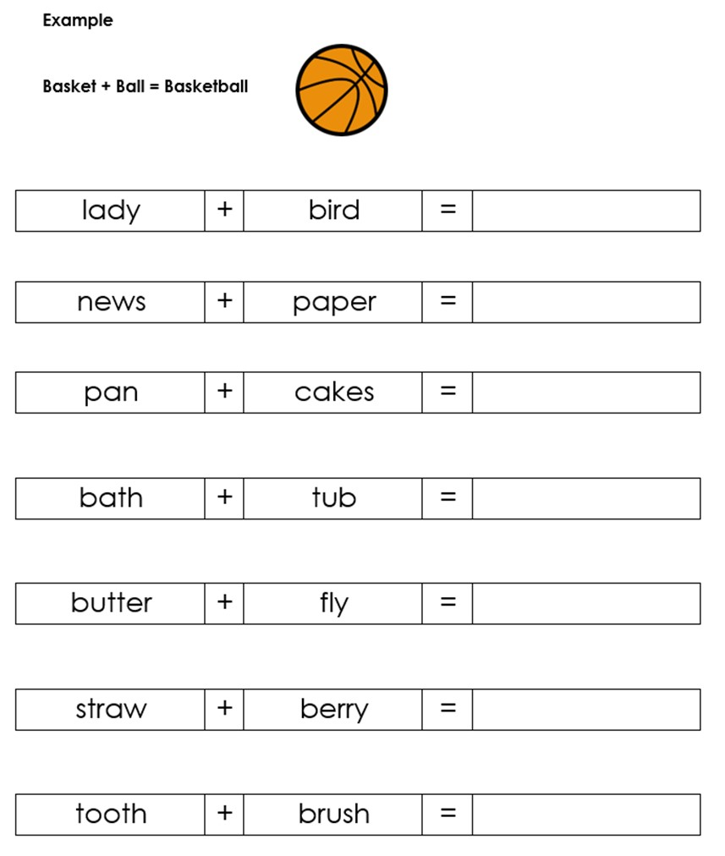

Slide 4


