Slide 1
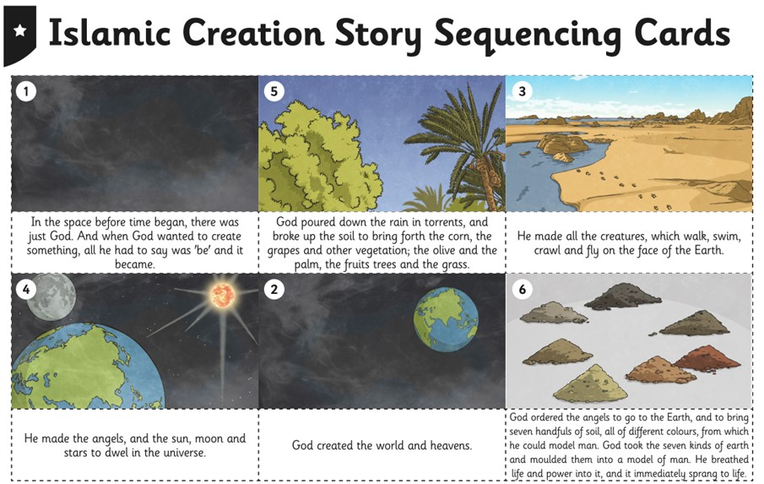
Read the story of Muhammad in order (remember to go by the numbers and not the picture order!

Slide 2
Can you retell the story of Muhammad as a comic strip?
Try and re-write it in your own words (you can use the first page to help you of course!)
Don’t forget your capital letters and your full stops.
Use your own drawings (if you really hate drawing or aren’t feeling that confident with them, then you can use the pictures on the last page.

Slide 3
_____________________
_____________________
_____________________
_____________________
_____________________
_____________________
_____________________
_____________________
_____________________
_____________________
_____________________
_____________________
_____________________
_____________________
_____________________
_____________________
_____________________
_____________________
_____________________
_____________________
_____________________
_____________________
_____________________
_____________________
_____________________
_____________________
_____________________
_____________________

Slide 4
_____________________
_____________________
_____________________
_____________________
_____________________
_____________________
_____________________
_____________________
_____________________
_____________________
_____________________
_____________________
_____________________
_____________________
_____________________
_____________________
_____________________
_____________________
_____________________
_____________________
_____________________
_____________________
_____________________
_____________________
_____________________
_____________________
_____________________
_____________________

Slide 5


