Slide 1
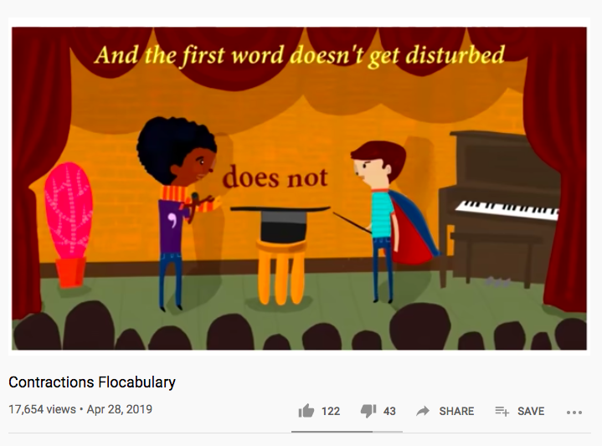

https://www.youtube.com/watch?v=FGf-SNfbtAQ
Click on the links, or type the video name into YouTube.
https://www.youtube.com/watch?v=gubPH3WEurg
Once you’ve watched them, try completing the worksheet.

