Slide 1
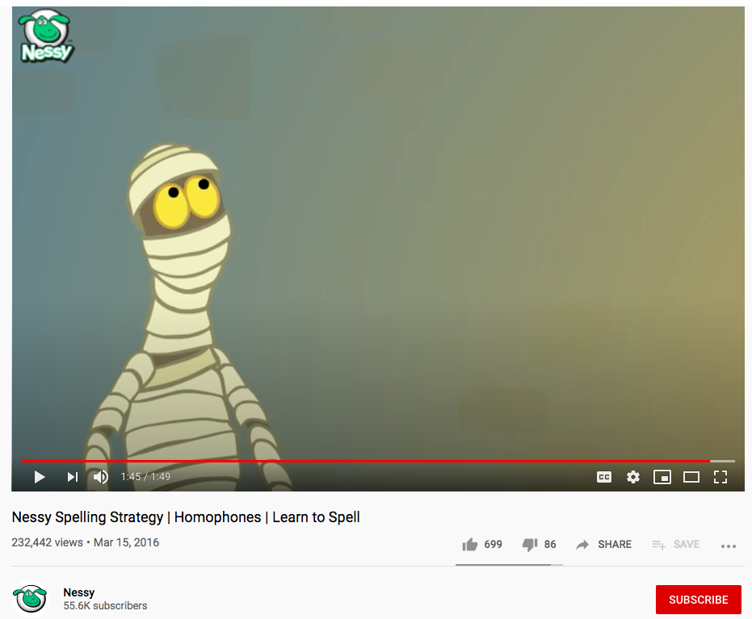
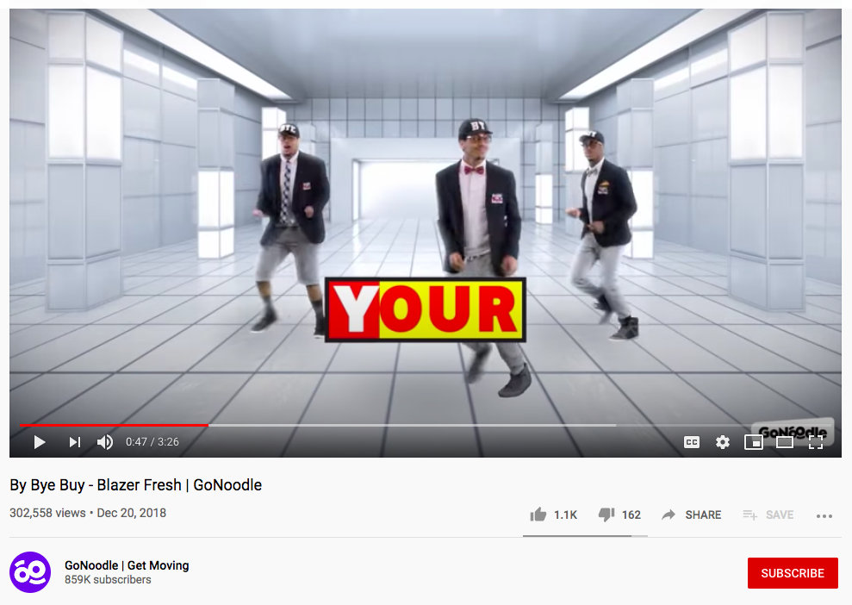
https://www.youtube.com/watch?v=Jw4IjeGPaz0
https://www.youtube.com/watch?v=nnjke7WERu0
Click on the links to learn about homophones! If you’re reading this from a paper copy, then simple go to YouTube and type in “Nessy Spelling Strategy – Homophones” or “By Bye Buy GoNoodle”.

Slide 2
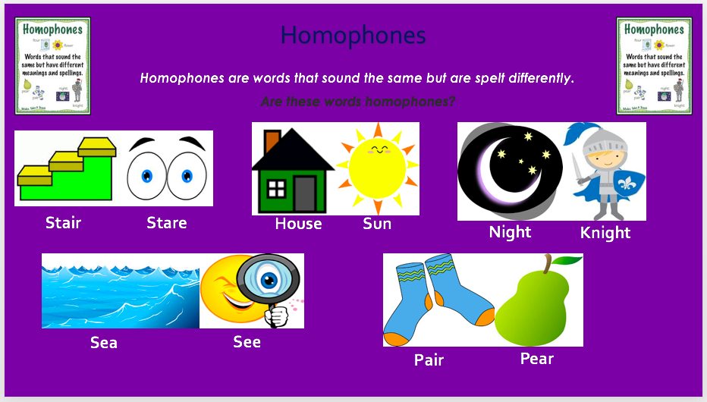

Slide 3
Homophones are words that sound the same but are spelt differently.
Quick task: Write these sentences out, choosing the correct homophone.
I have lost my pear/pair of socks.
I can see/sea the see/sea.
The knight/night goes to battle in the dark of knight/night.

