Slide 2
This pizza has been cut into 6 equally sized pieces.
Numerator
The numerator is the number at the top. It tells you how many pieces we have. In this fraction, we have 1 piece.
Example: Rebecca has stolen 1 slice of pizza.
1
-
Denominator
The denominator is the number at the bottom. It tells us how many pieces make one whole. In this fraction we know that 6 pieces will make one whole.
Example: The whole pizza is made up of 6 slices. Each slice is exactly the same size. They are equal.
6
Rebecca decides to steal one piece of pizza. There are 6 equally sized pieces that make this pizza whole. If Rebecca pilfers 1 piece, then she has taken 1/6 of the pizza!

Slide 4
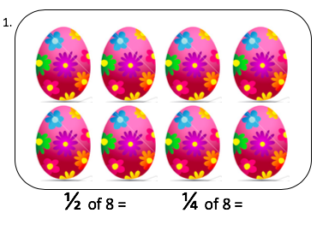

Let’s use bits of our fraction wall to help us work this out:
First we need to try and find ½ (one half) of 8
Choose the part of the fraction wall that matches the fraction in the question
Next share the 8 eggs between each piece of the fraction
When you have finished sharing you should not have any eggs left
You should count how many eggs are in each piece of the fraction. There should always be exactly the same number of eggs in each fraction piece.
My numerator is ‘1’ so I am only interested in how many eggs are in 1 of the halves.
So ½ of 8 = 4

Slide 5
Let’s use bits of our fraction wall to help us work this out:
Next we need to try and find 1/4 (one quarter) of 8
Choose the part of the fraction wall that matches the fraction in the question
Share the 8 eggs between each piece of the fraction
When you have finished sharing you should not have any eggs left
Count how many eggs are in each piece of the fraction. There should always be exactly the same number of eggs in each fraction piece.
My numerator is ‘1’ so I am only interested in how many eggs are in 1 of the quarters.
So 1/4 of 8 = 2

Slide 6
Now open the document with the questions and see if you can have a go using your fraction wall.

Slide 7
Fractions
Knowledge tablemats

Slide 8
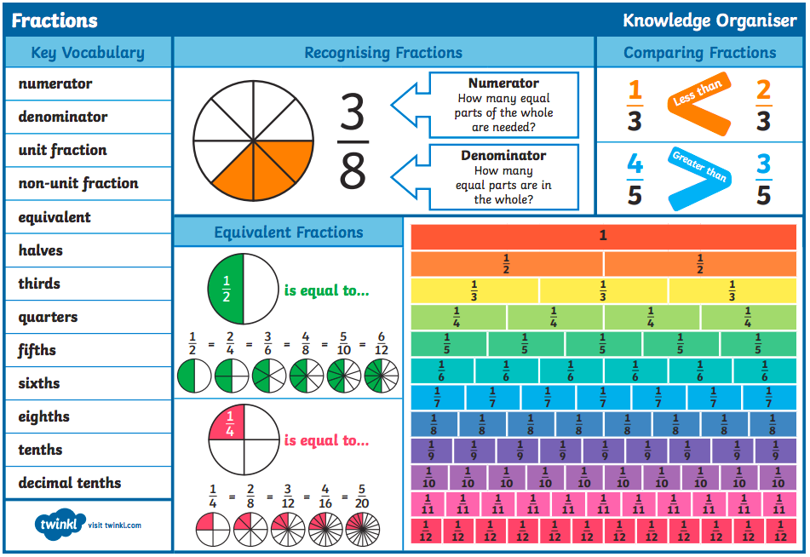

Slide 9


